Slide 1

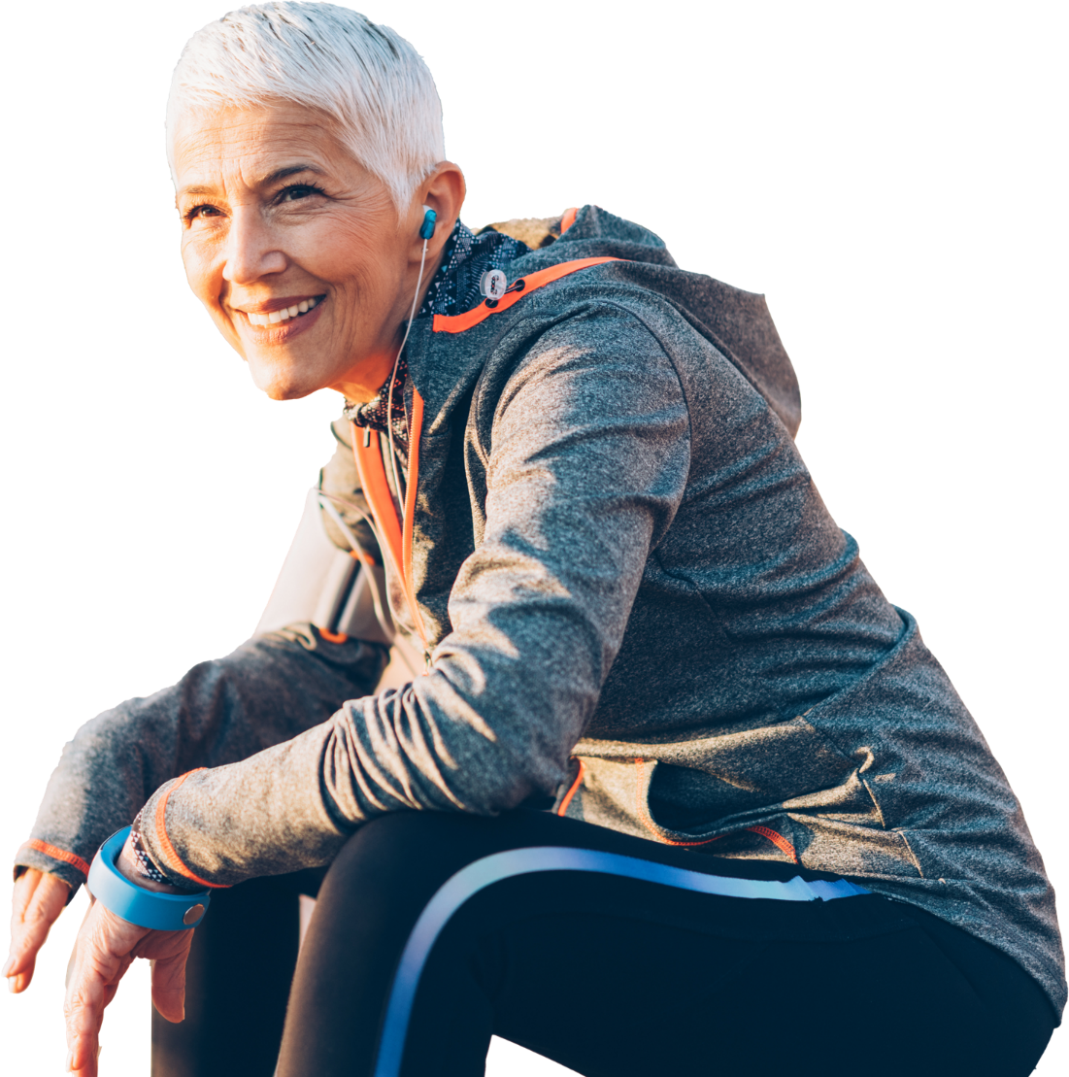
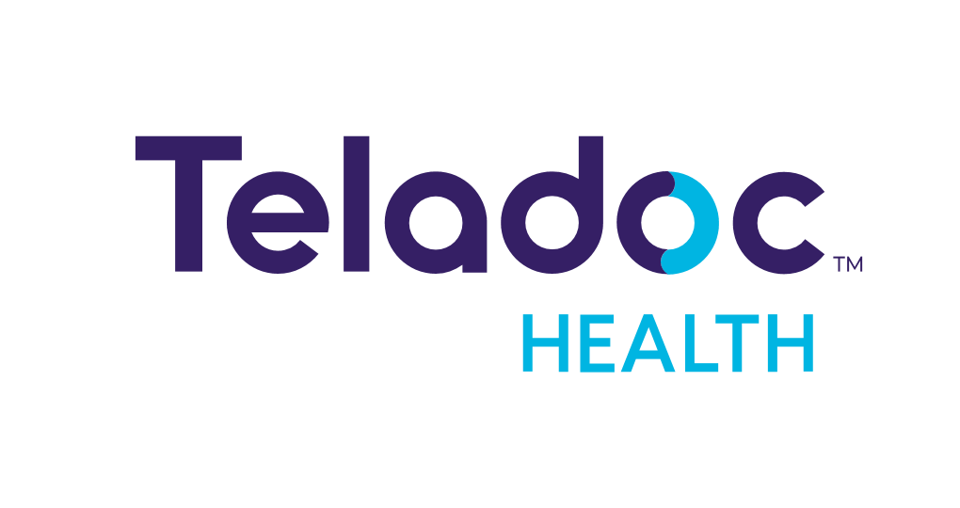
Empowering people everywhere to live their healthiest lives
Option to insert partner logo here
Notes:
In 2002, we set out to find a better way to connect doctors and patients.
And while our company, and the digital health industry, has massively evolved over the last 20 years, our mission has remained remarkably consistent.
Our goal isn’t to disrupt healthcare, but to empower people by transforming the healthcare experience to help people live their healthiest lives.

Slide 2

Our vision is to create a world where great healthcare is always within reach
Notes:
In 2002, we set out to find a better way to connect doctors and patients.
And while our company, and the digital health industry, has massively evolved over the last 20 years, our mission has remained remarkably consistent.
Our goal isn’t to disrupt healthcare, but to empower people by transforming the healthcare experience to help people live their healthiest lives.

Slide 3


Teladoc Health is the global leader in virtual care
90M+ Members¹
500M+ Health Interactions³
60+ NPS⁵
5000+ Employees Worldwide²
60M+ Cumulative Virtual Care Visits⁴
#1 Most recognized virtual care brand⁶
Includes U.S. paid members and visit fee only access
Teladoc Health data, 2023
Includes health interactions across all Teladoc Health businesses
Teladoc Health data, virtual care visits delivered since 2015
Member surveys across Teladoc Health products and services, 2021-2022
Based on Unaided Virtual Care Service Recall for September 2022
Notes:
Today, we are recognized as the global leader in whole-person virtual care and serve the growing virtual care needs of consumers and healthcare professionals around the world. Our corporate headquarters is in New York and offices are located throughout the Americas, Europe and Asia Pacific regions.
We were the first telehealth company to hit one million visits in 2015 and today, we delivered more than 60 million cumulative virtual care visits.
More than 90 million individuals around the world, including 1 in 4 Americans, have access to our services through an insurer or employer – and more than 1 million are enrolled in our chronic condition management solutions.
This unmatched scale enables us to serve more people than any other virtual care organization. In total, we have had more than 500 million health interactions with members who have conducted a virtual care visit, checked their health with a connected device, connected with a coach, engaged with digital health content (for example).
We’re proud to deliver and enable care at this scale while also earning high marks from our clients and members with a Net Promoter Score of +60. We are also the most recognized virtual care brand amongst consumers.
And we’re honored to do this work with more than 5000 employees worldwide who have been recognized as one of Newsweek America’s Most Trusted Companies, Great Places to Work and LinkedIn’s Top Companies in Healthcare.

Slide 4
Together with our clients, we are helping people live healthier lives
+60%
of Primary360 users hadn’t
seen a doctor in 2 years⁷; our members average 12-15 care team interactions per year⁸
68%
of eligible Primary360 members were referred for and completed preventive screenings for colorectal, breast and cervical cancers. ⁹
98%
Primary360
member satisfaction⁷
Primary360 care teams develop effective relationships with members
+1.12M
Members enrolled in our chronic care programs¹⁰; 56% of those active are in vulnerable or underserved communities¹¹
2x
Increase in device checks
by members enrolled
in programs to care for multiple chronic conditions¹²
90%
12-month member
retention in chronic
care programs¹³
We create meaningful
and sustained impact
for members living with chronic conditions
1.5%
Additional average weight loss over a weight management program alone¹⁴
9.6 mmHG
Average additional systolic reduction in blood pressure over a hypertension program alone¹⁴
0.5%
Average additional
A1c reduction over a diabetes program alone¹⁴
Mental health programs lead to better overall health
7. Primary360 Dashboard, Jan – Dec 2022
8. Teladoc Health data [DS-12531]
9. Teladoc Health analysis of > 3,000 eligible Primary360 members from Jan. 1-Oct. 30, 2022, using MIPS-based measure standards and augmented with text analysis across provider notes)
10. Chronic Care Dashboard [DS-12529]
11. Teladoc Health Corporate Social Responsibility Report [DS-123]
12. Teladoc Health data (DS-10502)
13. Teladoc Health data (DS-9596)
14. Teladoc Health Cohort Study (DS-8467)
4
Notes:
Today’s consumers want a high-quality experience they can trust to connect them with the care they need—and maybe even care they didn’t realize just how much they needed—at every step in their healthcare journey.
Meanwhile, organizations demand increased value from their virtual care investments—from extending access to care for underserved populations to improving clinical outcomes among the people they serve.
Together with our clients, we are creating meaningful health outcomes that empower people to live healthier lives and reduce healthcare costs for consumers and plan sponsors.

Slide 5
More than 20 years of leadership, innovation and growth
Ranked First in Customer Satisfaction in Inaugural J.D. Power Telehealth Study
NYSE: TDOC
Launched Mental Health and Dermatology Services
Launched Telemedicine Services in Canada
Named to TIME
100 Most Influential Companies
Founded Teladoc
BetterHelp joined Teladoc Health
Teladoc mobile app launched
Best Doctors and Advance Medical joined Teladoc Health
Launched Nutrition Services
Launched myStrength Complete and Primary360
First-ever general medical video visit
Launched Teladoc Health fully integrated experience
2003
2012
2014
2016
2018
2020
2022
2002
2010
2013
2015
2017
2019
2021
2023
First autonomous robot for clinical use
U.S. Food and Drug Administration clears Livongo Blood Glucose Meter
World's first commercial robotic telemedicine device connected via public internet
Launched Livongo for Hypertension
InTouch and Livongo
joined Teladoc Health
Launched Chronic Care Complete
Launched only over the air updates to Blood Glucose Meter
With Telefonica, expanded virtual care access across Brazil and Spain
Achieved milestone of 50 million visits worldwide
Notes:
In 2022, Teladoc Health celebrated our 20th year of delivering on the promise of virtual care. In that time, what was once a novel approach to care delivery has become an expectation. We’ve grown organically and through acquisition, always with a mind toward meeting the needs of what’s next in healthcare.
Over this time, our care and range of supports have touched tens of millions of lives across communities near and far. We’ve always had a laser focus on the individual, personal experience that healthcare is for each of us. That’s an approach we’ve always carried with us and one that will see us well into the future.

Slide 6
Sustained innovation to serve client and member needs
Pre-pandemic
Building core capabilities
2020 to 2022
Strengthen and expand services
2023 and beyond
Expand whole-person care value
Licensed platform for hospitals and health systems
High acuity
telemedicine
Solo enterprise platform
Solo + Microsoft Teams
Expanded in-patient connected care services
EMR integrations
Virtual nursing
Expanded integrations
Health assistant
Home Rx delivery
Expert medical
services
International
expansion
Lab testing referrals
Continuous glucose monitors
Home A1C test kits
Home phlebotomy
Expanded device flexibility
Access for
caregivers
Neck and back care
Dermatology
Clinical nudges
In-person care
referrals and navigation
Nutrition
Single, seamless consumer experience
Mental health
therapy
Medicaid
Medicare
Weight management
Provider-based care for chronic conditions
HEDIS and Stars support
Pre-diabetes
Clinical Services
Pediatrics
Hypertension
New Populations
Mental Health Complete
Federal/state government
General medical
Diabetes
Primary360
Integrations & Enhancements
Support health plans with gaps in care closure
Enabling Care Providers
Collaborative
whole-person care
Notes:
Our approach to innovation unlocks the promise of virtual care for clients and consumers. Our work is fundamentally virtually native, clinically data-driven, purpose-built for the intersection of healthcare and technology.
With more than $1 billion cash on balance sheet (as reported during Q3 2023 earnings) and more than $400 million invested in research and development in 2022, we’re clearly fueling the next wave of innovation in this unique approach to whole-person care, leading the way to help advance strategies and outcomes with our clients.
Over time, our product offering has evolved from a suite of point solutions to an integrated whole-person solution portfolio that help care teams address a broad spectrum of population’s healthcare needs.
The pandemic was an inflection point for consumer expectations from virtual care. Because of our groundbreaking work to create scalable virtual care offerings like our General Medicine, Mental Health, and Dermatology services in our earlier years of innovation, we were in a position to serve the burgeoning demand for care when people needed us most.
During the pandemic, our innovation didn’t rest. We focused on integrated solutions, serving Medicare and Medicaid populations, and new capabilities that support virtually-native hybrid care models that expand access, address care provider capacity constraints and lower costs of care around the world.
In 2023, we are investing in continued innovation to expand the value of whole-person care, supporting gaps in care closure and quality measures, and serving broader populations through our integrated experiences.
Unlike most of the virtual care market that is still focused on point solutions and narrow capabilities, Teladoc Health is here to partner with our clients across the broadest spectrum of care needs today & we have the knowledge, foresight, expertise, innovation, scale and capital to serve your future needs as well.

Slide 7


We are advancing a unique whole-person care model
Comprehensive and Integrated
Connected
Personalized
High Quality
Notes:
Since we were founded, we have been focused on a simple, yet revolutionary idea: that everyone should have access to a broader range of healthcare, anywhere in the world on their terms.
We have dedicated ourselves to transforming the healthcare experience by advancing whole-person care. Today, we are working with leaders and experts around the world to advance a whole-person care model that exceeds today’s expectations and anticipates whatever tomorrow will bring.
We believe that whole-person care must be:
Comprehensive and integrated: Within a single unified platform, the widest range of virtual care capabilities best supports people throughout their lifelong journeys to care for their health. Whole-person care addresses everyday health and well-being needs, as well as chronic conditions and acute concerns.
Connected: Delivering the right care in the right setting, whole-person care seamlessly combines virtual and in-person care in a hybrid model. Information is exchanged and clinicians are connected to help improve health outcomes for the patient and reduce the cost of care.
Personalized: Data-driven personalization takes into account an individual's socioeconomic background, health and risk factors, and preferences to create a better care experience. By applying these insights, whole-person care ensures all individuals feel seen, heard, and supported in their own healthcare journey. Experienced clinicians, informed by evidence-based care practices and insights about social determinants of health, deliver the highest quality whole-person care that fosters health equity and supports improved health outcomes for all people everywhere.
High Quality: Care that is evidenced-based, enriched by experienced clinicians and infused with insights from the social determinants of health supports a whole-person care journey. Rigorous clinical quality evaluation, peer review, credentialing and documentation must be combined with data-informed insights of the lived experiences of members to create a Learning Health System approach to quality. That system supports a whole-person care journey because it never stops evolving and improving to meet the shifting needs of the individuals seeking care.

Slide 8



Our whole-person virtual care model addresses the broadest spectrum of healthcare needs for more people
I need help managing
my anxiety
I am struggling
to maintain my blood pressure
I want to
easily connect with my primary
care physician online
I need to
complete my preventative
care screenings
I need to
have a surgical procedure
8
Notes:
Teladoc Health’s unique whole-person care model leverages insights, data, and clinical expertise to drive better health around the world.
As we talk about what it means to care for the whole person, we start by recognizing and addressing unique individual needs. While some virtual care solutions address a niche population or care for a specific set of medical needs, Teladoc Health uniquely offers an integrated virtual care model that addresses the broadest spectrum of healthcare needs for more people.
While members often come to us with a specific initial healthcare need (like a concern about blood pressure, mental health, or a desire to find a new PCP or specialists), we gather information about their health, their socioeconomic and cultural background, their healthcare needs and preferences so that we can streamline the experience and guide people to the right care, right away.

Slide 9

We deliver comprehensive, integrated virtual care that spans each stage in a person’s health journey
Chronic Condition Management
Mental
Health
Acute
Care
Proven Outcomes
Innovative Care
Models
Engagement
Specialty
Care
Primary
Care
Integrated Platform
Personalized Experience
Whole-person care services
Data & Analytics
Key enablers
9
Notes:
In Teladoc Health’s 2023 survey of more than 300 human resource decision makers, 95% of respondents agreed that whole-person care can improve the healthcare experience for employes and help them build a better benefits package. Other recent studies, completed by Teladoc Health, have shown that 78% of consumers want an integrated consumer experience for their mental and physical health. This is why we provide the most comprehensive, integrated spectrum of virtual care services in a single integrated experience that can include:
Primary Care: From the annual checkup and everyday health needs to managing chronic conditions and more complex challenges, members build an ongoing virtual care relationship with their primary care team. A personalized Care Plan offers clear next steps and follow-ups, and we provide referrals to in-person care as needed.
Mental Health: Convenient, stigma-free access to high-quality mental healthcare specialists, as well as content and tools to strengthen your emotional health on your own terms. In fact, on average, 90% of people who used our mental health solution say it helped them feel better.
Chronic Care: Personalized care and support for chronic conditions includes access to smart devices and expert coaches to track your weight, blood sugar and blood pressure levels and develop healthier lifestyle habits.
Acute Care: 24x7 access to licensed care providers who diagnose & treat non-emergency health conditions such as cold & flu, sinus infections, allergies, pink eye, stomach aches and more
Specialty Services: Connect with high-quality care providers with expertise in dermatology, nutrition, joint care, and more. Get an expert opinion on a diagnosis or treatment plan and help finding in-network medical providers to see in person.
We deliver this through a unified experience proven to drive greater engagement, utilization and satisfaction for consumers. The right side of the page highlights the foundational capabilities that uniquely power our model & create personalized, connected experiences at scale.
Innovative care models: We connect people to the right care at the right time. From smart connected devices and AI-driven “nudges and data integration,” to health coaches and therapists, to board-certified physicians and the world’s leading specialists. By tapping into this broad spectrum of clinical services anytime, anywhere – people are empowered with real-time information and guidance to take care of their health and avoid the unchecked progression of illness.
Integrated platform: Our technology platform is purpose-built, virtually native, and provides a secure, scalable foundation for whole-person virtual care.
Data and analytics: Data is a differentiator for us, powering our personalized care experience. Over 60% of our data is proprietary including self-reported values, propensity models, device readings, behavior-based triggers, clinical interactions, app usage, surveys, and referrals & it is complemented by third-party , such as claims. All of this enables us to help improve their health journey.
Personalized experiences: We empower consumers to connect to care wherever they are, in sickness and in health, and doing so in personalized, targeted and relevant ways. Teladoc Health takes a journey-based approach to better health and provides increasingly personalized content/outreach based on the member’s interactions with us. And all along the way, members receiving appropriate, personalized nudges to engage with their care plan and care for their health – advancing the longitudinal relationship – and staying on track with goals.
Member engagement: Our engagement is a game changer. It shapes an experience that empowers each member to progress on their journey to better health. Our trusted brand, broad marketing and healthcare partnerships, omni-channel outreach capabilities, proven best practices, robust library of tested marketing assets enables us to consult with clients and help improve virtual care engagement results with their populations.

Slide 10






Dedicated to high-quality virtual care delivery
Largest virtual
care network
Right care at
the right time
Quality assurance
and improvement
Industry
leadership
\
\
\
\
Primary care physicians
Expert specialists
Mental health specialists
Coaches and nurses
Appropriate referrals
Behavioral nudges
Digital therapeutics
Self-service health content
High-quality care standards
Clinical oversight and feedback
Performance measures
Learning and innovation
Research grants
and studies
Leadership in clinical quality standards and associations
First virtual care Patient Safety Organization
Recruiting
Credentialling
Onboarding and training
Provider relations
Notes:
High-quality care is our top priority at Teladoc Health. We take this responsibility to heart and work tirelessly to both deliver exceptional care today, while also as industry leader shaping the future of virtual care, at large.
Each day, our members trust us to deliver the right healthcare services at their time of need & our clients rely on us to improve access, outcomes, and savings. Our medical network & our clinical quality leadership ensure that we deliver on this commitment.
We have the largest and most diverse virtual care-focused medical network in the world with more than 10,000 licensed care providers spanning multiple specialties. We deliver exceptional, equitable healthcare that makes a positive impact and empowers people to achieve new levels of health. These clinicians hold a commitment to clinical quality, applying virtual care best practices and data-driven insights to deliver effective, compassionate and trustworthy care for every member we serve.
The Teladoc Health Medical Group recruits, credentials and supports provider relations for our U.S. network. Teladoc Health is accredited for credentialing by the National Committee for Quality Assurance (NCQA) and has been continuously accredited since 2013. The accreditation affirms that Teladoc Health has a thorough credentialing process with multiple layers of quality control.
We connect people to the right care at the right time: our stepped care model helps members experience digital interactions when that's appropriate and sufficient, and interact with a highly trained, highly specialized physician when that's really necessary. We offer a broad spectrum of care and support ranging from smart connected devices and AI-driven “nudges,” to health coaches and therapists, to board-certified physicians and the world’s leading specialists.
Teladoc Health assures high quality of care by delivering industry leading, high-quality programs and applying evidence-based clinical guidelines and selecting, monitoring and improving outcomes that matter. We leverage the National Academy of Medicine’s (formerly Institute of Medicine) 6 Domains of Health Care Quality - striving for care the is safe, timely, efficient, effective, patient centered and equitable. Our standards of care are distinguished by our research-based clinical policies and more than 100 proprietary practice guidelines developed over our 20+ years of delivering care via telemedicine.
Our layered clinician oversight program offers multifaceted, consistent performance measuring tools offering clinicians the oversight, evaluation and feedback that drives quality assurance while positively impacting lives. Provider dashboards and ongoing peer feedback serve as a foundation for clinical innovation and continuous quality improvement.
As the industry leader in virtual care and a learning health organization, we are collaboratively advancing virtual care delivery and advocating for high-quality care practices. Each year, our clinicians contribute to medical research to advance the field of medicine and shape policies that improve quality and access. Leveraging our unique data and expertise, we also partner with leading research institutions to advance improved clinical decision making, safer prescribing, and better health outcomes.
As part of our successful antibiotic prescribing stewardship program, we have undertaken a five-year, AHRQ grant-funded research study together with the University of Southern California (USC) Schaeffer Center for Health Policy & Economics and Northwestern University, to lead the first-ever, large-scale study to assess antibiotic prescribing practices in telemedicine.
Our executive clinical teams thought leadership contributes to the innovation of the telehealth industry. They are frequent speakers on the topic and contribute to key clinical research in associations such as NCQA taskforce on telehealth policy.
In May 2019, Teladoc Health founded the healthcare industry’s first Patient Safety Organization (PSO) dedicated to virtual care. Known as The Institute for Patient Safety and Quality of Virtual Care, this entity is listed and certified by the Agency for Healthcare Research and Quality (AHRQ) and formally recognized by the U.S. Department of Health and Human Services (HHS). The PSO conducts quality and safety initiatives with and on behalf of key healthcare stakeholders to improve the safe delivery of virtual care. The goal of the PSO is to allow for a safe place for clinicians to report errors to help improve patient safety and healthcare quality. The PSO makes it possible for information from healthcare providers to receive certain legal protections in spirit of safety and improvement. With this information the PSO team can apply root cause analysis to understand the true root of any issues, recommend and participate in implementing solutions, and help educate care providers to promote learning and prevent future safety events.
Teladoc Health was selected to participate in The National Quality Forum (NQF) Action Team on Virtual Healthcare Quality. Working with other experts, we collaboratively identified priority challenges and recommended actionable objectives to improve virtual healthcare quality.

Slide 11

We personalize care experiences by applying data at scale
Data and AI guide next-best actions for members and care providers
Clinical
interactions
(3rd party)
Health
surveys
Device
readings
(3rd party)
Scale and scope
of data
>2 billion health and engagement data points¹⁵ of which >60%
are proprietary¹⁶
Thousands of digital and virtual interactions for a single individual
Teladoc
Health
device
readings
Rx data
Claims
data
Deep data science expertise
80+ data scientists with >300 years cumulative virtual care experience¹⁷
Teladoc
Health
clinical and
coaching
interactions
Lab
results
1:1 health interaction
with Teladoc Health
Wellness
entries
Public data
exchanges
Individual health/care data
delivered by external source
3rd party population data
15-16: Teladoc Health data [DS-12289]
17. Teladoc Health data [DS-12430]
Notes:
Our ability to leverage data to power personalized care and experiences is truly unique. With more than 20 years of virtual care experience, we have aggregated more than 2 billion data points developed from an array of different sources, both internal and external to Teladoc Health. Our deep expertise in data science and machine learning turns this data into insights that create a personalized care experience that creates high levels of health engagement.
Data and AI are at the heart of combining clinical science and data science, codifying an impactful next best health action to take for consumers and providers alike. Applied Health Signals, deployed at scale, are the difference between a care model that looks good in theory, and one that actually works in practice as a bridge to personalized care plans.
Examples:
Referral to Mental Health or Chronic Condition Management program
Sophisticated matching of patients and best care providers
Nudges to drive member (and clinician) behavior change
Triaging of consumers to right level of care, including self-management
Deeply personalized digital experiences, supporting Health Equity
Automated triggers for clinical interventions
Evidence-based medicine prompts to support clinicians

Slide 12







Our purpose-built, virtually native platform provides a secure, scalable foundation
Unified data fabric
Expansive, integrated dataset
Integrated patient experience
Single app and patient ID, personalization
Integrated benefits administration
Service eligibility, insurance coverage
Multi-disciplinary care hub
EMR and clinical practice platform
Unified service delivery infrastructure
Cohesive customer service and support
Designed for collaboration
Open APIs, last mile integration
This voluntary certification places us amongst an elite group of organizations worldwide recognized for meeting the highest standards for data protection and information security.
Notes:
Our technology platform is purpose-built, virtually native, and provides a secure, scalable foundation for whole-person virtual care. We have invested in technical, logistical, operational infrastructure that gives us the unique ability to deliver high-quality, personalized care at scale in a comprehensive manner. And we continue to invest and innovate to improve and expand these capabilities.
To give you a sense for some of the strengths of the platform:
Unified data fabric: We have built a powerful integration of data from various points, including member-provided information, interactions, behavior, personalized experiences and preferences.
Integrated benefits administration: Regardless of plan design, we verify service eligibility and insurance coverage to streamline access and effectively facilitate administrative and financial transactions with carriers
Unified service delivery infrastructure: Our unified approach to service delivery drives an integrated view of the customer and can provide high quality, streamlined support.
Integrated patient experience: Patients have a global ID for accessing all care services in an integrated app experience. Powered by data, we are able to deliver personalized communications, nudges and “next best action” recommendations to drive greater health engagement and outcomes
Multi-disciplinary care hub: Our EMR and clinical practice platform are optimized for high-quality virtual care delivery, including care coordination, referral management, and pharmacy management
Designed for collaboration: Open APIs enable secure data exchange with partners, third-party care providers, lab services, and devices for care continuity and to streamline the patient and care provider experience.
As we leverage the power of data and analytics, we’re fierce advocates for doing so in a way that protects the privacy and sensitive information of the people we serve. We are committed to transparency in how we collect, store and use information, and offer people meaningful choices about how their information is used. We conduct mandatory annual compliance training for all employees on the importance of full compliance with privacy and security principles. We are committed to designing experiences and tools that protect consumer privacy and safety.
Teladoc Health has achieved HITRUST CSF certiﬁcation—the benchmark healthcare organizations require to safeguard their protected health information (PHI) and measure proficiency for information protection—as well as SOC 2 Type II certification. The HITRUST framework includes compliance with the Health Insurance Portability and Accountability Act (HIPAA) and Health Information Technology for Economic and Clinical Health (HITECH) standards, addressing cybersecurity threats and vulnerabilities, data protection standards and physical security.

Slide 13








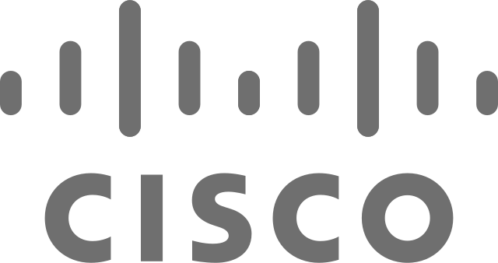
















Trusted to serve more than 12,000 clients worldwide
+60%
of the top U.S. hospitals
and health systems¹⁸
+100
U.S. health plans¹⁸
+60%
of Fortune 500 employers¹⁸
18. Teladoc Health data
Notes:
Around the world, we are work with more than 12,000 clients including the world’s leading insurers, employers, hospitals and health systems. Together, we are continually advancing the healthcare experience.
Our clients span all sectors of healthcare, including:
More than 60% of the Fortune 500 employers such as AT&T, Cisco, Hyatt, Microsoft, SAP – as well as thousands of small businesses, labor unions and public sector employers
More than 100 U.S. health plans including Aetna, Amerigroup, Centene and many Blue Cross Blue Shield plans. We support all lines of business including Self Insured, Fully Insured, ACO, Medicare, Medicaid and Exchange populations.
More than 150 global insurance and financial services firms such as AIG, AXA Global, Canada Life and MLC who make our virtual care services available to their clients and members.
More than 60% of the top 100 U.S. hospitals and health systems and many others around the world such as Cleveland Clinic, Jefferson Health, Johns Hopkins, Mayo Clinic, and Northwell.
Through close collaboration, we develop tailored solutions and create meaningful results with our clients and partners. Our client NPS (+60) and retention rates (+90%) are high as a result of the close partnerships and value we create.

Slide 14


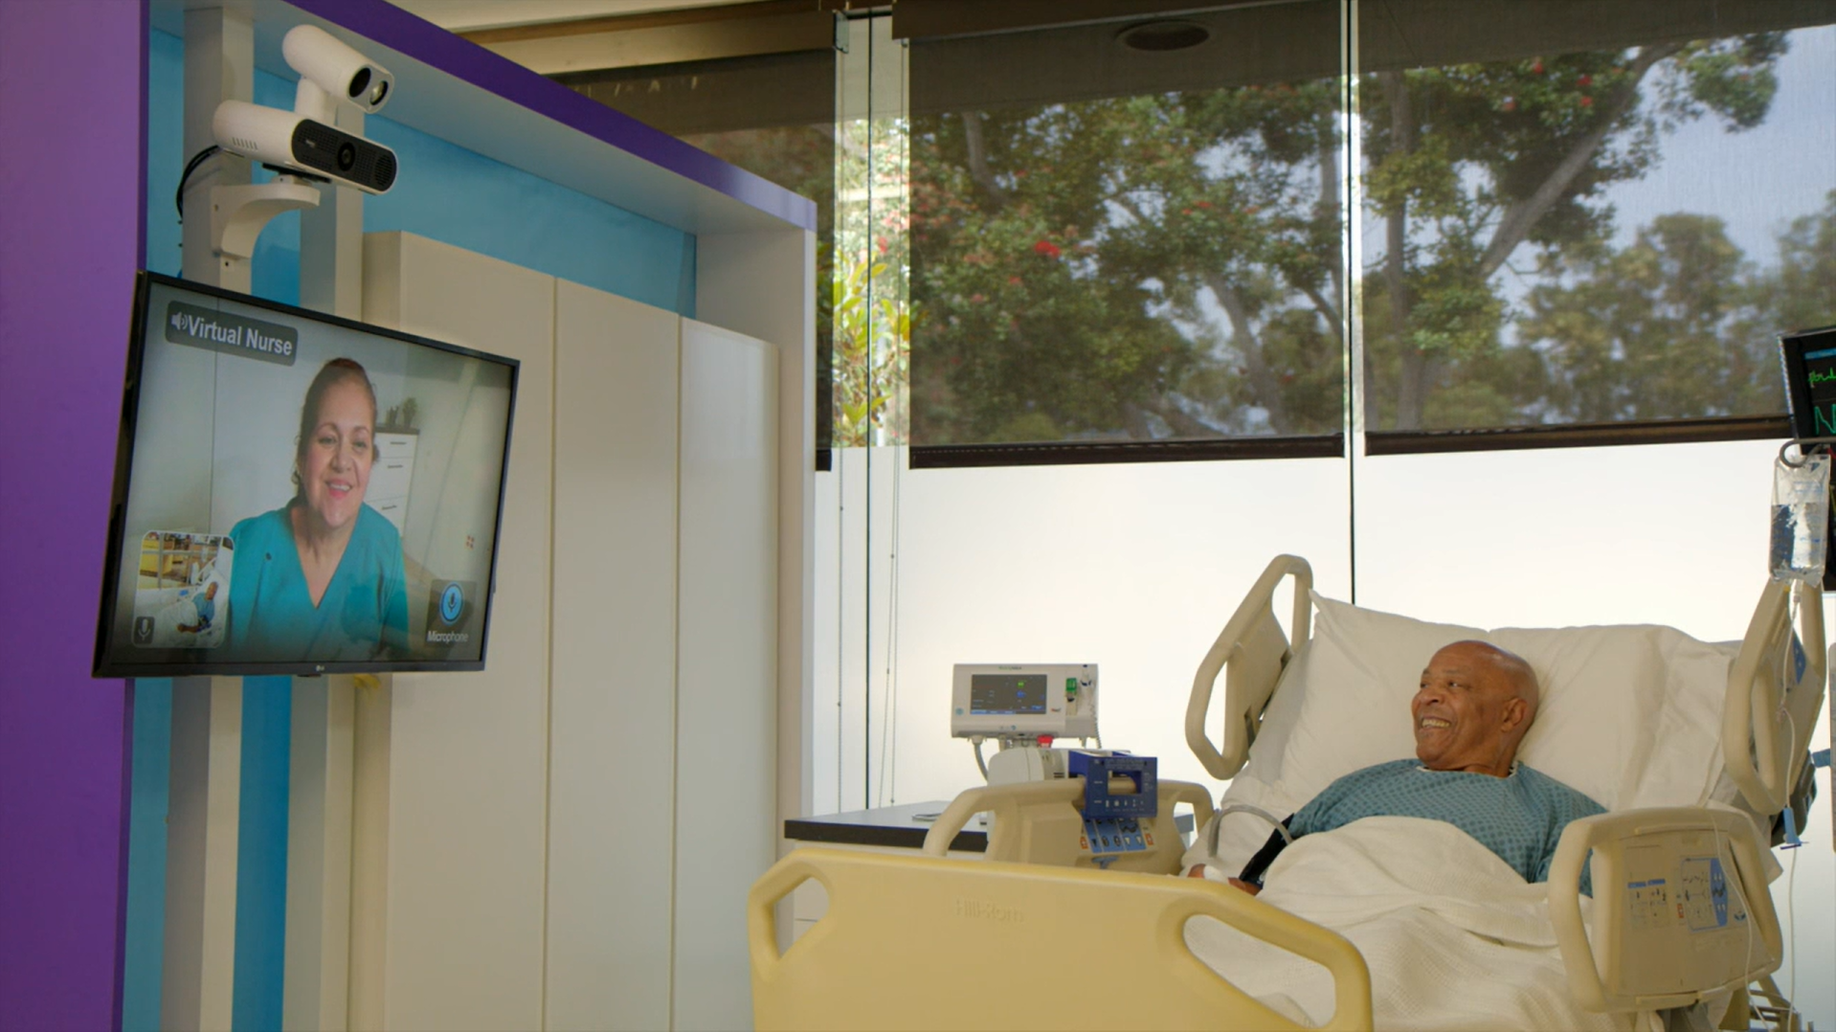



We enable virtual care at scale from the hospital to the home
FOR HOSPITALS AND HEALTH SYSTEMS
Fully integrated suite of connected care solutions through hardware, software and services
Strategic partner with health systems, applying solutions to help transform care delivery
Continual innovation with partners like Microsoft to provide enhanced value and capabilities to EHR and other third-party systems
Enable a seamless experience for clinicians and patients that spans across the care continuum, from Inpatient, Emergent and Ambulatory care to the patient’s home
60%
of top 100 hospitals and health systems are clients¹⁹
>600
hospital and health system clients¹⁹
19. Internal data disclosure data
Notes:
Teladoc Health’s Hospital and Health Systems business delivers a fully integrated suite of connected care solutions (hardware, software, and services) to help hospitals and health systems of all sizes offer state-of-the-art, in-house telehealth solutions. Teladoc Health is more than a single point solution vendor -- we are a strategic partner with health systems, applying solutions to help transform care delivery, while solving the most pressing issues (workforce shortages, clinician burn out, financial pressures, patient access and equity). More than 60% of all health systems have selected Teladoc Health as their partner
Teladoc Health continues to innovate with partners like Microsoft to provide enhanced value and capabilities to a health system’s EHR and other third-party systems to help deliver a seamless experience for clinicians and patients that spans across the care continuum, from Inpatient, Emergent and Ambulatory care to the patient’s home.
Partnering with Teladoc Health’s solution for hospitals and health systems means bringing a global leader in virtual care directly into your organization and joining hundreds of hospital and health system clients in their digital transformation and the way they deliver care.
Teladoc Health clients are uniquely equipped to support personalized care in any environment, harness data analytics through a single platform, and scale into high-performing systems that help improve the health of whole communities. An enterprise-wide approach to virtual care can help address some of the core issues that challenge the financial stability of hospital and health systems.
Teladoc Health’s enterprise solution, Solo, integrates with existing technologies like the EMR and in-room telehealth products to provide a unified virtual care solution. It reduces administrative burden, facilitates collaboration and empowers better patient care.
With endless use cases that are completely catered to an organization’s workflow, some of the most common include:
Inpatient Services – enable virtual nursing, critical care, hospitalists and more
Emergency Services – facilitate collaboration, quickly, with virtual stroke, neonatology and behavioral health solutions
Ambulatory Services – Keep care teams connected to patients throughout their care journey, wherever they are
Integrated virtual care can stabilize workforce challenges, expand and strengthen consumer relationships, advance on health equity, and scale operational efficiencies and cost savings.
An enterprise-wide approach is the most effective way to leverage existing technology investments to expand capacity or deepen capabilities.
By marrying wrap-around, in-person functions with virtual care technologies, hospitals and health systems can sustain a new dimension of care that flows across the entire care continuum.
EMR integration with our virtual care platform that operates on a secure cloud gives providers access to the complete range of virtual health solutions while easing the burden on IT resources.
Cincinnati childrens
CAMC
Parkview
Novant
Hackensack
St Luke’s
UAB
Franciscan
Bryan

Slide 15


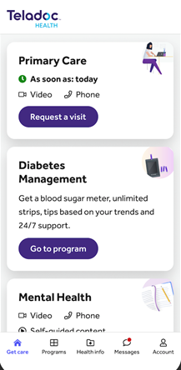
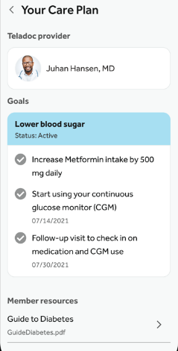






We are creating better health for individuals and populations
FOR EMPLOYERS AND HEALTH PLANS
28.8%
improvement in medication adherence for members living with diabetes²²
42%
of mental health visits
by Medicare Advantage members would not have otherwise sought treatment²³
$966
annual member savings attributed to diabetes management by leading health plan²⁴
Integrated virtual care services
to address broadest spectrum of health needs for more people
Support health plans with gaps-in-care closure and improved health outcomes for people living with chronic conditions
High-performance engagement programs powered by data, consumer insights and proven
best practices
Experienced partnership to design and implement innovative care models and virtual-first plan designs
22. SAP member outcome data through February 28, 2022
23. AFSPA member outcome data through May 31, 2022
24. Florida Blue Study, April 1, 2021 - April 1, 2022
Notes:
We understand the importance of a unified healthcare experience and the fatigue that fragmented solutions can create for consumers and plan sponsors alike.
Teladoc Health’s whole-person care solution uniquely addresses the broadest spectrum of a person’s care needs – primary care, chronic care, and mental healthcare – in a single integrated app experience. Whether connecting immediately with a doctor about cold/flu symptoms, identifying a leading specialist for a review of cancer treatment, providing personalized mental health resources or supporting members with chronic care solutions and coaching, virtual care simplifies how members navigate the complex healthcare system—often helping them resolve their needs without the need to leave home.
We help members reach their health goals, closing gaps in care and improving your quality measures. We deliver industry-leading clinical outcomes through our multi-condition, longitudinal care that engages members, facilitates early identification of chronic conditions, supports sustained behavior change, and helps to reduce the risk of costly health events. Our clinical improvement results are both immediate and sustained over 5+ years – for all your members – with even greater results for your uncontrolled members – as measured by A1c, blood pressure, and weight reduction. This creates a significant return on investment for you and real impact to your members’ health (source: Teladoc Health savings methodology decks).
The Teladoc Health brand is well known and trusted to serve the broadest spectrum of healthcare needs. Our team of more than 150+ data scientists and consumer engagement specialists leverages experience, best practice and expertise to drive industry-leading engagement, enrollment, and utilization of our virtual care services. Our data-driven, journey-based campaigns meet individuals where they are and provide support in the moments they are making important health decisions. Leveraging our large library of customizable marketing assets (on engagementcenter.com), we partner with clients to activate campaigns that complement their benefits and communication strategies and empower each member to progress on their journey to better health.
More than 80% of our clients indicate that they view us as a strategic partner to their organization. We work together with clients to share best practices and insights, defining together how virtual care can amplify your longer-term benefits strategy. According to our survey of large employers, the majority of respondents (73%) are at a pivotal point in their transformation journey. While they may be offering a variety of solutions to address individual health needs, these offerings are not optimally integrated, fully adopted or driven by a virtual-first plan. Leveraging our Virtual Care Transformation Model, Teladoc Health experts can work with you to develop a baseline and define a path forward to help your organization respond to—and anticipate—market dynamics, emerging virtual care solutions and technologies, and the needs of the people you serve.

Slide 16

Unlocking value for all stakeholders
Empowering consumers with a single access point
for whole person care regardless of clinical situation, helping to improve health outcomes, lower costs, and consumer experience
Reducing costs for health plans and employers
with the broadest portfolio of integrated,
data-driven virtual care solutions
Enabling care providers to achieve system-wide virtualization of high-quality care
16
Notes:
Because we are unlocking value for all stakeholders – consumers, clinicians, and care providers – the demand for unified whole-person care continues to accelerate.

Slide 17

Making a positive difference in our communities
Improving health equity and access to high-quality healthcare
  Advocate for policies to address persistent disparities
  in technology, connectivity, digital literacy, and access
  Enable members to self-identify race, ethnicity, age, preferred language, and gender identity
  Support patients with diverse languages, including a full Spanish Teladoc Health app
  Design products and communications for people of varying abilities and health literacy levels
  Support World Telehealth Initiative (WTI) to serve underserved populations worldwide
  Provide free care to communities impacted by
  natural disasters
Investing in our colleagues by fostering
a vibrant, inclusive work environment
  Great Place to Work® certified
  Seven active business resource groups
  53% of U.S. new hires identified as Asian, Hispanic or Latino, Black or African American, or other diverse backgrounds²⁵
  15,000 hours of charitable work by our colleagues in 2022²⁵
\
\
Our annual Corporate
Social Responsibility Report highlights our work to empower all people everywhere to live their healthiest lives.
25: Teladoc Health Corporate Social Responsibility Report
Notes:
We are committed to advancing greater health equity and creating greater access to healthcare for all people everywhere. This commitment shows up in the people we hire and with whom we work, the products and experiences we create, the quality of healthcare we deliver and the investments we make to improve access to healthcare.
We’ve established governance, leadership and workforce infrastructure to ensure our people focus on health equity in each area and every level of our business. For example, we have integrated diversity, equity and inclusion into our decision-making framework with the addition of our first Chief Health Equity Officer, and by elevating the position of Diversity, Equity and Inclusion Officer to our company’s Operating Committee.
We create and evolve our products and services to support a range of health needs and we’re making healthcare more accessible by:
We advocate for policies that address disparities in technology, connectivity, digital literacy and access to healthcare. For example, we have convened partners from across the health system -- such as Ascension, AARP, the American Hospital Association, the American Heart Association and the American Medical Association -- to launch Telehealth Access for America (TAFA), a public education campaign committed to better care, expanded patient choice, and protecting access to critical telehealth services.
We made new investments this year to collect more quantitative and qualitative patient data, helping to further support identification of disparities at the population level and improve care. Beginning in 2023, we’re launching new capabilities for our members to self-report an expanded range of health equity-related data including race, ethnicity, gender identity, pronouns and preferred language.
We deliver care members in more than 240 languages including a full Spanish language app experience. Over the last year, the company has also invested in bringing on more than 100 new Spanish-speaking providers. Early data indicates these steps have already made an immediate and measurable impact. For example, as of late 2022, the satisfaction ratings among Spanish-speaking individuals using Teladoc Health services exceeds that of non-Spanish speaking individuals.
We are committed to ensuring our products and communications are accessible for people of diverse abilities and health literacy levels. For example, we have been increasing our accessibility features to better accommodate phone-based preferences, low-bandwidth environments and support people with visual and physical impairments.
The World Telehealth Initiative (WTI), a non-profit organization, provides sustainable medical expertise to the world’s most vulnerable communities to build local capacity and deliver core health services through a network of volunteer healthcare professionals supported by Teladoc Health technology. For example, we helped WTI quickly mobilize to address the humanitarian crisis in Ukraine, training Ukrainian surgeons via video to handle battlefield trauma injuries and providing specialty medical care for those in need, building skills and reducing the burden on local health systems.
One of the devastating impacts of climate change is the rise in natural disasters, which can sharpen health disparities and limit care access. Building on a first-of-its-kind partnership with the American Red Cross launched in 2016, we are proud to continue offering 24/7 free access for those impacted by natural disasters, which this year included response efforts in 12 states.
We believe that healthy minds and diverse perspectives inspire innovation. To that end, we emphasize a work environment that enables employees to be their healthiest and most authentic selves. As a foundational element of our Diversity, Equity & Inclusion ecosystem, our seven active business resource groups (BRGs) connect people, support authenticity and build community. These internal employee networks help amplify the Teladoc Health culture of inclusion, both inside and outside of the company, and serve as a critical space for networking, workshops, mentoring and more.
We also understand the importance of representation across the organization. We continue to advance our commitment to recruit, promote and support a culturally and linguistically diverse workforce that is responsive to the communities we serve. As we continue to work toward these goals, we are proud of the progress we’ve made. In fact, 53% of U.S. new hires identified as Asian, Hispanic or Latino, Black or African American, or other diverse backgrounds.
Our company values center on taking care of others, and when we work together, we can help even more people, including those in our local communities. We set an ambitious goal last year to clock a collective 15,000 hours of volunteering as a company. Our employees exceeded that goal—by addressing food insecurity, raising funds to combat juvenile diabetes and contributing their time to many other causes that matter to them.
We are proud to be recognized for our culture —one that prioritizes employees’ health and well-being and offers them tools and support to thrive personally and professionally. We measure our success in terms of increased employee diversity, engagement and satisfaction. In 2022, Teladoc Health was certified as a Great Place to Work and named to LinkedIn Top Companies in Health Care, Forbes Best Employers For Women and America’s Best Employers Diversity.

Slide 18

Guided by shared values
We are passionate about taking care of people.
We are committed to unsurpassed quality.
We keep our promises.
We lead with integrity, accountability and transparency.
We stand up for what’s right.
We strive to create value.
We respect each other and value succeeding together.
Notes:
When we work to serve our clients and patients, you’ll find that our colleagues and our care providers are guided by a shared set of core values. We are a mission-driven organization focused on taking care of people, creating value, and leading with integrity.
As a result, we’re uniquely able to lead and innovate in virtual care creating a positive impact at scale for organizations like yours.

Slide 19







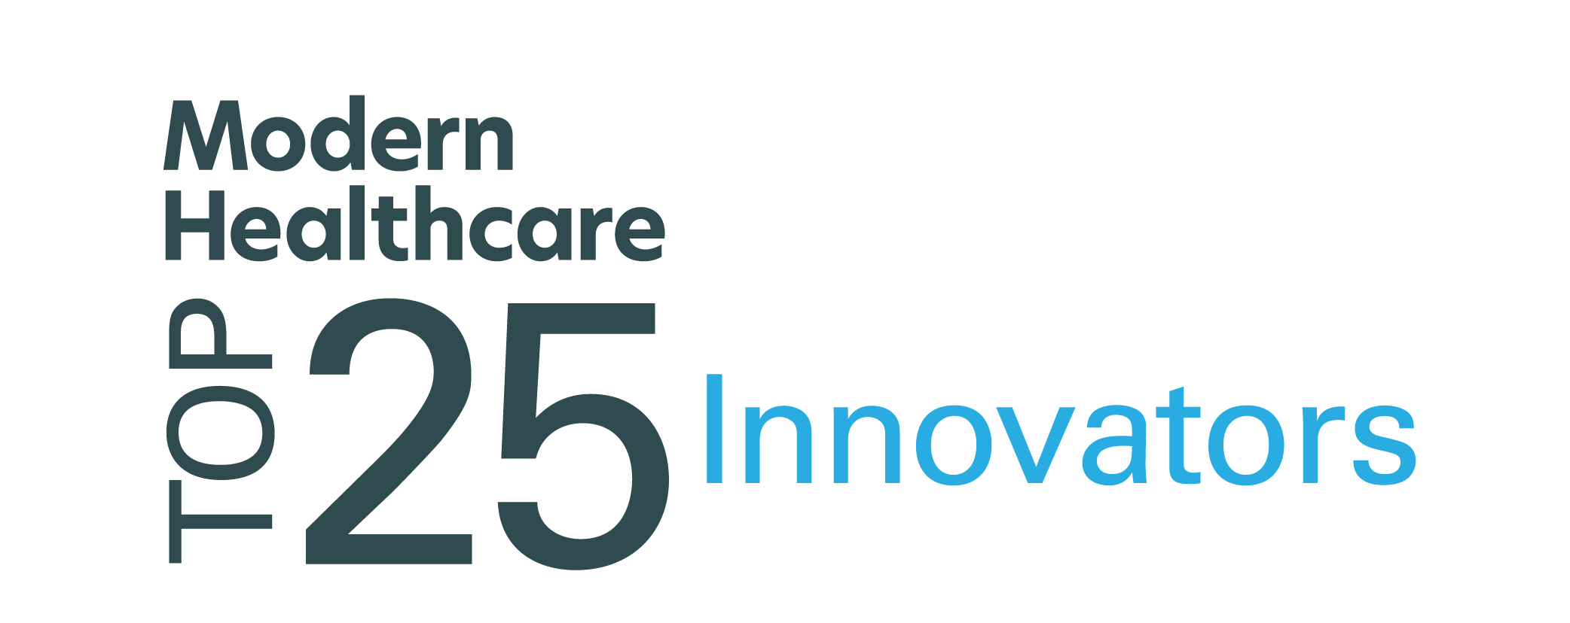
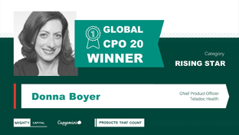
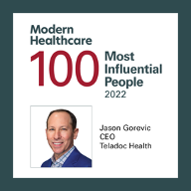
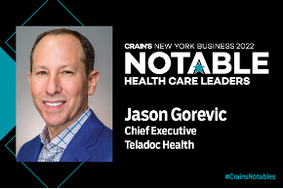

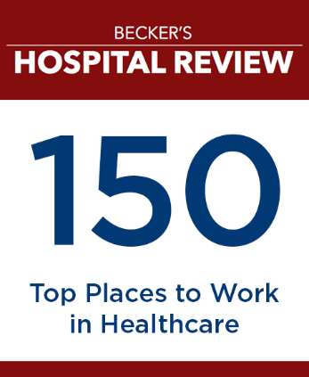





Recognized for industry leadership
2nd year
2nd year
Best Online
LGBTQIA+ Counseling
2023 CIO Award for Teladoc Health Mental Health Complete

Slide 20
Teladoc Health is the trusted partner with the financial strength and scale to serve your needs today and tomorrow.
20 years
leadership in
virtual care
$2.4B
2022 revenue
⁺$1B
cash on balance sheet
$400M
in R&D investments
Our proven, consistent leadership drives better health around the world. | Delivering at unrivaled scale, we are a growing company with great momentum. | Our financial position is very strong with balanced growth of revenue and profitability. | We are confidently investing more in innovation than at any time in our history.
Notes:
We all read the news and know that it’s an uncertain economic environment. Interest rates are up, financing markets have tightened and the ability to access liquidity are testing all-time lows. It’s clear that privately-held startups ay struggle in this environment as they deal with the fact that it’s harder – and more expensive – for them to get the funding they need.
Within this macroeconomic context, we appreciate that financial strength must be a more important criteria than ever in your decision making. As a leader in your organization, you are looking to make thoughtful selections of strategic partners who demonstrate ability to deliver on commitments and create value in the near-term and to invest in the infrastructure and innovation that will position your programs to thrive in future.
As we look across the digital health sector, it’s clear that Teladoc Health is the most financially strong company in digital health.
We've been leading the way in virtual care since 2002. Since we were founded more than two decades ago, we have been focused on our mission that everyone should have access to the best healthcare and we have been leveraging insights, data, and clinical expertise to drive better health around the world.
We deliver high-quality virtual care at an unrivaled scale: more than 60 million visits since our founding and 18 million visits last year alone. More than 85 million people have access to our services including 1 in 4 Americans. Enrollment in our chronic care programs now exceeds 1 million.
Built on a strong foundation, we are also a growing company with great momentum: $2.4 annual revenue in 2022 with an outlook to deliver $2.6 - $2.675 million in revenue in 2023. Because we are a publicly-traded company (NYSE: TDOC) our quarterly financial reporting is transparently available to you.
As a well-run company, we are focused on balanced growth of revenue and profitability and our cash position is very strong. We have more than $950 million in cash on our balance sheet and we anticipate generating free cash flow of at least $100 million in 2023 – which positions us to confidently invest in our business.
We are investing more in R&D ($400 million in 2022) than at any time in our history, deeply innovating to advance connected, hybrid whole-person
If you’re looking for a virtual care partner that's going to be around for the long-term, Teladoc Health is it. We’ve made strategic decisions that put our company in a strong position for years to come. And we are well positioned to innovate, integrate, and scale to support your success as your partner for today and tomorrow.

Slide 21
Thank you
First Lastname
Job Title
012 345 6789
firstlastname@teladochealth.com

Slide 22
Additional cover options

Slide 23

Empowering people to live their healthiest lives
Option to insert partner logo here

Slide 24


Empowering people to live their healthiest lives 1
Option to insert partner logo here

Slide 25

Empowering people to live their healthiest lives 2

Slide 26

Empowering people to live their healthiest lives 3

Slide 27


Empowering people to live their healthiest lives 4
Option to insert partner logo here

Slide 28


Empowering people to live their healthiest lives 5
Option to insert partner logo here

Slide 29


Empowering people to live their healthiest lives 7
Option to insert partner logo here

Slide 30


Empowering people to live their healthiest lives 8
Option to insert partner logo here

Slide 31



Empowering people to live their healthiest lives 9
Option to insert partner logo here

Slide 32

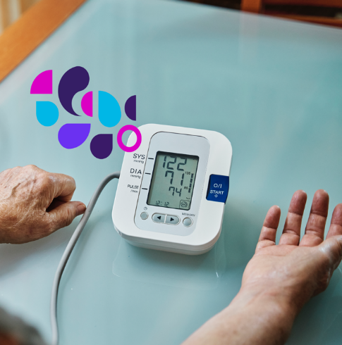

Empowering people to live their healthiest lives 10
Option to insert partner logo here

