Slide 1
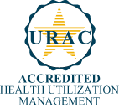
INETICO is a Proud Partner, Providing the most cutting edge technology and breakthrough Clinical Risk Mitigation Solutions in the Industry today.
Full service medical cost containment solutions company
Based in Tampa, Florida
Founded in 2004
Over 55 employees/multi-locations
URAC accredited for:
Utilization Review
Case Management
Disease Management
Single platform, integrated services
Serving over 700,000+ health plan participants
Partnering with TPAs, Health Plans, Carriers, Consultants & Brokers
URAC Accredited in Utilization Management, Disease Management & Case Management

Slide 2
What is Octane Wellness?
A wellness program designed to identify the health status of your members.
Delivers the tools to educate, create awareness and behavior changes that improve their health and productivity.
Includes telephonic and online Wellness Coaching tools to address pre-chronic conditions.
Offers Disease Management to provide tools to assist high risk members identified with chronic conditions.
Provides aggregate de-identified reports that enable employers to track participation and associated incentive programs.

Slide 3
Risk Mitigation Model
Wellness Process
PREVENTATIVE
CONCURRENT
RETROSPECTIVE
CHRONIC ILLNESS COMPLIANCE
RISK MITIGATION
CARE MANAGEMENT
CLAIMS MANAGEMENT
Wellness
DM
UM,CM,
DM
PPO
MACB2
$0 COPAY
MAINTAINENCE
MEDICATION
ANS
PRE-NOTE
CATASTROPHIC
PAR3

Slide 4
Program Components
“OCTANE’s establishes communication between your members and their health give them a clear picture of their wellness baseline while matching realistic goals to meet their individual needs”.
OCTANE’s Process of Communication
Program Initiation
On-Site Education 2X Annually
and Remote Support
Program Maintenance
Member Information Materials Distributed
Establish Web Portal & On-site Biometrics
Baselining of Wellness Indicators
Distribution of Member Results
Executive Analysis Provided & Reviewed
Remote Support by Wellness Coordinator
Physician
Coordination for at-risk Members
Customer Annual Planning Reevaluation
Accountability and Support
Metrics Based Performance Improvement
Customer Service
Wellness Indicators of Focus (Using Comprehensive Metabolic Panel):
Program Success Factors
Self Reported |  | Biometrics
Absenteeism Exercise Tobacco Alcohol Stress | Nutrition Preventative Medical Screening | BP BMI Cardiac Thyroid Kidney | Bone Pancreas Liver Waist Circumference
Early identification of impending Risk Factors
Synergy w/ Employer Wellness Programs
Physician Coordination
Outcome Metrics focus

Slide 5
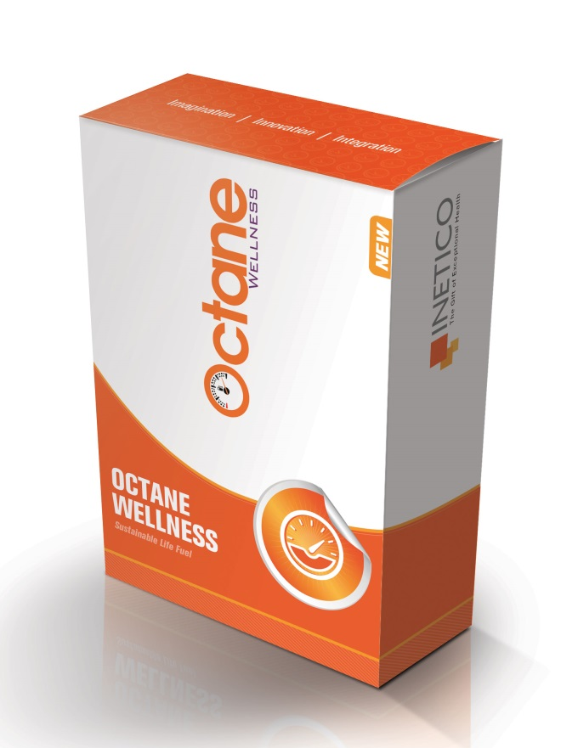
OUR STRATEGIC APPROACH IS TAILORED TO YOUR NEEDS.
Octane’s strategic, three-step design helps organizations control healthcare costs, increase employee productivity, reduce absenteeism and create sustainable results.
Our Proven Model For Effective Change Includes:
Evaluate
Comprehensive testing and assessment of health risks among total employee population.
2. Engage
Customizable incentive programs designed to create positive behavior change that leads to improved health.
3. Manage
Integrated reporting, tracking and trend analysis of corporate and individual activities and results.

Slide 6
Octane’s target Focus
Targeted Risk Mitigation
Targeted Focus
Primary Target Market
“Prevention”
Early Intervention
At Risk Cardiac, Respiratory, Pre-Diabetic, Obese, Smokers, Etc.
Recent MI, Stroke, etc
Current Rehab patients
Concurrent Intervention:
At Risk and either don’t know it or haven’t acknowledged it
INETICO
DM
INETICO
CM
High
Acute Care/ Current Event
Very High Risk
Moderate
Risk
Current or Recent MI or other significant health event
Restricted from Exercise for any reason
Established CV Disease, Diabetes, etc.
History
May have had an event
Significant issues indicating high likelihood of an event
Low Risk
Elevated Health indicators
Likely on Medication
Severity of Illness/Risk of Negative Health Outcomes
Healthy
Young
History of Heart Disease or other Chronic Conditions
Young
Active
No History
Low
0%
100%
Percent of Patient Population

Slide 7
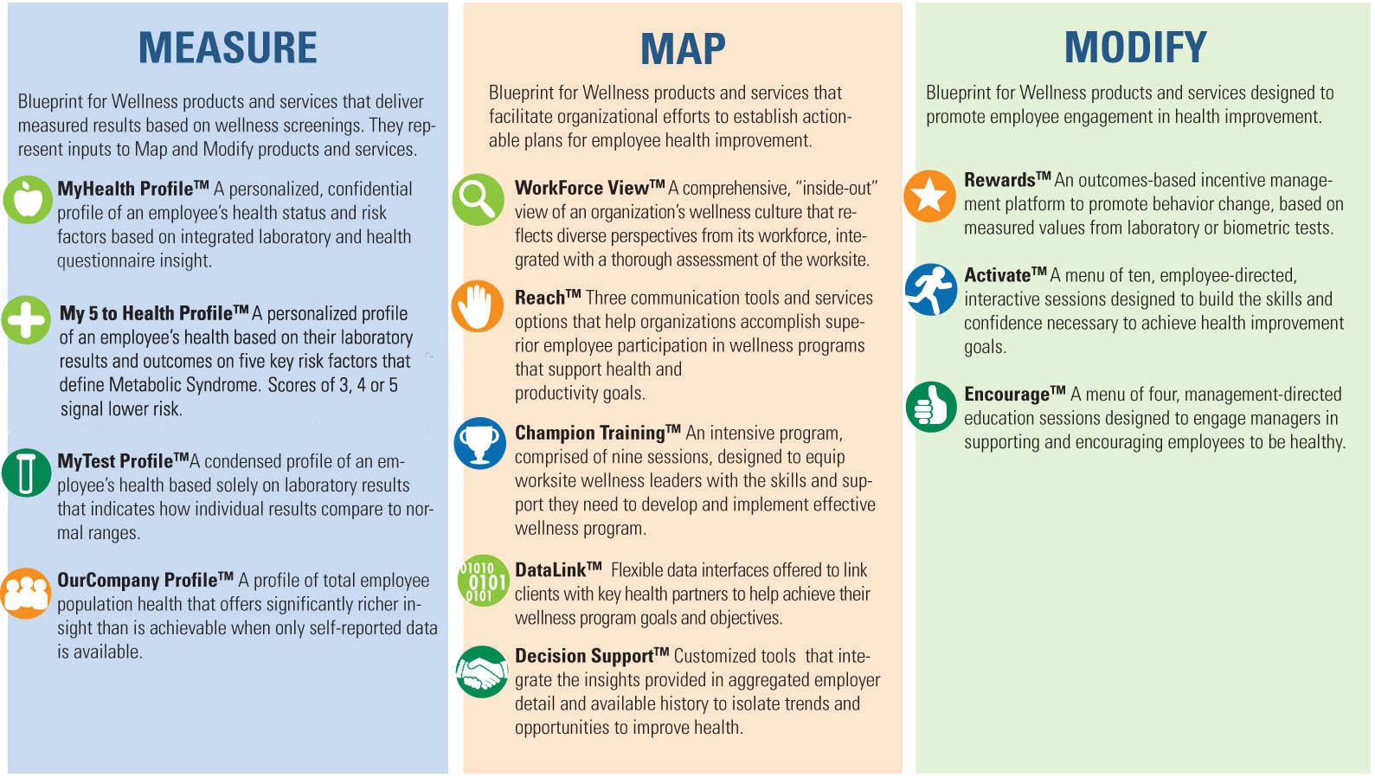
Focus on Metrics and Improvement
Biometric screenings and what employers need
in-between to achieve measurable improvement
Notes:
We focus on metrics and improvement across all three service categories that cover screenings - highly objective measures of health – to insights, tools tactics employers can use between screenings to achieve measured improvement. Which ones are chosen, and how they are employed will determine the way and the speed that you want to pursue that improvement.
This chart highlights the different ways Blueprint for Wellness can support your efforts to more actively and effectively engage your employees in health improvement. (Isolate a service in each category and communicate the value it adds.)

Slide 8
Screenings are the Foundation
Close the gap in missing laboratory and claims data
Add objectivity to health risk identification and wellness stratification
Provide evidence-based insights that drive targeted health improvement
Establish 2,000+ Patient Service Centers (PSCs) nationwide a baseline and tracking for employees’ “measured” values
Notes:
Screenings offer substantial and unique value to wellness initiatives. Once part of organizations’ benefits mix, it quickly becomes clear that they are truly “foundational”. They help capture, and contribute to the benefit derived from other health improvement initiatives.
First, they close the gap in missing laboratory and claims data.
They also bring objectivity to health risk identification and wellness stratification.
They provide an outstanding source of evidence-based insights that companies can use to drive targeted, actionable health improvement.
And very importantly they establish a baseline of “measured” values that employees can use to track their progress over time, just as they do for employers on an aggregated basis.

Slide 9
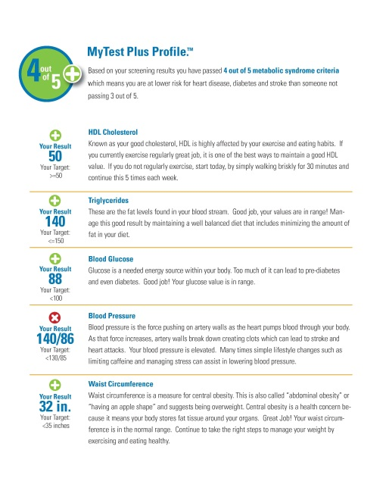
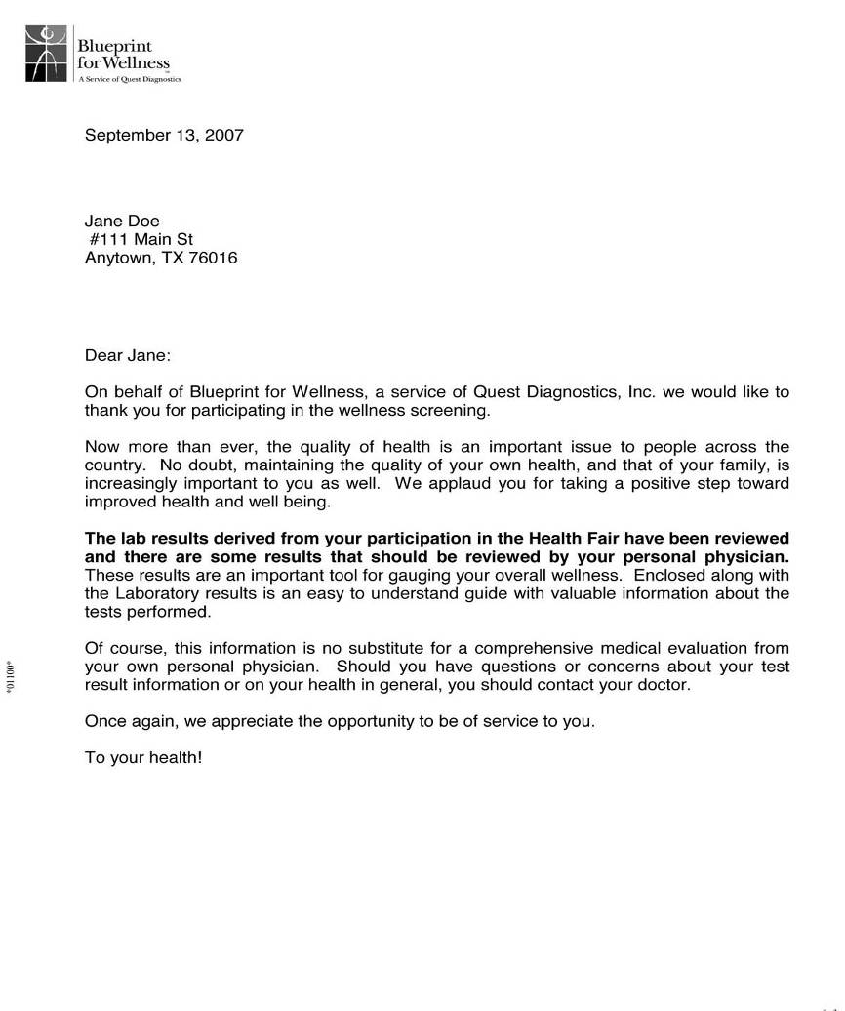
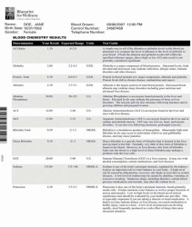
Introducing “My 5 to Health Profile”
New!
My 5 to Health Profile™
with Metabolic Syndrome insight
Personalized 8-page participant report
Introduces participant to Metabolic Syndrome risk factors and calculated score based on American Heart Association guidelines
Builds health literacy and flags abnormal results
Dynamic, 4-color printed report, and online printer-friendly report**
Online version features prior year results to provide historical trending*
Features full-color physician tear-out summary page and encourages coordination of care with physician
* for employers who repeat screenings with Quest Diagnostics
MyTest Profile™
Reports labs and biometric measurements
Paper and online (color)**
Notes:
Here is our newest personalized Profile, the “My 5 to Health Profile”. We recommend this high-impact solution for organizations that want to share insights with their participants, but don’t want to use our Health Questionnaire (HRA). This solution seizes participants’ “moment of impact” when they see their screening results, and are most open to learning, and making a decision to take action to improve their health.
Like the MyHealth Profile this report communicates participants’ test values and whether they are in range of target values used to determine their risk of Metabolic Profile. Insight to an individual’s risk of Metabolic Syndrome is gained through the interaction of five risk factors and how each compares to a corresponding target value.
The My 5 to Health Profile is 8 pages and includes a personalized introductory letter, the Metabolic Syndrome scoring page, and several pages of individual test results that indicate where they fall within a reference range, and explanations regarding them.
The online version also provides historical scores where applicable.
Like the MyHealth Profile, the My 5 to Health Profile features a tear-out page located in the back that participants are encouraged to share with their physicians.
The MyTest Profile is available for participants that complete biometrics and screenings, without our Health Questionnaire. It does not provide insight to participants’ risk of Metabolic Syndrome. MyTest Profile is also available in paper and online formats. The online MyTest Profile is presented in full-color; the paper version is black and white.

Slide 10
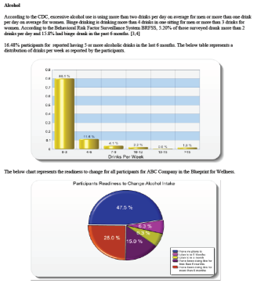
Your Company Profile
Aggregate report summarizes participant results and identifies health risks
Integrates responses from laboratory testing, biometrics and health questionnaire
Analysis of work group results enables targeted follow-up and program planning
Results delivered securely to health plans and other 3rd parties electronically
Can provide normative comparisons* and includes Intervention Opportunity Index for top risk factors
Prevalence
Readiness to change
Cost exposure
Notes:
Employers also receive aggregated insights regarding the health of their populations via the OurCompany Profile.
OurCompany Profile integrates data points from lab testing, biometrics and health questionnaires.
Where more than 40 participants exist, reporting can be completed at more granular levels, for example, by work group, shift, or location.
At Client’s direction, results can be delivered securely to health plans and other 3rd parties electronically to facilitate program planning.
We can also provide normative comparisons* which include an Intervention Opportunity Index for the top risk factors.

Slide 11
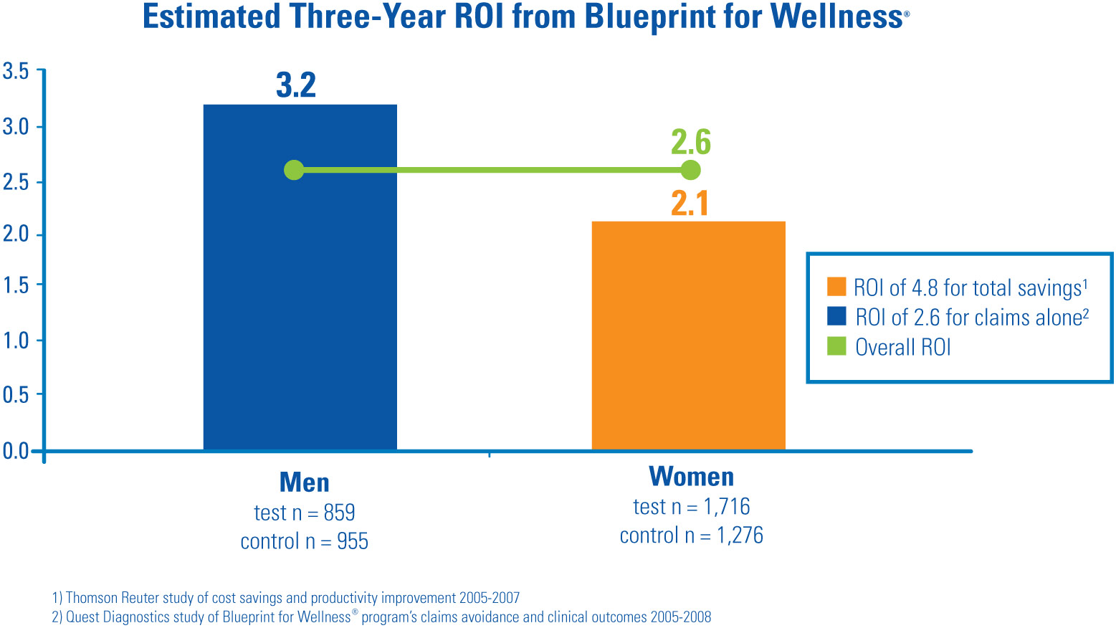
Positive Return on the Individual
Collecting and sharing laboratory data and health measures generates a positive return on investment
Notes:
Blueprint for Wellness screening and reporting generated a positive return for the company and its people. We call it, “Return on the Individual”. In a study conducted with employees of Quest Diagnostics who consistently participated in Blueprint for Wellness over four years vs. a matched control group that did not over the same four years, showed an overall return for 2.6, or $2.60 for every $1.00 invested in the screenings.
The ROI was mainly achieved through lower increases in medical claims for older participants (over 45 years old).
The net ROI is negative for younger aged participants (under 45 years old). It is possible that there are long-term benefits for younger enrollees that have not been captured in this limited 4 year study, such as preventive screenings and more health behaviors.
The study also showed that Blueprint for Wellness is a rich source of information that can help employers better manage their health risks.
About 50% of the participants who measured out-of-range (for a particular test) in their first year showed improvements (e.g. returned to normal) in subsequent years.
The population as a whole seems to have heightened sensitivity to health risks, and showed improvements in many health behaviors and attitudes over the four years.
The information can also be used in HIPAA-compliant ways to better identify targets for intervention programs.

Slide 12
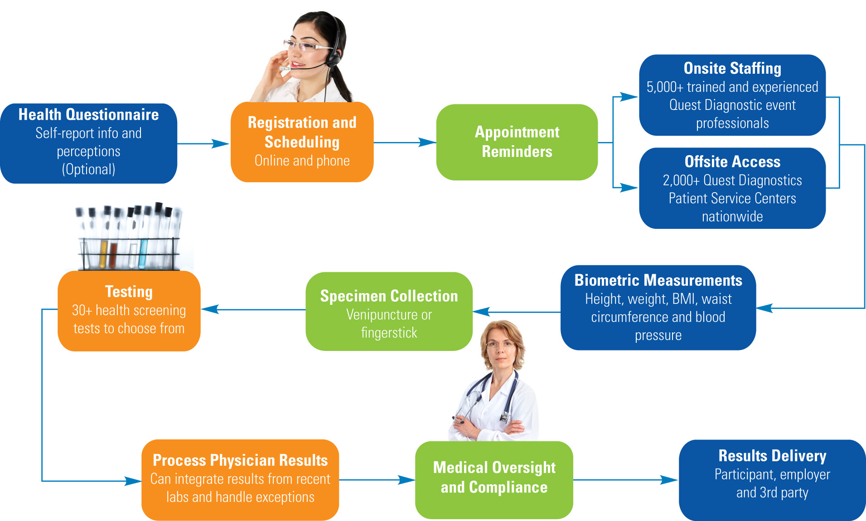
We Manage the Entire Program
Complete Support from Screening to Results
Notes:
When you deal with Quest Diagnostics you deal with a capable and experienced team that will reduce the burden on you, and optimize your experience and your employees’ experience. We manage the entire program from screening through resulting.

Slide 13
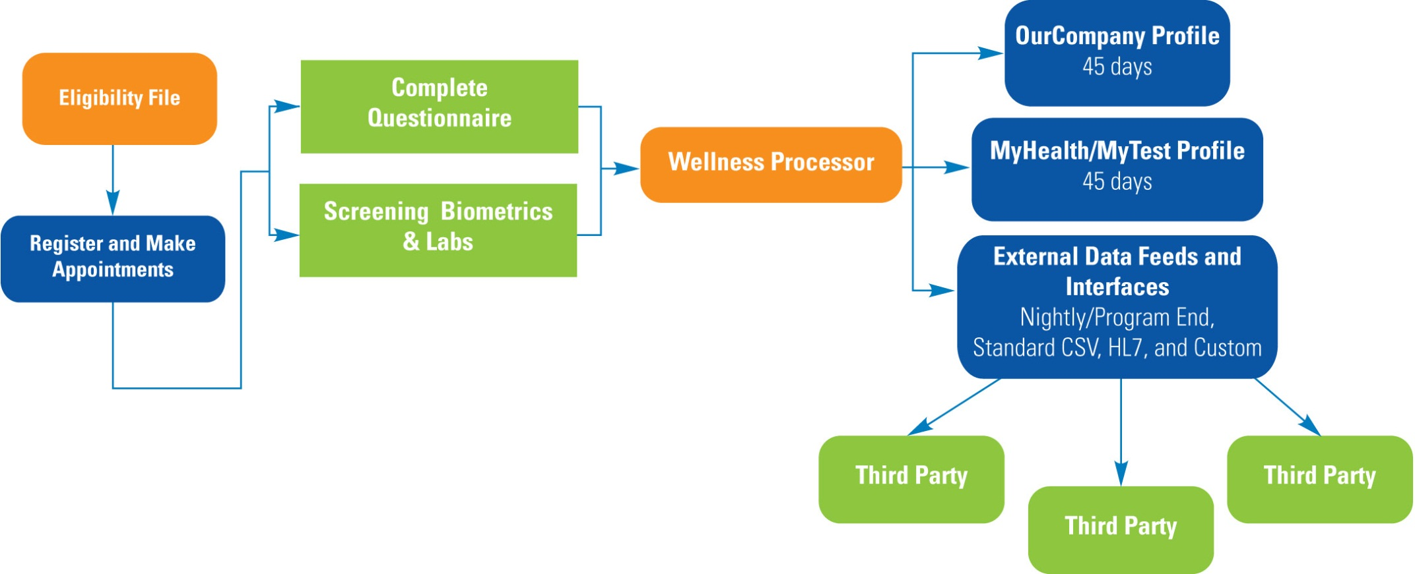
Fully-Integrated Data Flows Securely
Notes:
Our systems and processes are fully integrated, so data flows securely throughout the process to its designated end users – the employer, individual employees, and if you wish, to authorized 3rd parties that can include health plans and health partners who benefit from the ability to target their services effectively.

Slide 14
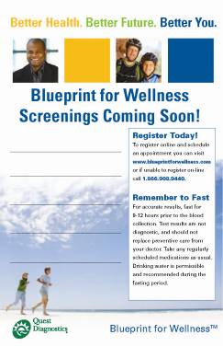
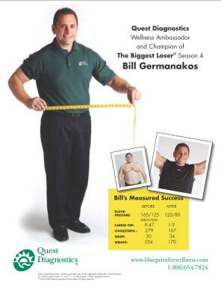
Participation is Critical
Communications consultation with each client
Review of key consumer communications
Provide core marketing templates at no additional cost
Posters
Email call-outs
Letter
Stuffers
Provide experienced guidance on incentives
Plus and premium service packages available at minimal cost add customization
Date: [Tuesday, Month, xx] Time: [7:30a.m. – 11:30a.m.] Where: [Conference Room xx]
Notes:
You’ve heard me say several times that screenings are the foundation of an effective and successful wellness program.
This fact makes a specific effort around driving employees to participate in screening events as important as planning the events themselves. If employees don’t screen, they miss the opportunity to receive objective, evidence-based insights that can be a stimulus for taking action.
When employers have strong participation the information they receive is powerful, decisions that need to be made among alternatives to drive improvement are more clear, and the overall return to the employer and its employees are optimized.
For these reasons we offer counsel and assistance to help drive participation through a service we call “Reach”.
Each Blueprint for Wellness client receives the benefit of a Communications consultation with an experienced Marketing team member, and complimentary access to a diverse number of marketing templates they can use to customize their employee communications.
They will also receive guidance on incentive values, an area of growing interest to employers where we have conducted research and will bring value-adding expertise.
As we come to understand your objectives and the resources and plans you have to address them, we can also discuss additional opportunities to drive participation through the utilization of marketing tools provided in our “Reach Plus” and “Reach Premium” service packages. These can include direct mailings to employees’ homes to promote participation among spouses, new wellness program and logo development, participation promotions, and video development.
The key takeaways here are: Participation is essential to your program’s success, and that we have significant experience, and can help you accomplish your goals.

Slide 15
Rewards Drive Health Improvement
Reward help employers engage employees in their health by establishing attainable goals and rewarding those who reach them
Database Participation
Cohort: N = 85,646
Outcomes Program Cohort:
N = 9,062
Notes:
The below chart shows the rate change (percent of participants moving from an out of range to an in range status) by program type. It is clear that allowing participants to learn their numbers yields positive movement in change, but when outcomes based incentives are added to the screening an even better rate of change is seen.

Slide 16
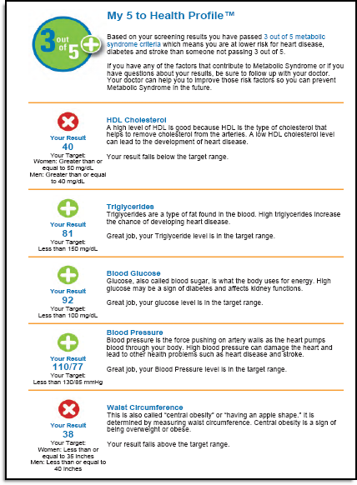
You Choose Measures that Matter
Reward based on screening measures that make sense to your employees
Choose from 15 different measures to incent − individually or in combination
Metabolic Syndrome* is a smart choice backed by science with familiar measures including BMI, Blood Pressure, Glucose, Triglycerides and HDL Cholesterol
* offered in our My5 to Health report
Outcomes-based Options
Blood Pressure
BMI
Cholesterol/HDLC Ratio
Cholesterol
Cotinine
Glucose
HDL Cholesterol
Hemoglobin A1c
LDL Cholesterol
Triglycerides
Weight
Waist/Hip Ratio
Waist Circumference
Hip Circumference
Whole Blood Non-HDL

Slide 17
member engagement and participation/compliance
Increase AWARENESS of INETICO/CARE at Plan level:
Work with HR Dept to fully understand the benefit of positive DM outcomes that result from member participation
Work with Plan Members to help them become familiar with INETICARE
Utilization / Case / Disease Management Brochure
Worksite Posters
Health Fairs and New Employee Orientations
Payroll Flyers or statements on paystubs promoting INETICO / INETICARE
Routine communications from HR to employees regarding benefits
Incentivize program candidates to engage and participate
$0 Copay Incentive Program for maintenance medications

Slide 18
The Gift of Exceptional Health
Thank You!
“We look forward to working with you!”

