Slide 1
Caring Through Crisis:
How New York Presbyterian is Supporting Employees During Covid-19 With Care & Learning as a Benefit
Location:
NYC and Westchester
Employees:
50,000
Industry:
Hospitals & Healthcare
CONFIDENTIAL: NOT FOR EXTERNAL DISTRIBUTION

Slide 2
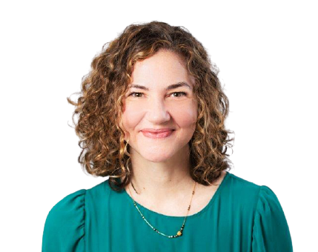
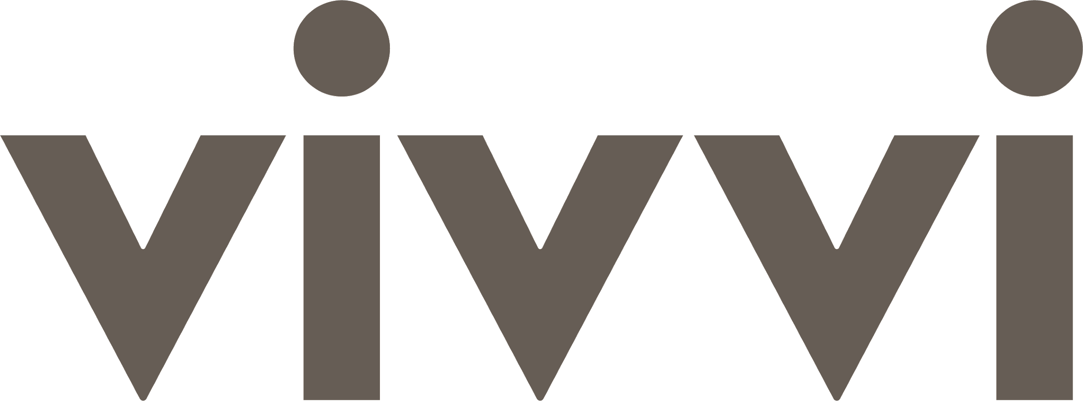
Challenge Support essential working parents through COVID crisis
Solution A comprehensive, multi-faceted childcare and learning program
When the COVID-19 pandemic hit New York, NYP required an immediate solution that maximized its employees’ availability to serve on the frontlines. As hospital workers continued to fight the pandemic, they struggled to find stability at home due to school closures and inadequate remote learning environments.
NYP needed an offering that was:
Reliable and expansive so that parents had predictability to take on hospital shifts, including weekends and holidays
Designed with rigorous health & safety protocols
Convenient and easy for parents to access
Scalable, allowing for 10x parents to participate in the benefit within 7 months.
Vivvi partnered with NYP’s HR, Benefits, and Employee Recognition teams to provide high quality childcare and education so that healthcare workers were available physically and emotionally to serve on the front lines.
The solution that Vivvi and NYP implemented included:
Fully subsidized emergency on campus backup care 7 days a week
A customized Summer Camp program for children ages 6 to 14 at NYP’s Westchester campus, including round-trip transportation from 6 pick-up locations
Weekly Virtual tutoring for over 1,000 children ages 5-18
“Vivvi was incredibly responsive to our organization’s needs during various periods of the pandemic and worked with us to scale our programs quickly and safely. Through the partnership, our frontline workers were able to care for patients without disruption, and our employees feel respected and appreciated for the work they do, allowing them to bring their best selves to work.”
Britt Sinha, Corporate Director of Benefits, Health & Well-Being
CONFIDENTIAL: NOT FOR EXTERNAL DISTRIBUTION

Slide 3
Program Timeline
Vivvi hosts 19,541 tutoring sessions by Spring Semester end
NYC declares a State of Emergency
NYP requests a summer camp at its Westchester campus
Last day of Vivvi Summer Camp
March 31, 2020
July 6, 2020
September 1, 2020
December 23, 2020
August 15, 2021
March 12, 2020
Vivvi Tribeca Campus opens for children of NYP frontline workers
June 3, 2020
First day of Vivvi Summer Camp, serving 97 children
August 14, 2020
NYP requests a Virtual Tutoring program for 1,000 children
Vivvi hosts 5,398 tutoring sessions by the Fall semester end
Vivvi hosts 250 children across two sessions of Vivvi Summer Camp
May 15, 2021
Vivvi quickly built safe and effective programs for NYP’s evolving needs.
Responsive
Within 3 weeks of declaring an emergency, Vivvi was open to serve NYP families
Flexible
Each program was built to fit a unique need for NYP’s people at the right time
Valuable
Vivvi has safely served over 1,000 families, allowing NYP’s employees to show up when they’ve been needed most
CONFIDENTIAL: NOT FOR EXTERNAL DISTRIBUTION

Slide 4
Vivvi Impact
NYP Parents Succeed
When Their Children Do
77%
Less Burnout
78%
Improved Academic Performance
50%
More Loyalty
71%
More Confidence
41%
Increased Safety & Focus at Work
65%
Strong Relationships
21%
More Shifts Covered
35%
Better Time Management
CONFIDENTIAL: NOT FOR EXTERNAL DISTRIBUTION

Slide 5
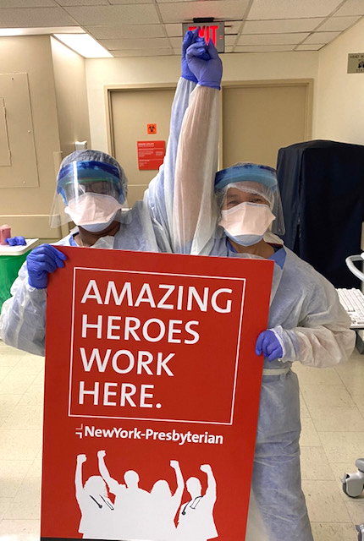
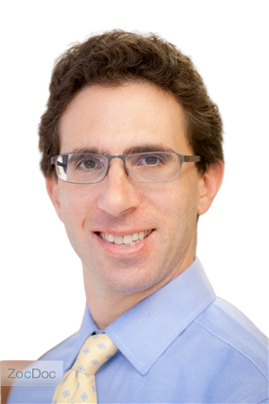
Results
During a time of immense stress for working parents, NYP ensured that its employees’ had access to child care when most centers and schools were shut down. Throughout the summer and the school year, Vivvi provided care and learning that kept NYP parents present and focused at work, less overwhelmed, and more appreciative of their employer.
1,507 Children
15,356 Shifts
0 Cases
97 NPS Score
Served across Vivvi’s programs
Worked by NYP employees
Of COVID-19 during any program
For Vivvi’s virtual tutoring program
“Our family would like to thank the Vivvi staff for their excellent care and teaching. During these difficult months, it helped us both continue our jobs and most importantly, gave our daughter a sense of normalcy. We appreciate Vivvi very much.”
Andrew Bohmart, MD, NYP Dad
CONFIDENTIAL: NOT FOR EXTERNAL DISTRIBUTION

Slide 6
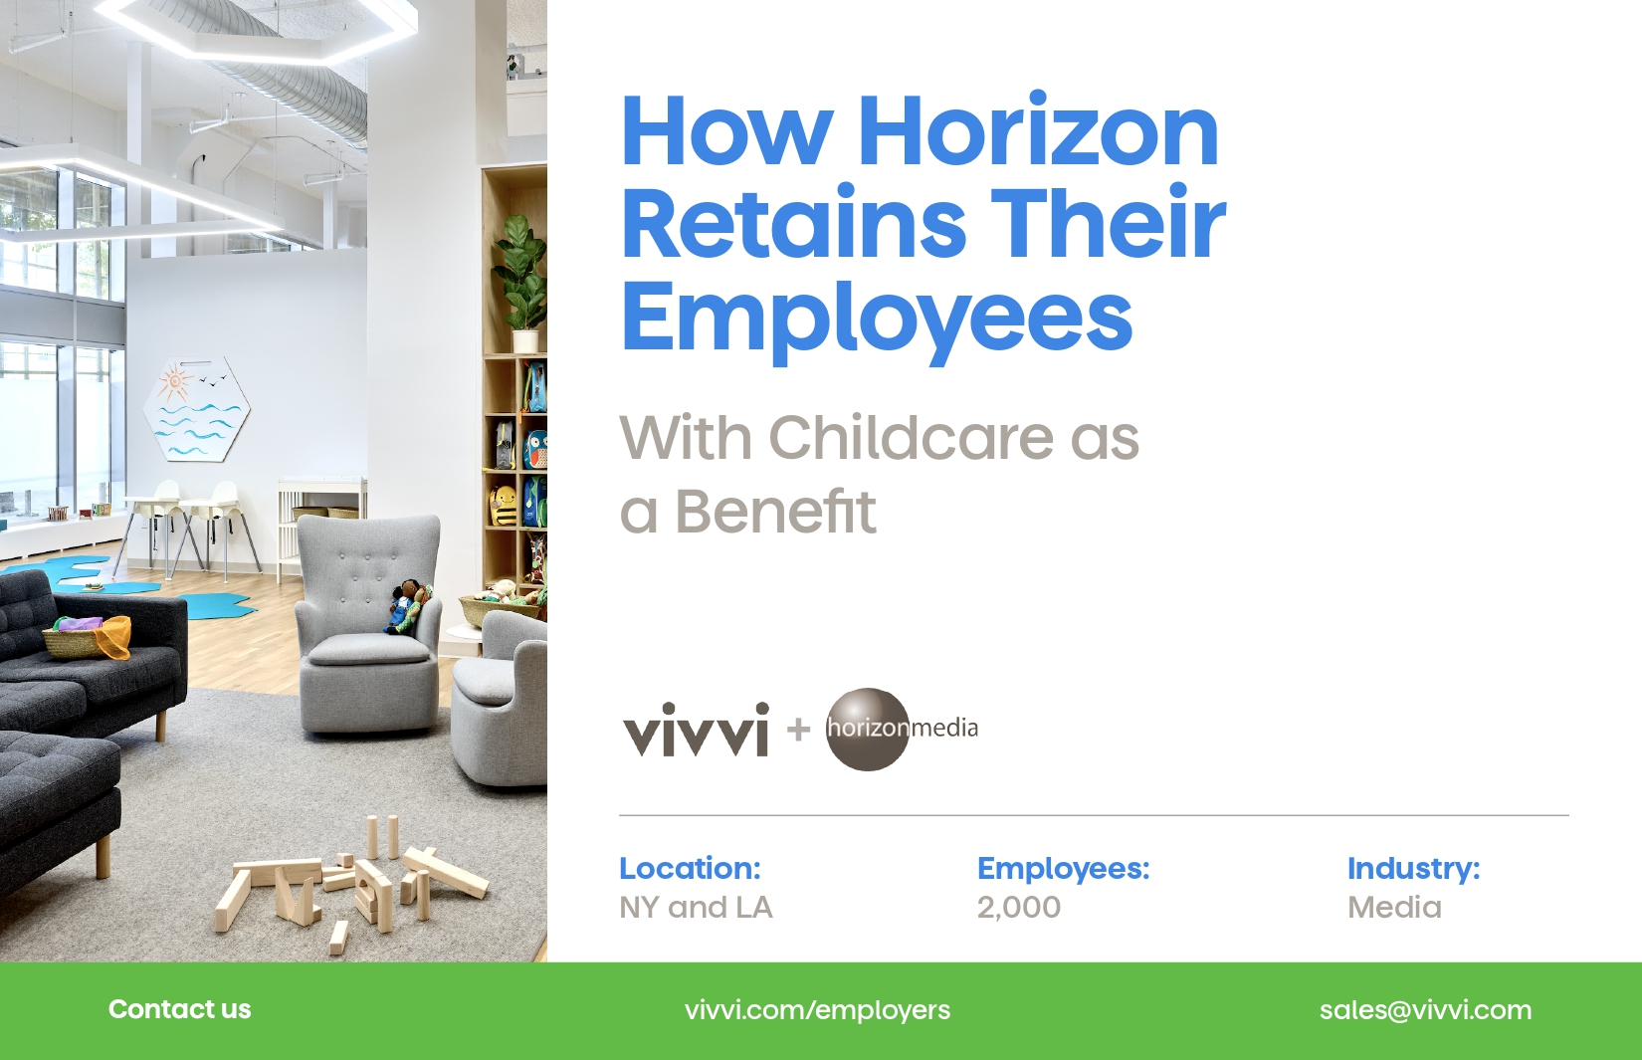

Slide 9
