Slide 1
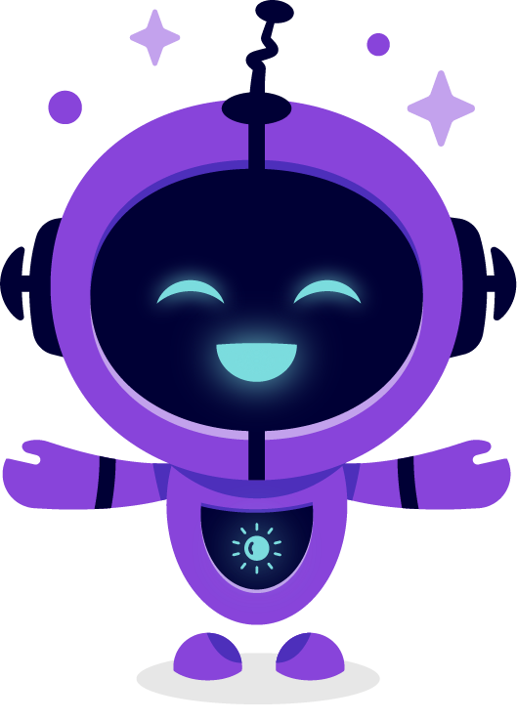

Slide 2
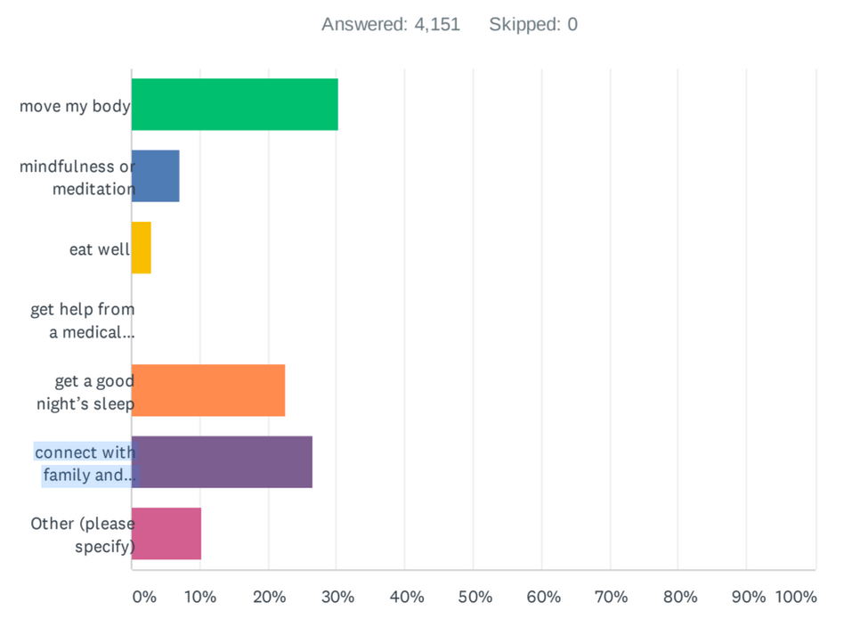
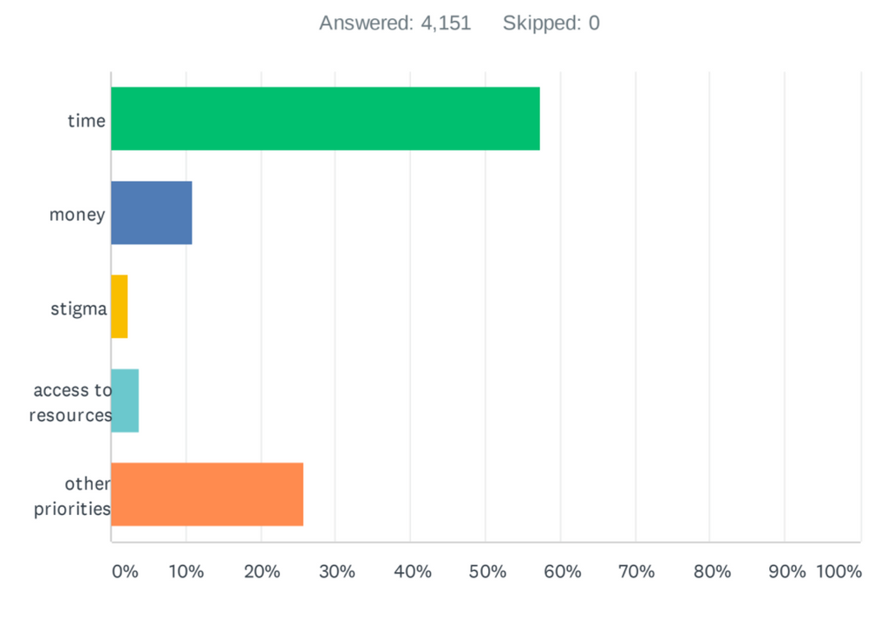
What Improves Your Health?
What is the best way you have found to manage your mental well-being?
What gets in the way of managing your mental well-being?

Slide 3
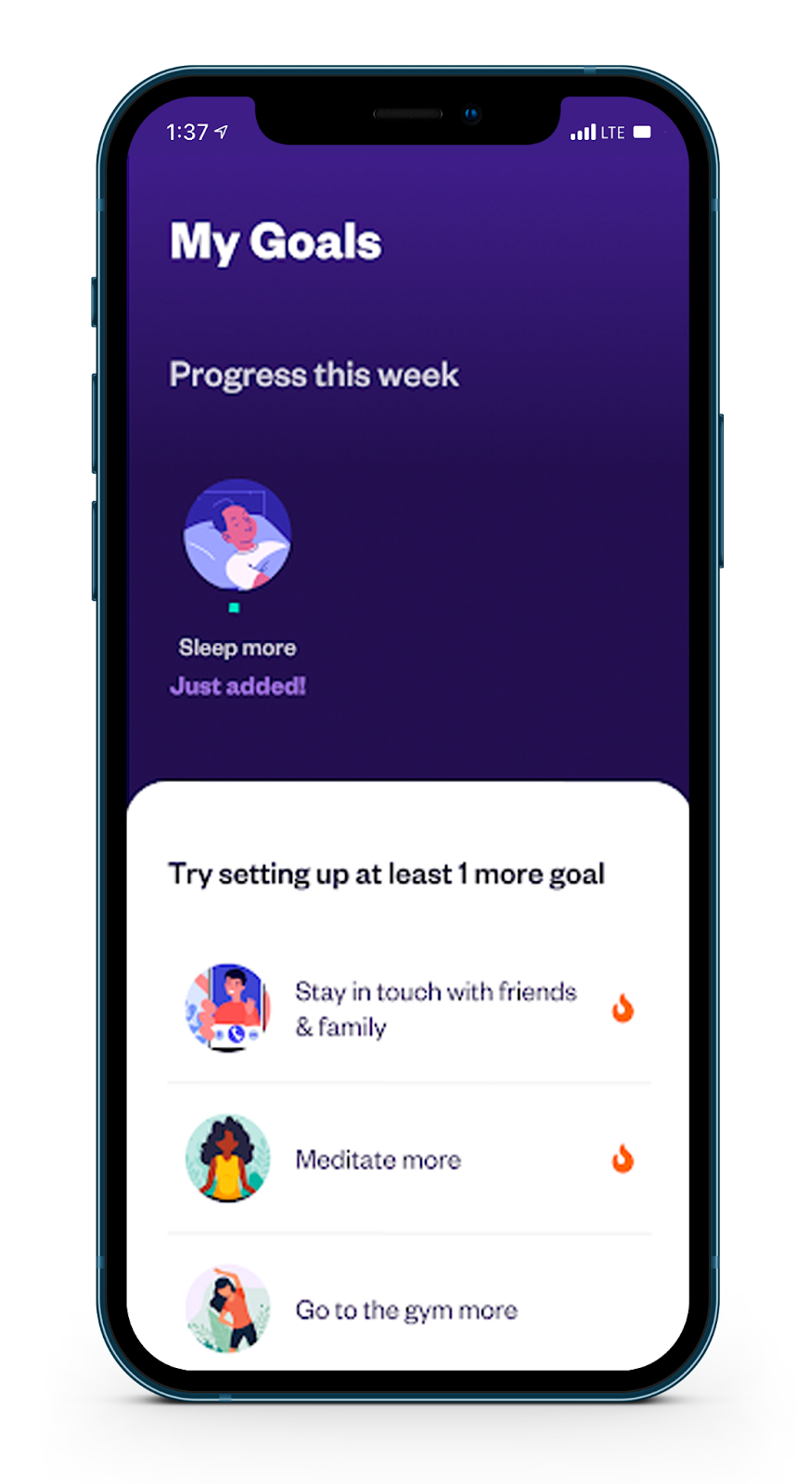
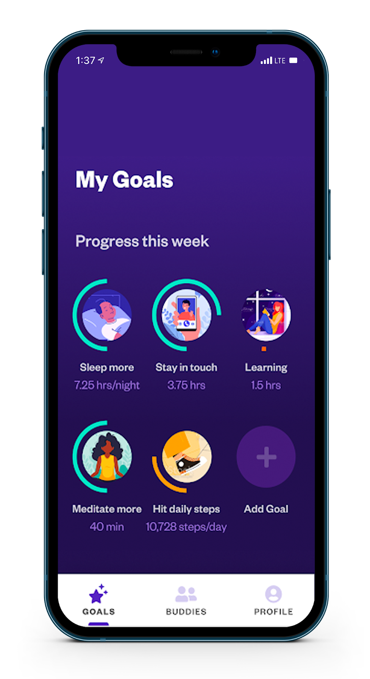
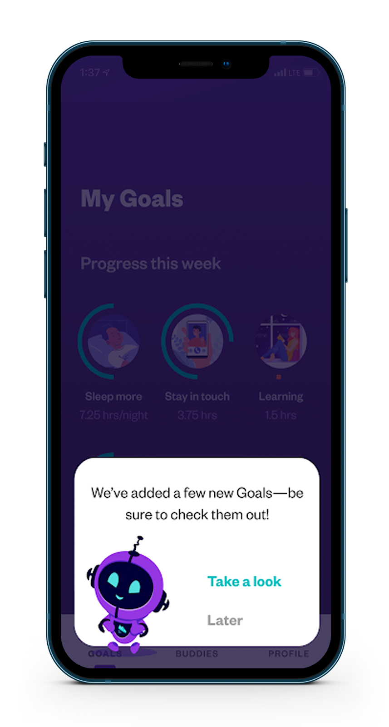
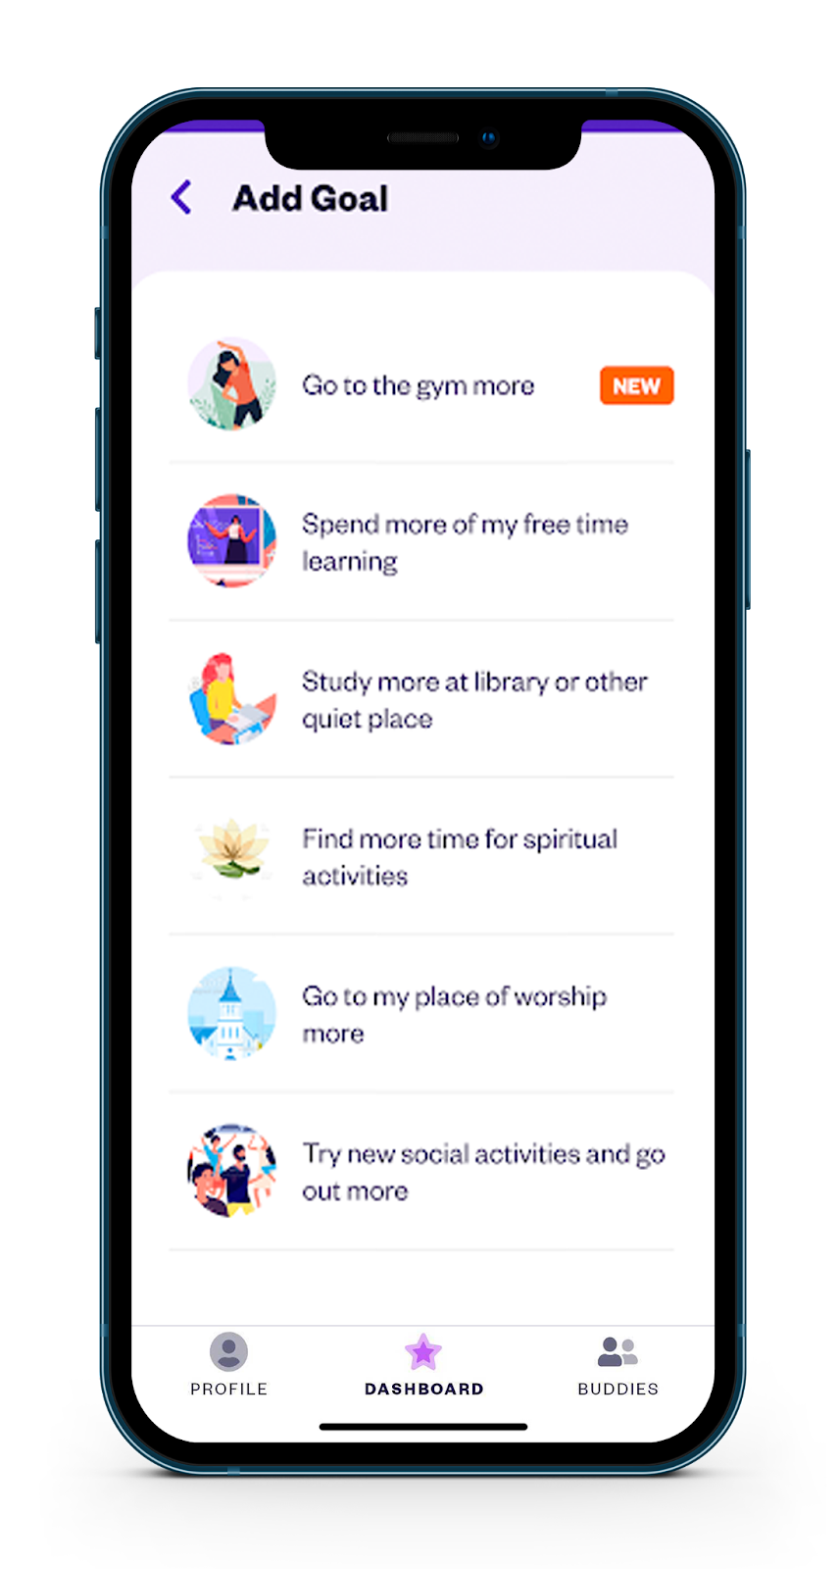
How it works
Notes:
Replace with efficacy slide chart

Slide 4
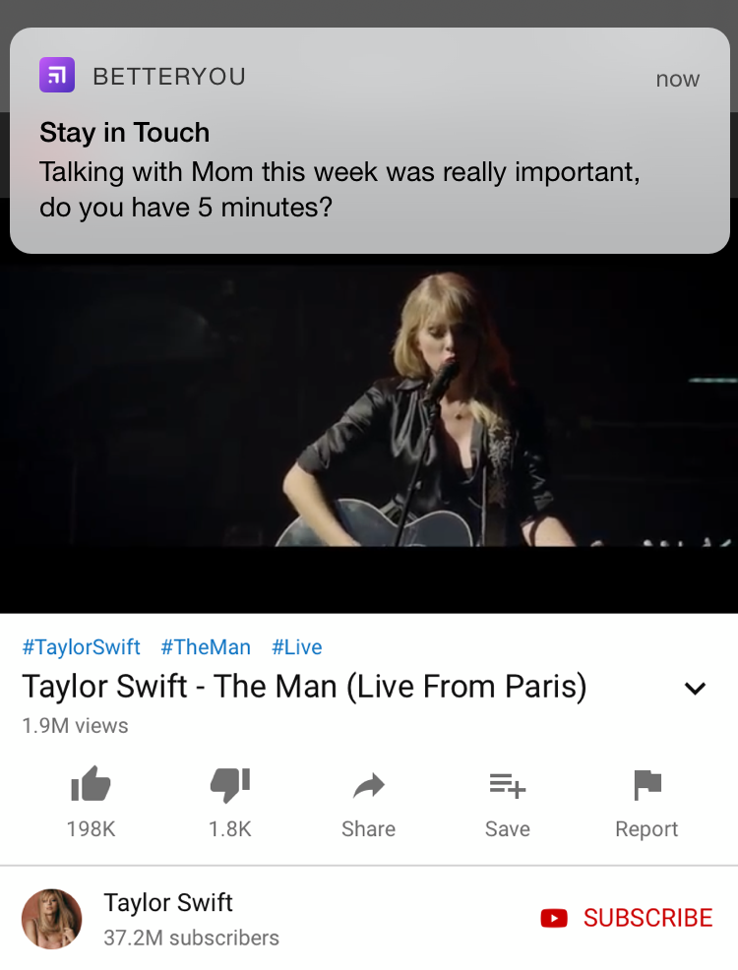
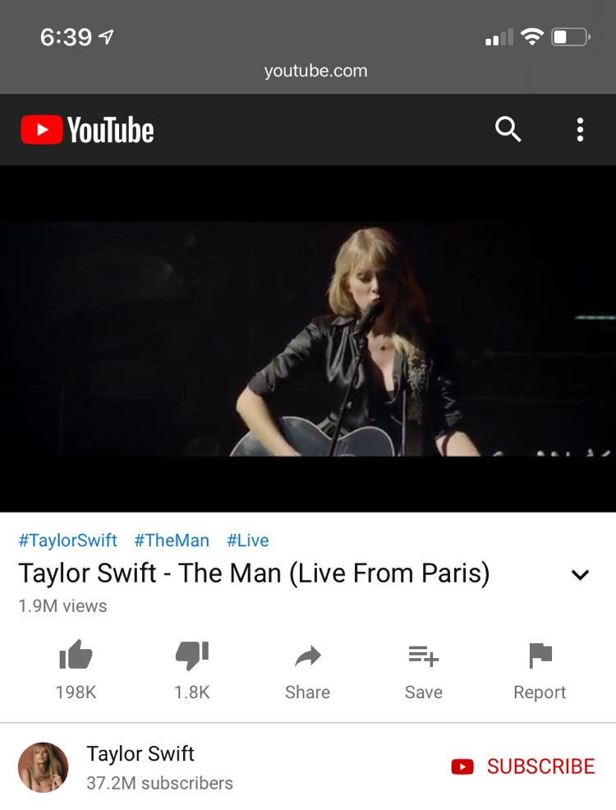

Slide 5
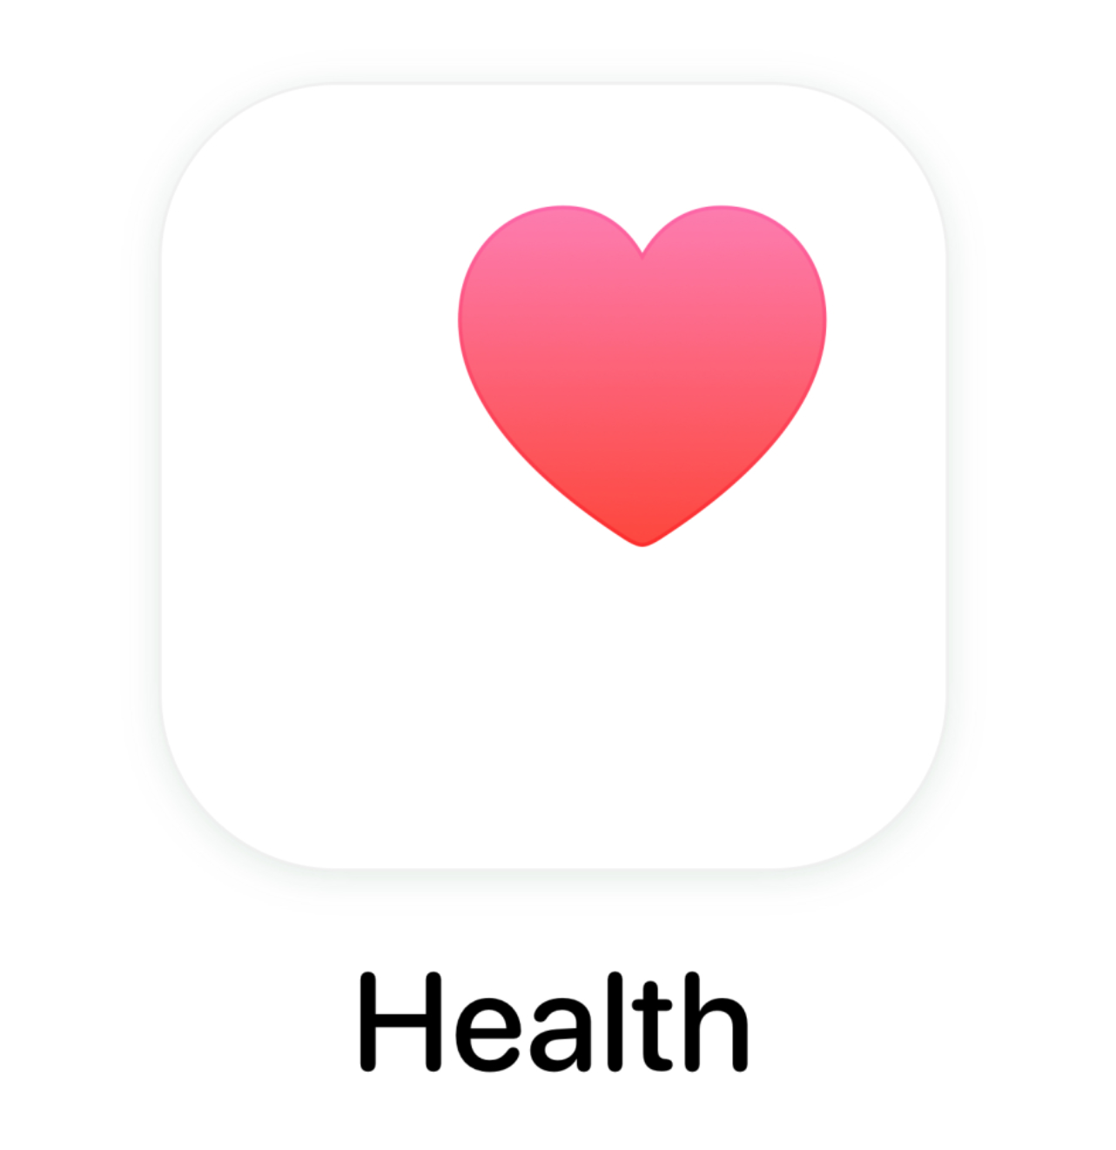
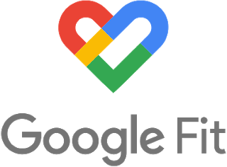
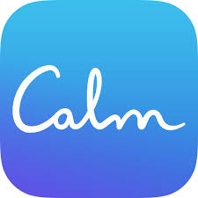
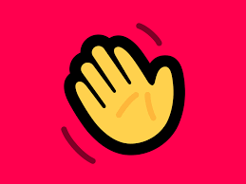
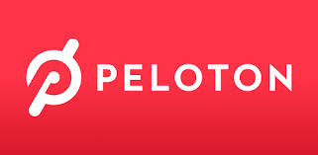
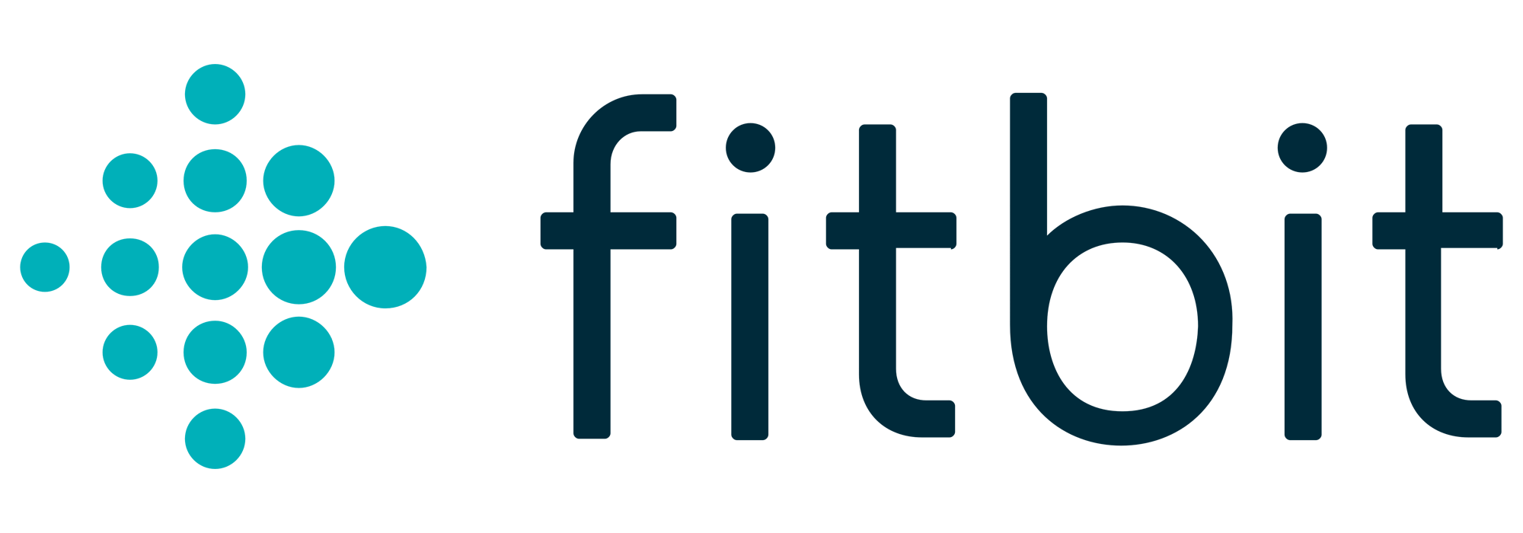
Integrations
BetterYou syncs up with over 10,000 apps. This enables you to get credit for spending time toward your goals in the ways that make sense for you.

Slide 6
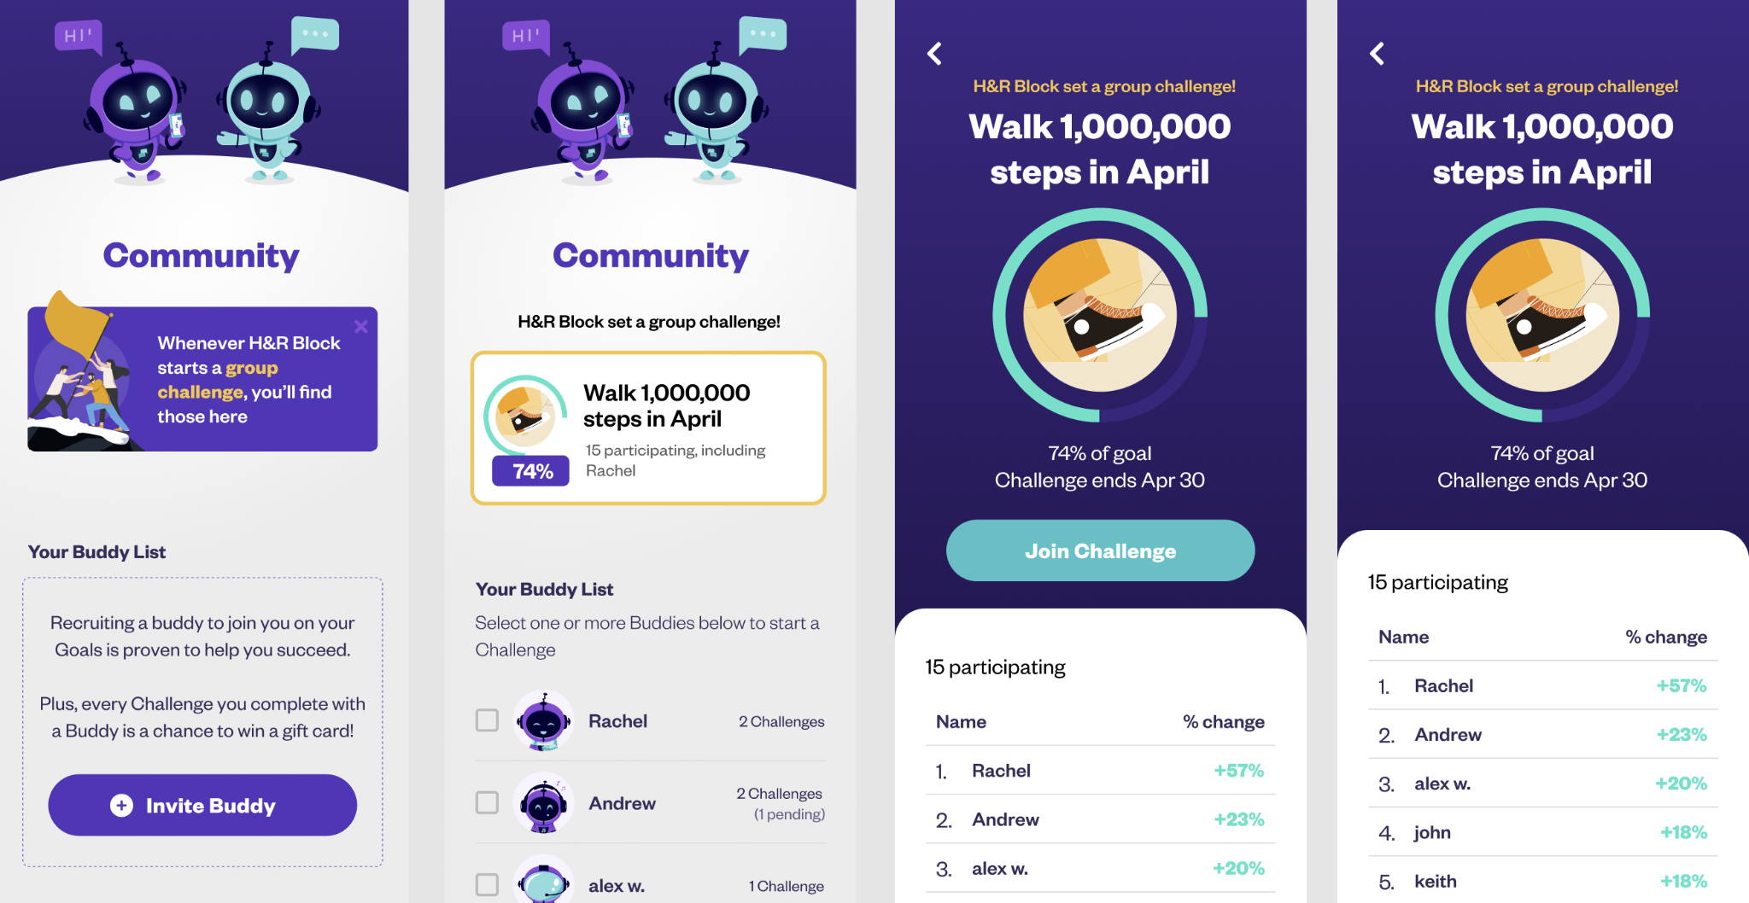
Community Challenges

Slide 7
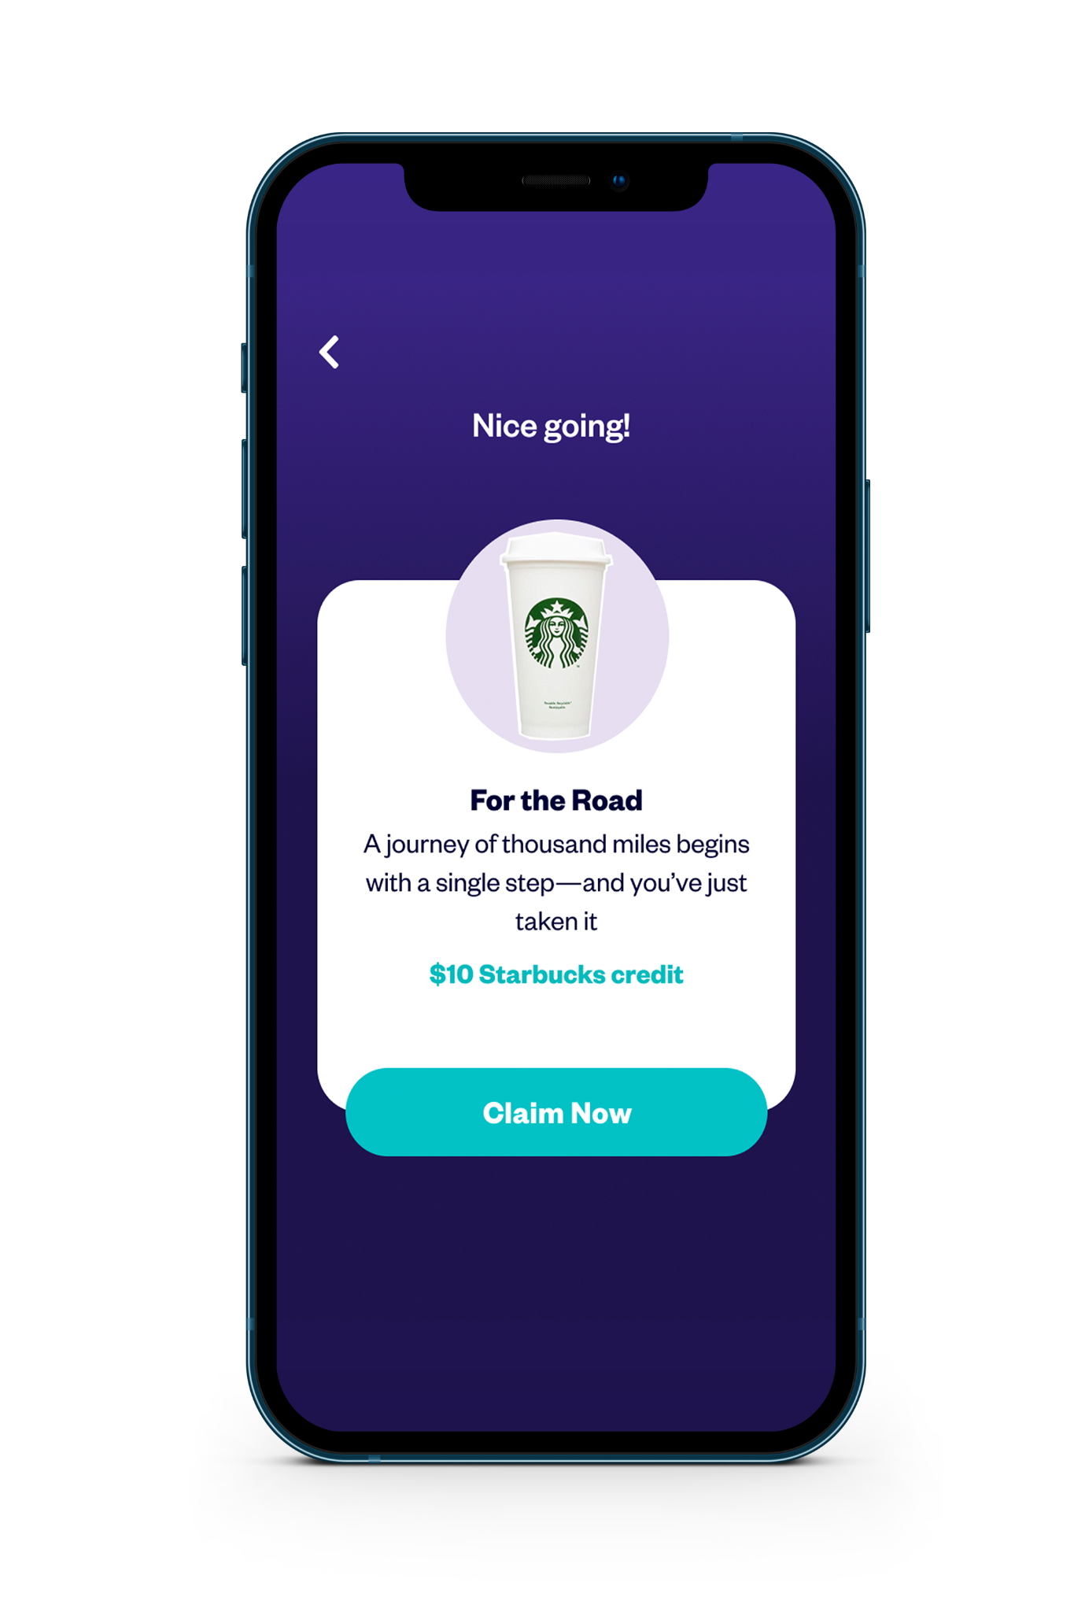
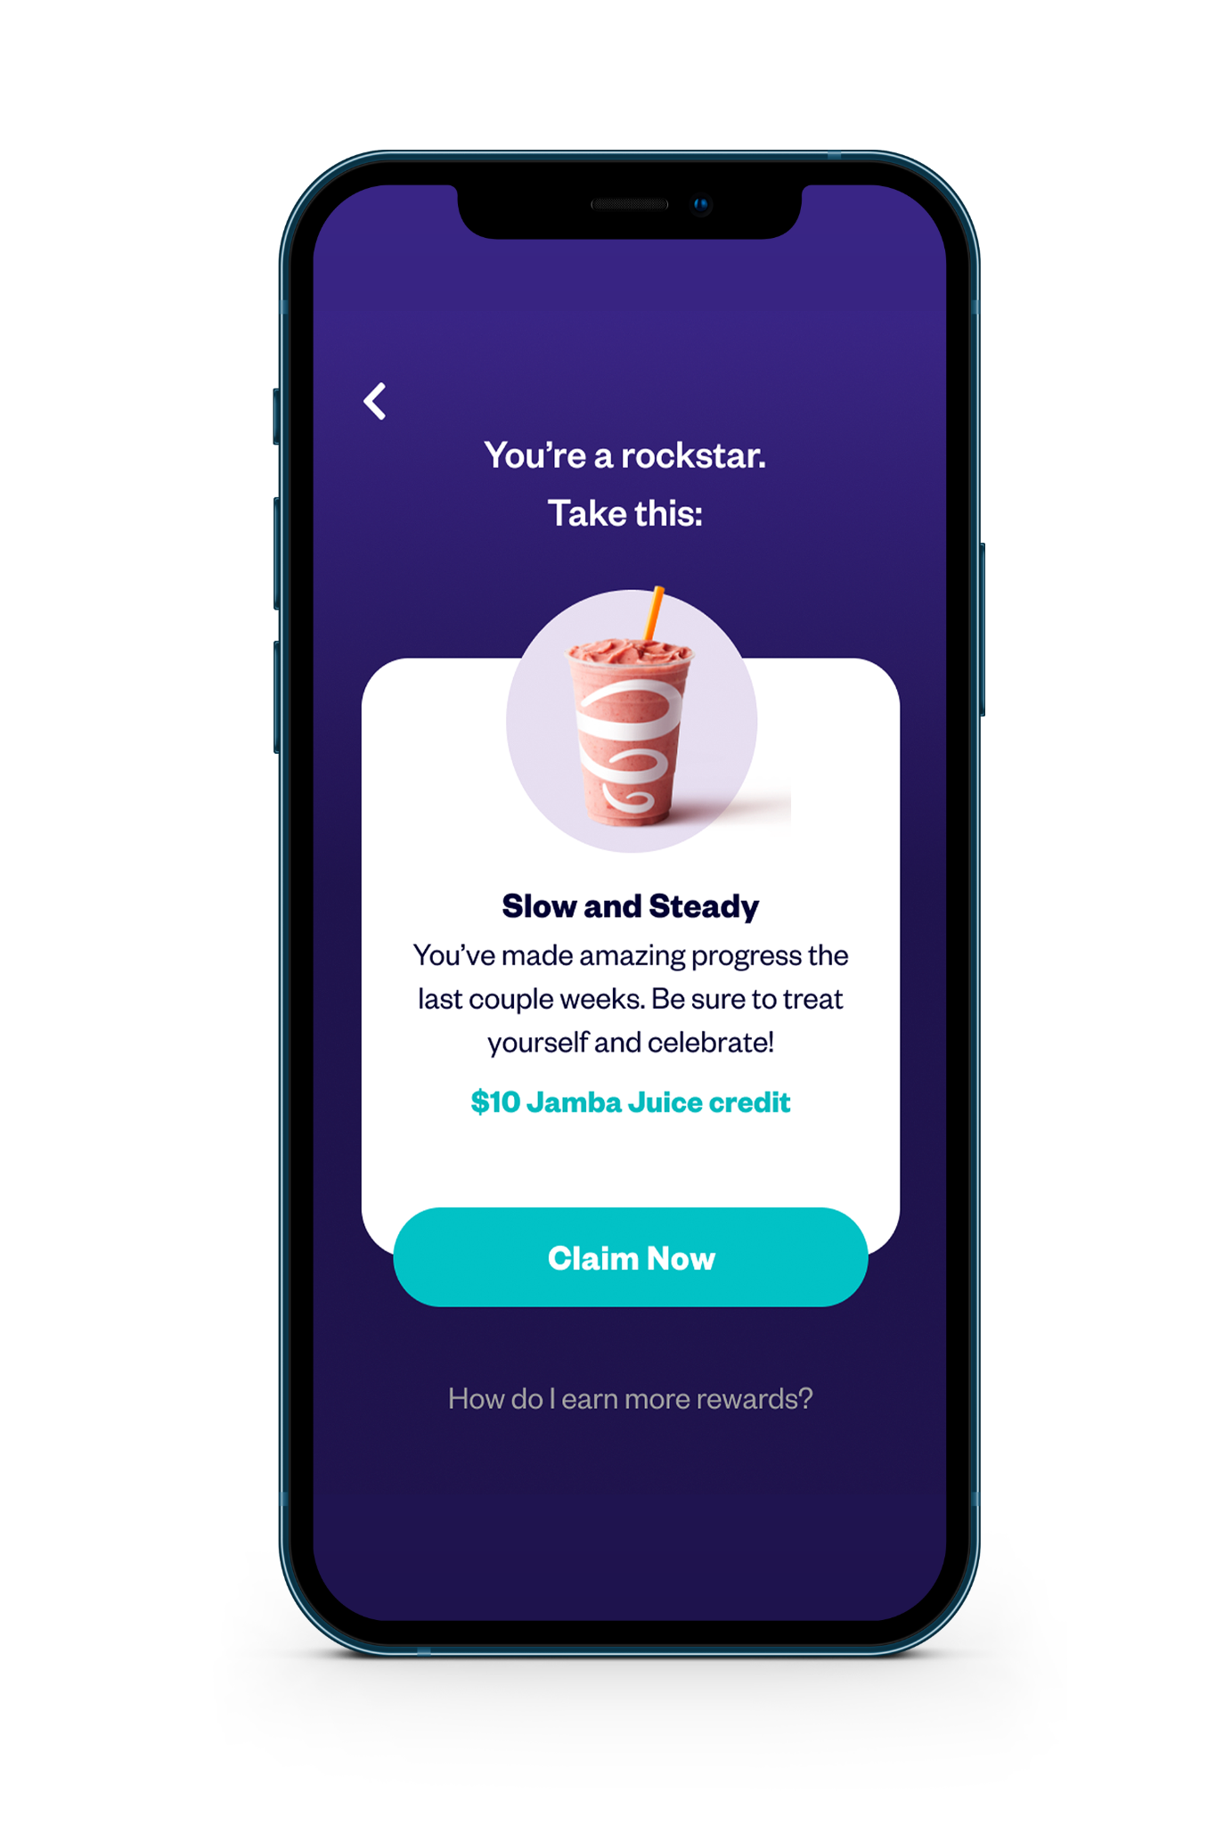
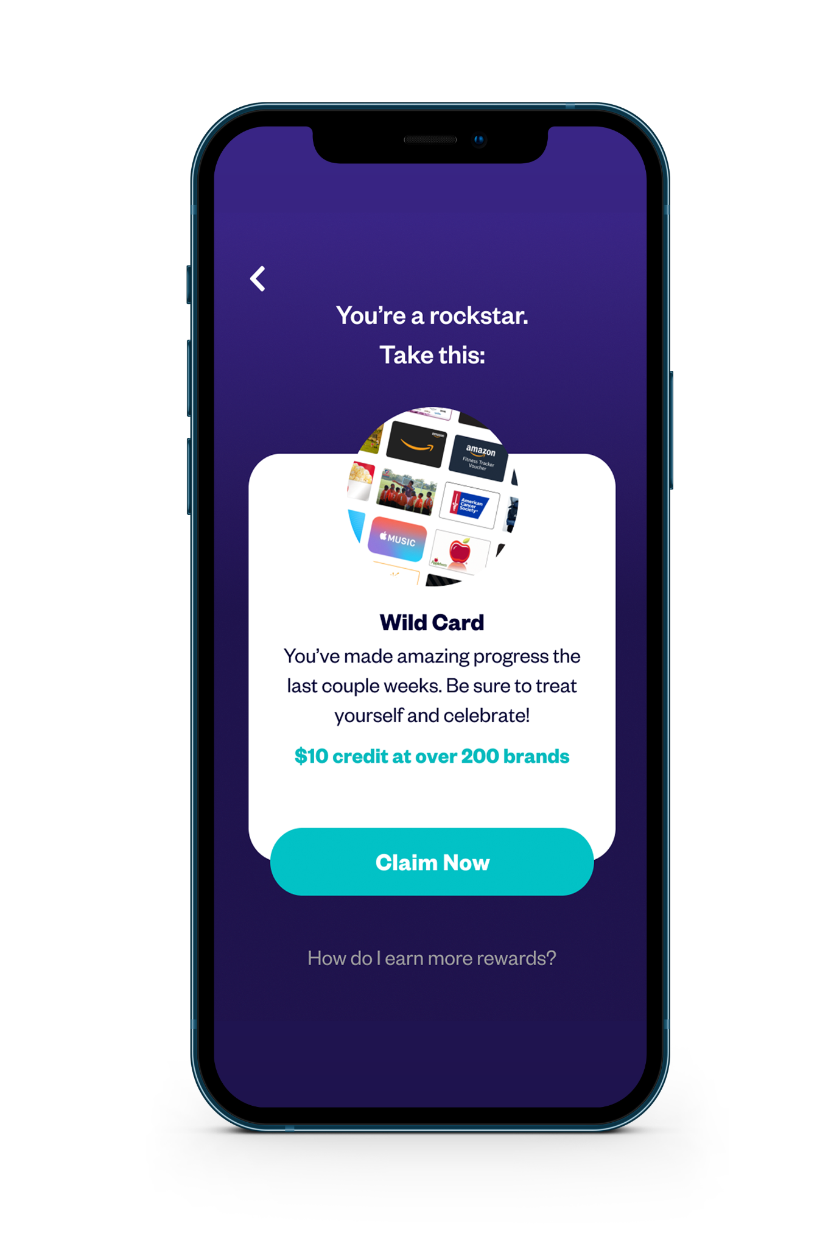
Now-That Reward Framework
Rewards
Reward
Each reward is a surprise. Not walk 10,000 steps = gift card
Reward
Each reward is a surprise. Not walk 10,000 steps = gift card
Reward
Based on doing what you want to do
Notes:
https://www.figma.com/file/Me4m0JsNCF3Qp4WwVScIMV/rewards-ui?node-id=0%3A1

Slide 8
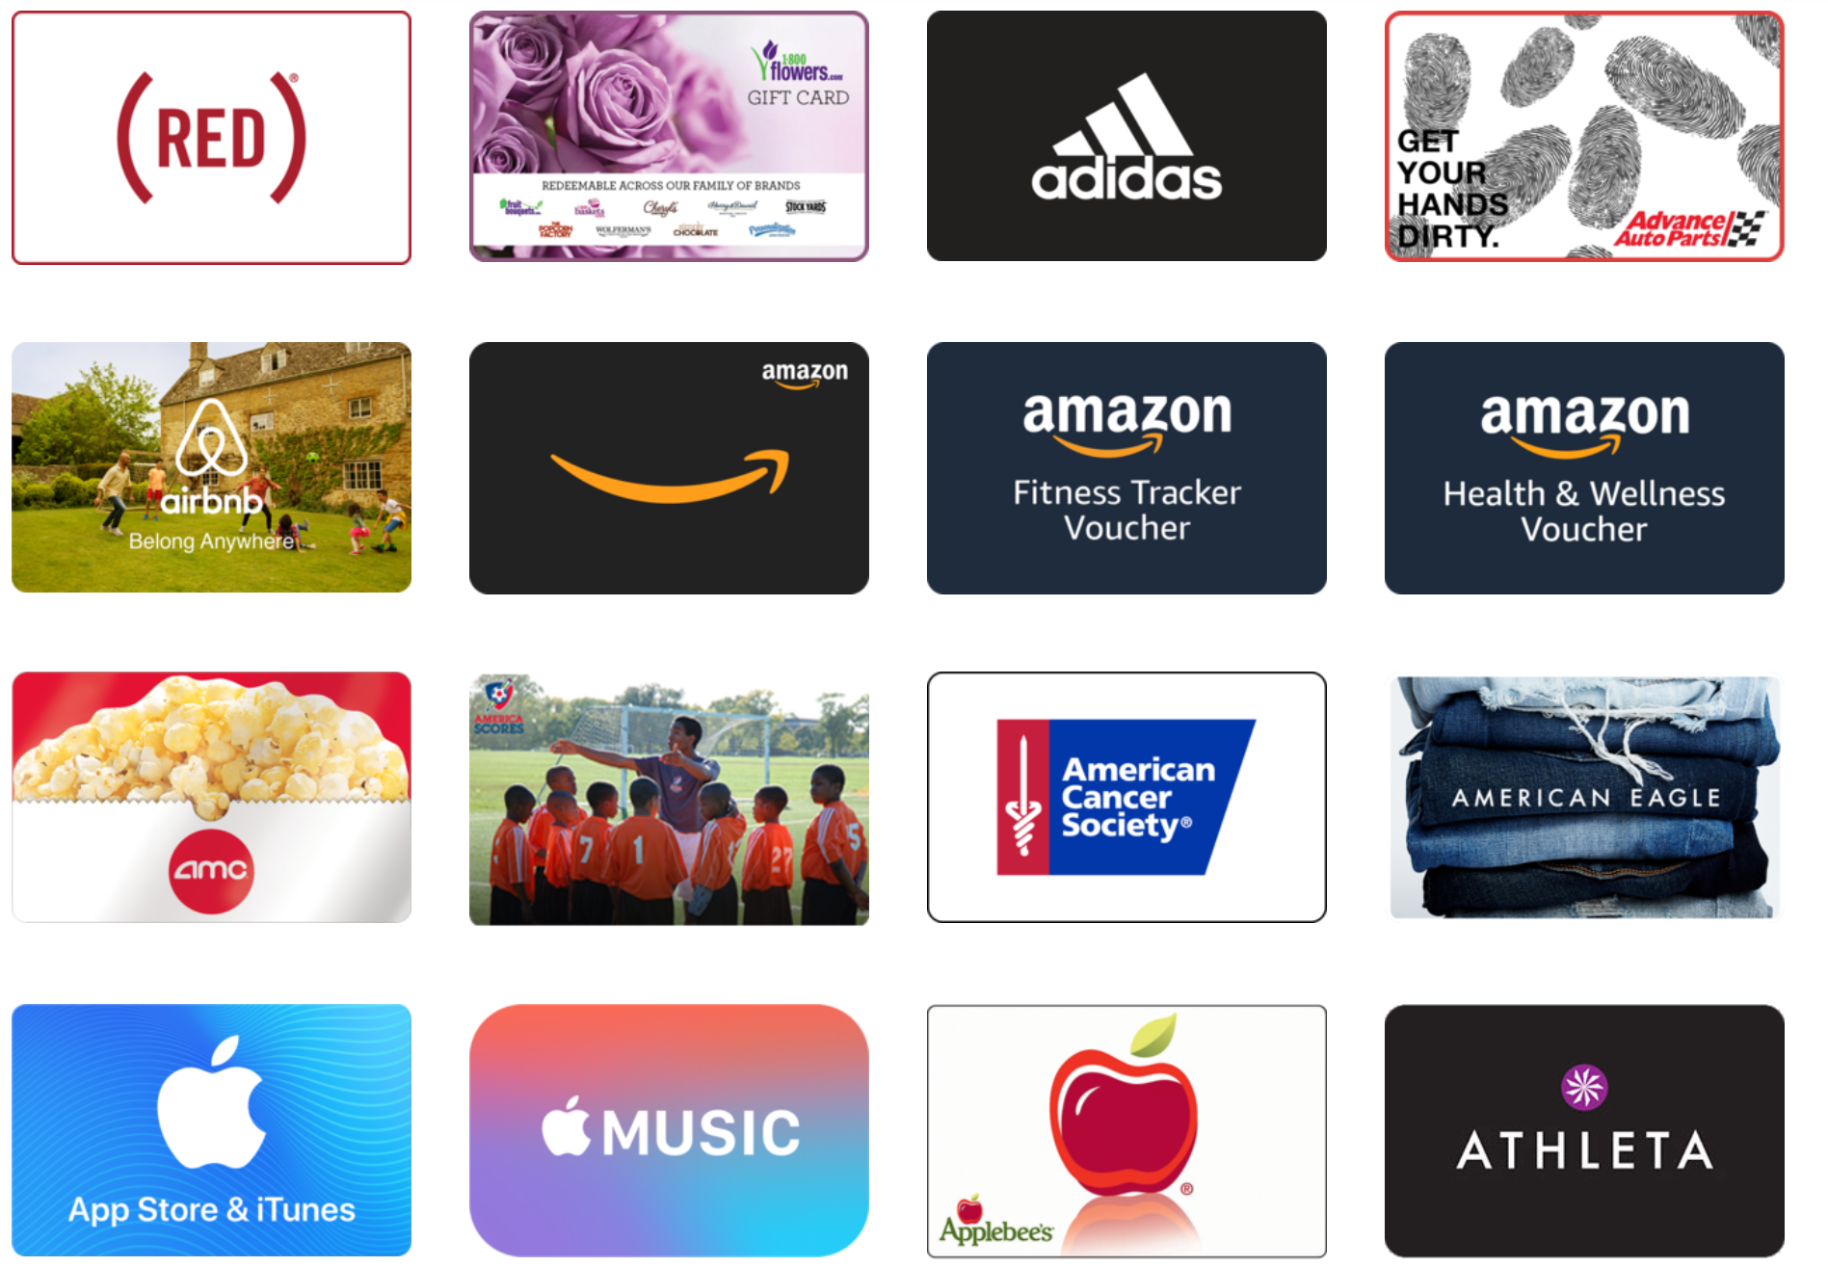
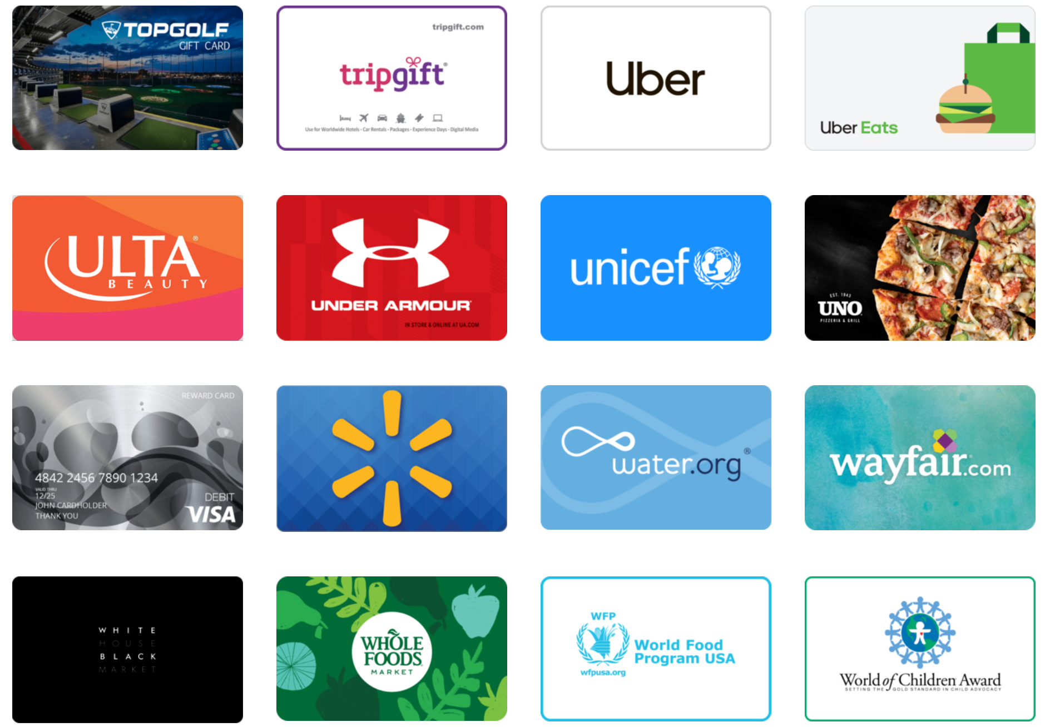
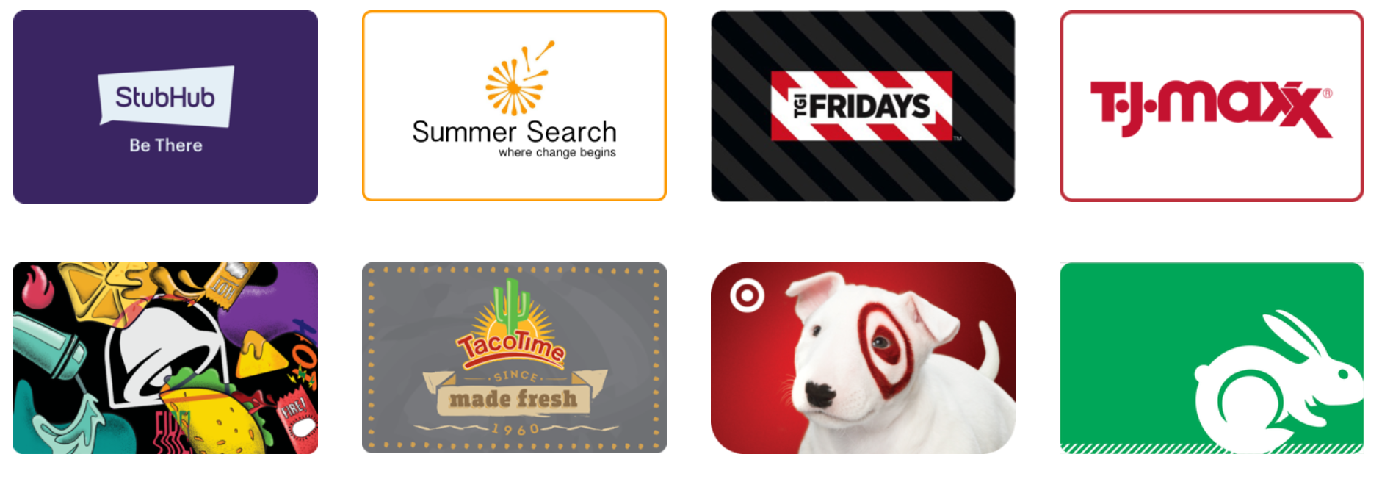
Rewards Catalog (80+ Options)

Slide 9
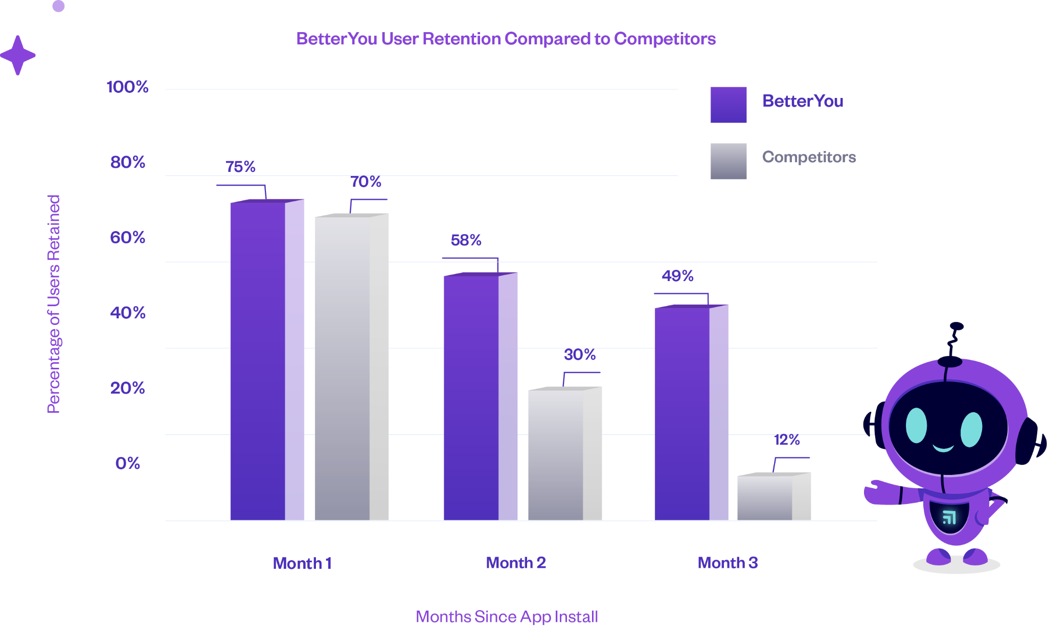
3x Industry Average Retention
Notes:
Replace with efficacy slide chart

Slide 10
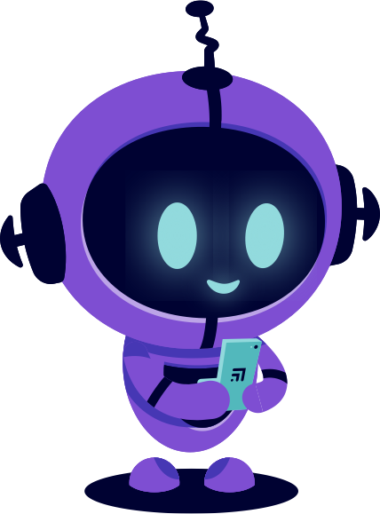
H&R Block Snapshot
500 employees signed up in the 1st week
“I love being connected to my fellow employees and doing challenges. Right now Tax Season is crazy so not much free time, but it doesn't take a lot of time for walking.”
“Encouraging, keeps me on track to reach goals.”
“[I like that] It is behind the scenes keeping track. I don't have to input any details once the set up is completed.”

Slide 11
Sampling of Customers

Slide 12
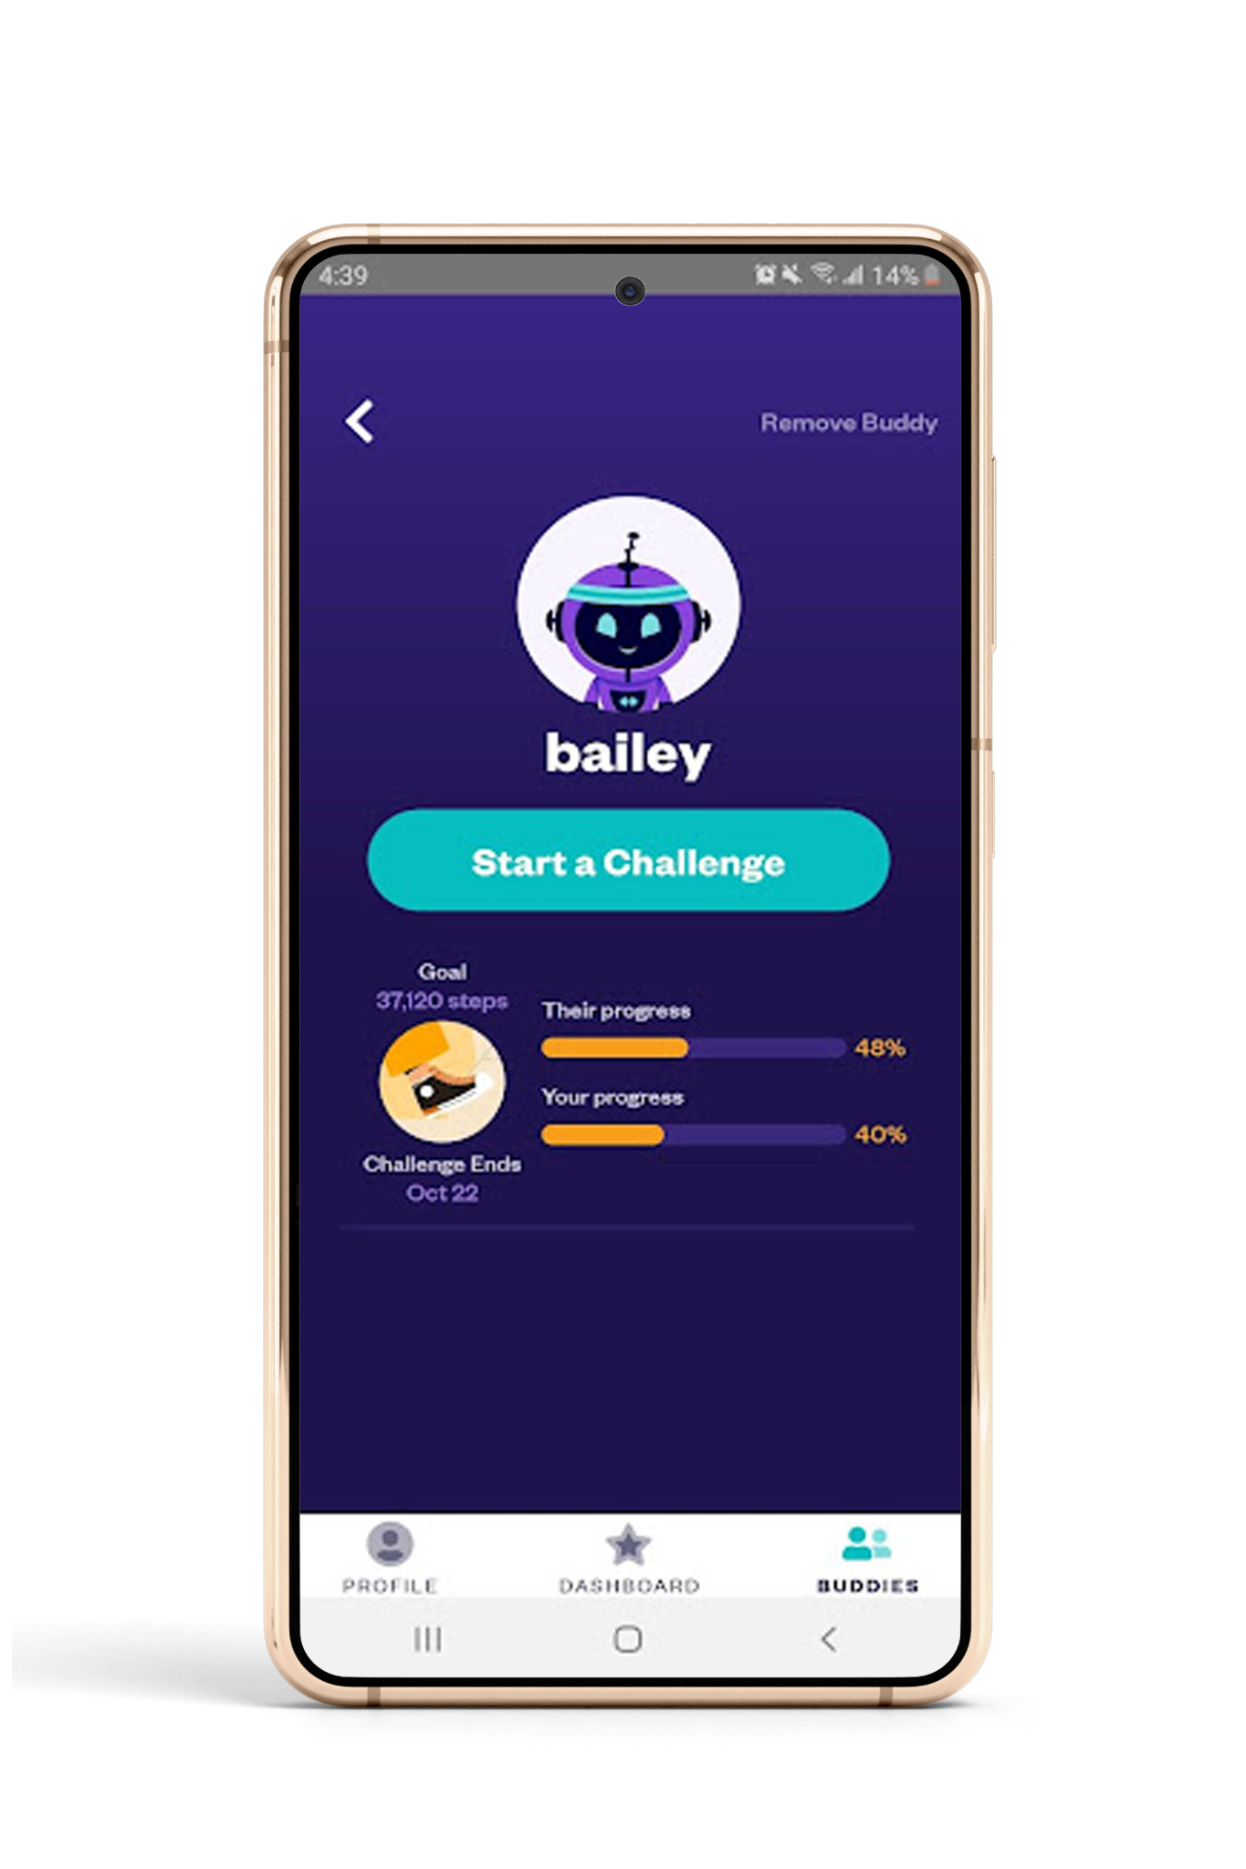
Challenges
Run challenges with individuals, groups, or company wide in the different wellness goals.
Looking to boost engagement for your steps challenge? What if it didn’t require wearables or manual entry? Wanting to try something new? How about a sleep or mindfulness challenge to give people a boost!

Slide 13
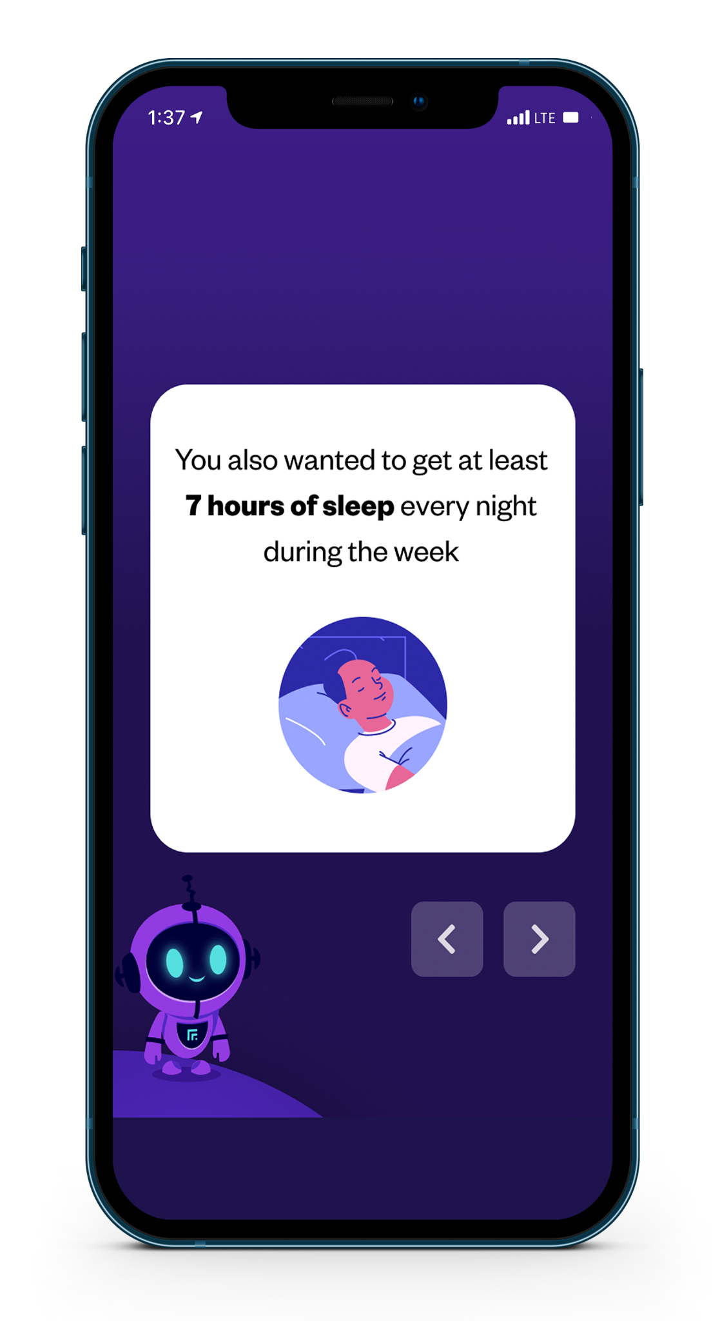
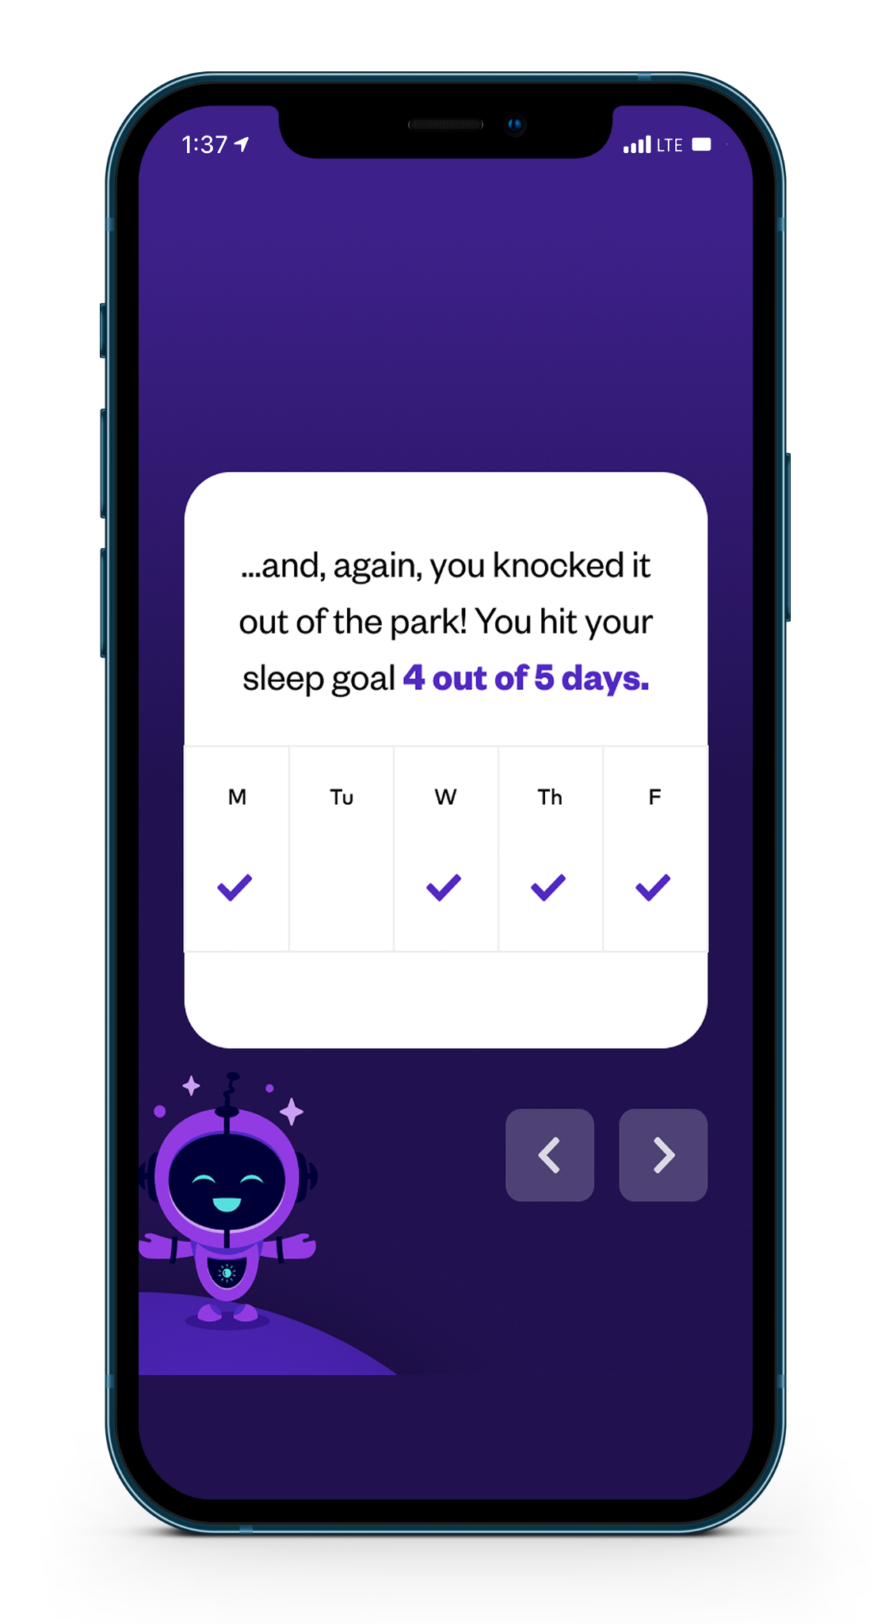
Highlights
See your past wins in different categories and showcase how far you’ve come.
Used as a baseline to help members set new goals or maintain existing milestones

Slide 14
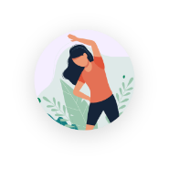
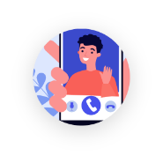
User Testimonials
Easy to integrate with fitness trackers. Good app to use and set goals for a better you. Education, social, fitness, and spiritual goals can be customized. Highly recommend it to take tiny steps to improving yourself.
Love it!
This app is like having a little motivating partner in your pocket! Definitely recommended to many friends.
Notes:
https://www.figma.com/proto/0mbMLAT6xUprj3xy2ooy9Y/onboarding-ui?node-id=1%3A776&viewport=847%2C-121%2C1&scaling=min-zoom&page-id=0%3A1

Slide 15
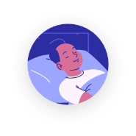
User Testimonials
This app is very helpful in starting new habits and creating new goals for yourself. It even rewards you for your hard work and I really appreciate that aspect! I have been getting more sleep, working out more, and staying on top of my health with this app.
Great app. Helps me stick to my goals and adjust as needed. I have been improving my habits and adding in new ones.
Notes:
https://www.figma.com/proto/0mbMLAT6xUprj3xy2ooy9Y/onboarding-ui?node-id=1%3A776&viewport=847%2C-121%2C1&scaling=min-zoom&page-id=0%3A1

Slide 16
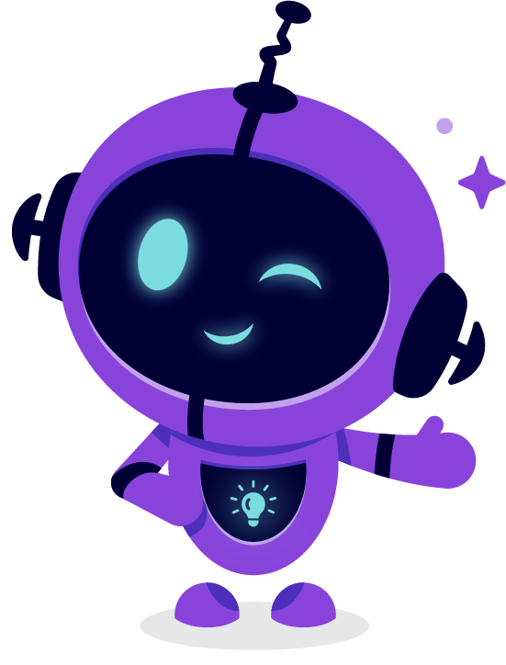
Location
St. Paul, MN
Follow Us
LinkedIn
Instagram
Contact
seanhiggins@betteryou.ai
Notes:
Last Slide

