Slide 1
2020 Plans for your Employees
2019 was the year where fabulous became alive through live challenges, connecting our users.
2020 is the year where everything we’ve created will cultivate into one unique Fabulous experience.

Slide 2
The Foundation of Fabulous
At first, you start by taking care of yourself, climbing the Three Mountains of increasingly advanced personal development, and equipping yourself with the Fabulous Creed to stay grounded every step of the way.
Then, once you have mastered your key areas of improvement, you can branch out and take your growth in any direction. This stage is the foundation.
*Once the foundation is built, changing employees
behavior becomes easy!*

Slide 3
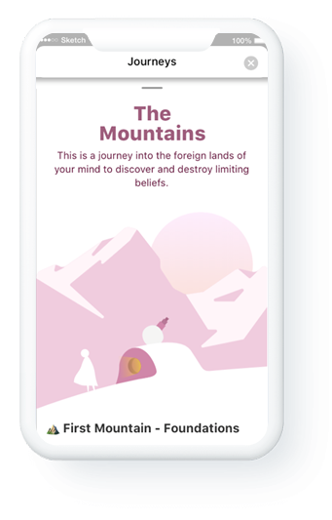
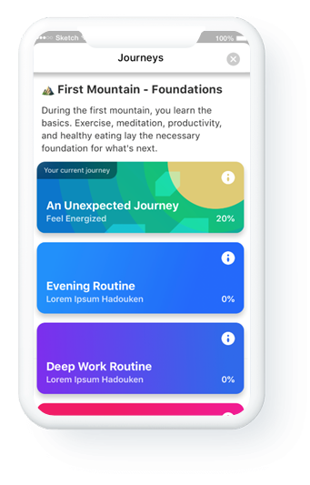
The Three Mountains
The 3 mountain journey is a metaphor for the core growth plan we provide every employee.
Learning basic morning and evening routines to bookend the day, full of keystone habits that naturally lead to additional improvements (ex: meditation, exercising, etc.)
Uncover and undo the mental patterns that hold them back.
Solidify a philosophy of living that prioritizes continuous growth.
We will recommend certain activities that build into the specific journey your employees are on. They will have some choice in each activity, but they all fit into the overarching goal.
How does this translate into the product?

Slide 4
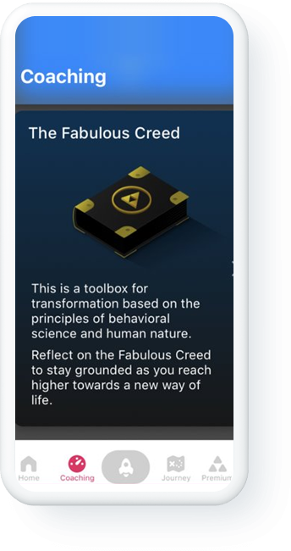
Fabulous Creed
The Fabulous Creed is a list of ‘laws’ based on behavioral science and supports every phase of development.
The creed will help ground your employees whenever they need general guidance.
How does this translate into the product?

Slide 5
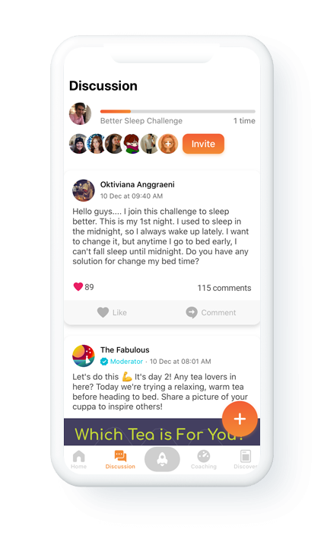
A Fabulous Community
The Fabulous culture is marked by a commitment to growth and contribution. Employees have the ability to build and join groups based on shared goals.
Our aim is to unite like-minded people who share the same ambition to thrive and make an impact.
New ways to connect your organization coming soon…
A journey focused on community
New ways to connect users (e.g., Live Challenges)

Slide 6
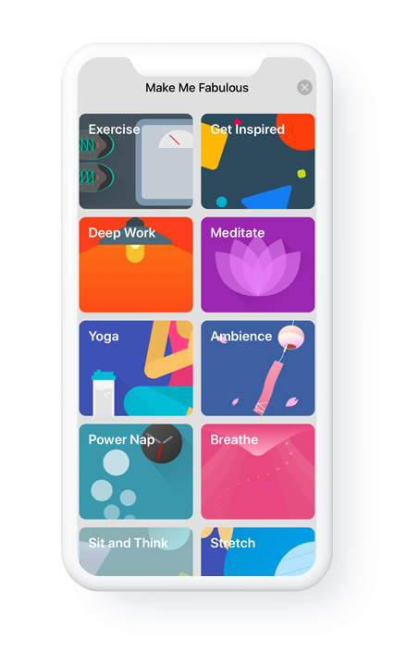
Building a habit of using Fabulous
For the Fabulous app to become a habit, it needs to be helpful and enjoyable.
Fabulous will enhance your employees
experience through several new features…
*Driving high employee engagement is top priority of ours

Slide 7
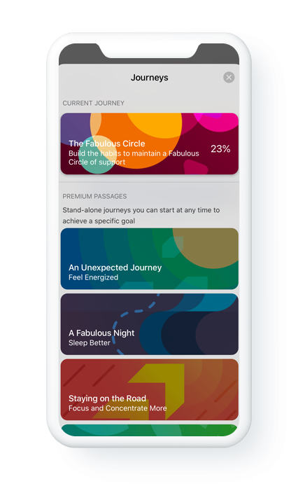
Journey Personalization
Users will choose where they go by building journeys
based on their individual goals.
Within those journeys, you can pick the route that best suites you.
*Giving your entire team a tailored plan increase engagement and the chance of changing

Slide 8
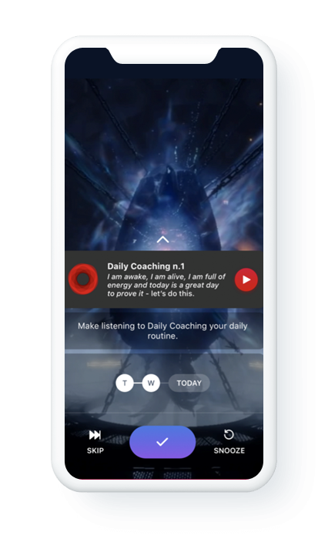
Daily Coaching
Employees will begin each morning with a 3-minute
motivational message! Each piece will nudge the
user towards a positive mindset that keeps them
centered and inspired to be better all day.
Daily coaching will both be a product feature &
a habit built-into your morning routine.
How does this translate into the product?

Slide 9
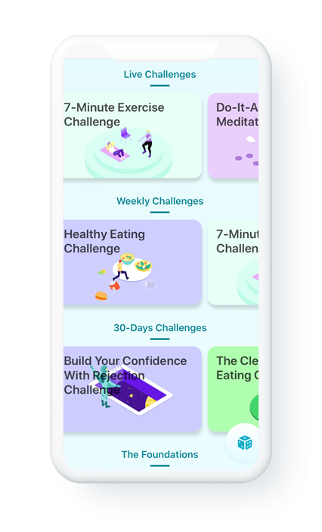
Live Challenges
A live challenge is an opportunity to work on a goal with the support of a group. Users will be able to share best practices and derive motivation from connections to others.
*This is a great way to connect your organization and build a culture around wellness.

Slide 10
The Path of the User
Start Fabulous Journey
Go through the 3 mountains journey and prioritize self-care by incorporating two pauses into each day.
Learn the Fabulous Creed and practice it at every level. Join Live Challenges and derive inspiration from other Fabulous users.
Continue practicing the 3 mountains journey to advance self-mastery.
Create your own community and start inspiring change!
This is not a journey that will take weeks, or months or a few years. This is a lifelong journey.

