Slide 1


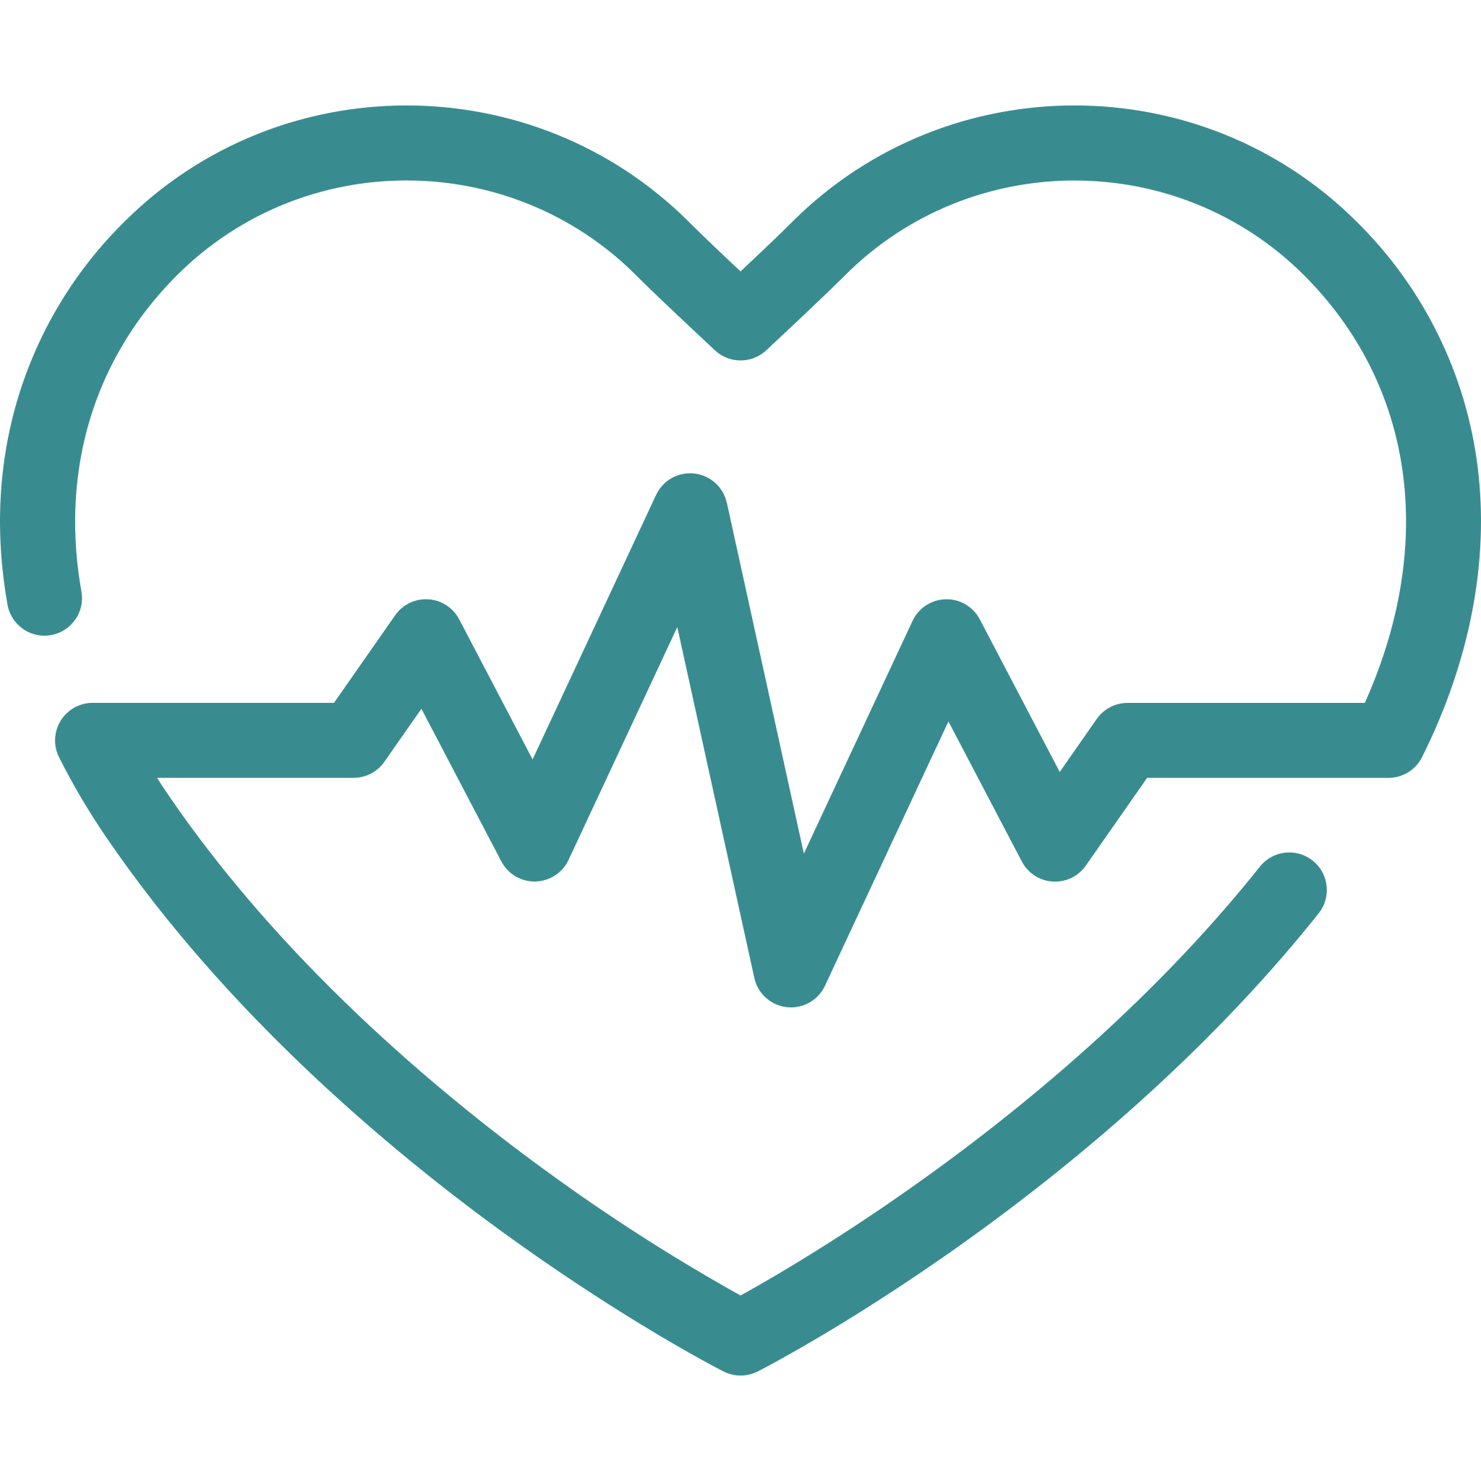

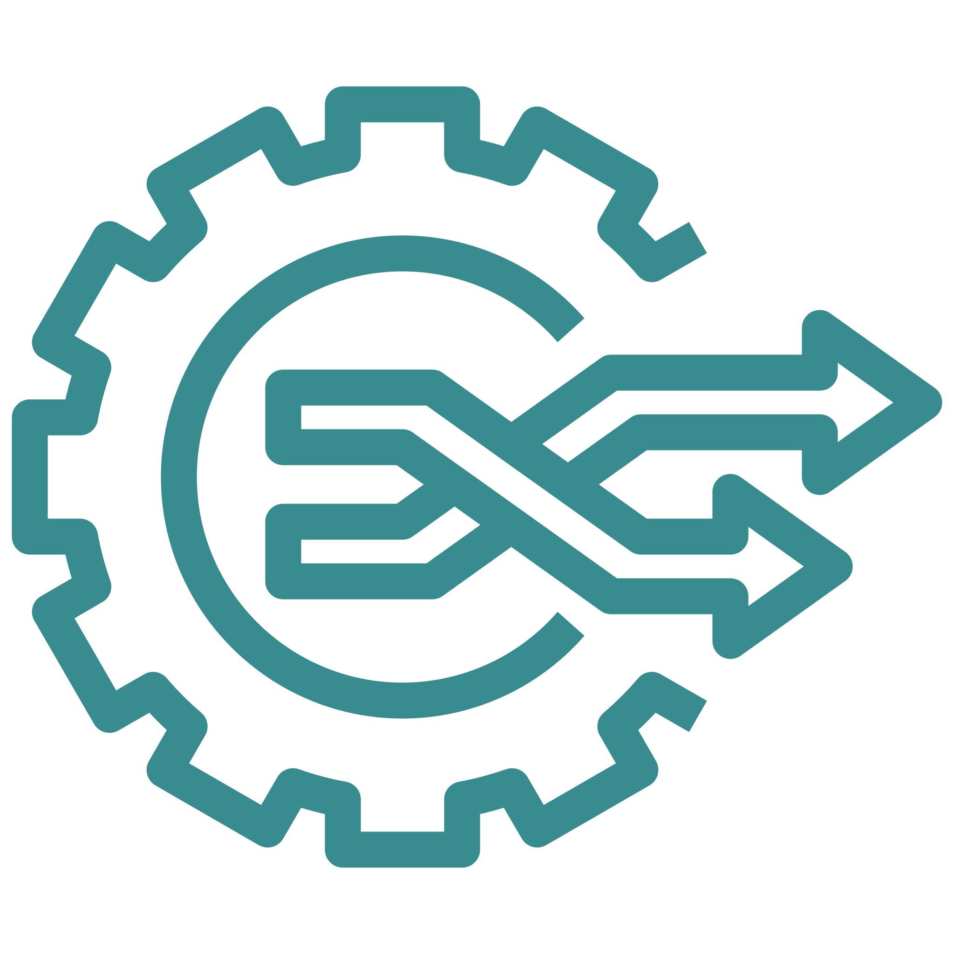
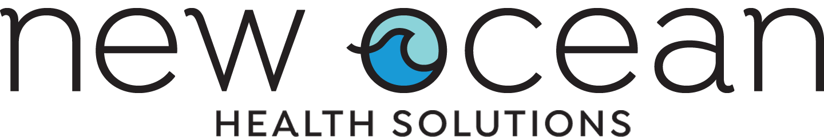
New Ocean Helps People Feel Better—and Work Better
It’s time to stop paying for health and wellness that doesn’t work.
Employees need a holistic picture of their health, actionable insights that motivate lasting change, and a positive user experience that connects them to the right information at the right time—to minimize searching and maximize doing.
IN HEALTH AND WELLNESS
Easily integrates with your current technology
Personalized user experience that encourages healthy lifestyle changes
Save money
with a high-value solution that reduces healthcare claims
CHALLENGE | NEW OCEAN’S APPROACH
A clunky user experience from disparate third -party apps that result in scavenger hunts | Intuitive user experience that provides the right information at the right time
Fragmented solutions give employees an incomplete picture of their health | An all-in-one, personalized platform that addresses holistic health with actionable insights
Poor design fails to address participation barriers and leaves users feeling stuck and disengaged | Readily available resources get users offline and on their way toward healthy goals
Engagement up to
80%
Improve your
bottom line with increased employee healthy activity and productivity
80%
Addresses
of chronic disease costs
Users who engaged in behaviors that reduce risk of chronic disease
56%
Address employees’ holistic health
with our all-in-one platform
44%
of users report improved life satisfaction
Whole health management that addresses chronic conditions, lifestyle, and emotional health needs
Backed by evidence-based medicine and behavioral science
Drive change
across your organization with scalable solutions
Preventative care activity increased by
31%
newoceanhealth.com

