Slide 1


CHANGING
TIDES
THE
NOVEMBER 2022

Slide 2

CONTENTS
WHAT WE’LL COVER TODAY…
Our Vision: Changing the Tides on Health and Wellness
Our Position: Health is Wholeness
Challenge: Scavenger Hunts Instead of Solutions
Challenge: Failure to Understand Holistic Health
Challenge: Prioritizing Engagement Over Effectiveness
Our Experience
Results
Our Solution: Platform, Program Suite, Content, and App

Slide 3

VISION
CHANGING THE TIDES ON HEALTH AND WELLNESS
We bring together all the elements that make up “health” into one science-based, high-value, easy-to-use solution, improving the health of your people so they can focus on the health of your business.
From managing chronic conditions to tracking mental health and sleep, New Ocean delivers total health management solutions with digital coaching for every individual, in every stage of wellness, at every organization—for a fraction of your cost.

Slide 4

POSITION
HEALTH IS WHOLENESS
New Ocean’s in-house, seamless solution functions with wholeness in mind, to help companies improve the health and productivity of their employees, by providing:
An all-in-one platform that addresses holistic health
A sensible balance of tangible features and tools that delivers high impact—and high value
An approach that incorporates best practices for behavioral change and health management
An intentional design that centers on the needs and experience of the end user
The word "health" comes from the Old English word “hælþ,” which means “wholeness”.
Today, many companies are relying on health and wellness management "solutions" that feature isolated products and fragmented services. We're here to change that.

Slide 5

CHALLENGE
WELLNESS PROGRAMS SHOULD OFFER SOLUTIONS, NOT SCAVENGER HUNTS
There is a design problem in the health and wellness technology space
Systems fail to simplify complexities, piling up features to meet requirements
No consideration for the end user
Employees are lost with overly complex choices and setup—destroying the value of the program

Slide 6

NEW OCEAN'S APPROACH
SIMPLICITY – THE RIGHT INFORMATION AT THE RIGHT TIME
Our platform works to solve client needs with positive user experiences
Digitally embedded coaching programs based on tried-and-true research and testing
Employees are motivated, not mandated, to engage with content

Slide 7

CHALLENGE
FAILURE TO FULLY UNDERSTAND
EMPLOYEES’ HEALTH FROM A HOLISTIC PERSPECTIVE
Employers use a fragmented approach that addresses pieces and parts rather than the whole picture
As a result, employees are left to sift through partial solutions
Chronic conditions, weight and nutrition, mental health are all addressed separately, not cohesively
Result: a significant loss in the utility of health management solutions for employees, and reductions in productivity and the bottom-line for employers

Slide 8

NEW OCEAN'S APPROACH
ONE MEANINGFUL DESTINATION WITH SOMETHING FOR EVERYONE – AND EVERY EMPLOYER
Our platform is designed to deliver actionable insights and results
Our solutions empower employees at all stages of health and life
Simplified health assessments, health tools and trackers, premium reporting provide a more complete picture of their holistic health
This helps create more productive, happier, healthier workforces, resulting in a positive impact on a company’s bottom line

Slide 9

CHALLENGE
MISPLACED PRIORITIES OF ENGAGEMENT OVER EFFECTIVENESS
  Poorly designed programs leave users feeling stuck, spending too much time searching
  Employees need increased health literacy to stop their scrolling and engage in meaningful change
  Employees want to know if the solution is credible before they buy in

Slide 10

NEW OCEAN'S APPROACH
LESS TIME LOOKING, MORE TIME DOING
  Excellent user experience, backed by research and behavior science, is our core philosophy
  We provide resources that educate your employees on how to work on what matters to them, getting them offline and on their way toward their goals
  Features like challenges, rewards, and virtual communities keep them motivated
  We focus on features that employees love—like digitally embedded coaching—all under one cohesive, turnkey solution

Slide 11



CASE STUDY
EXPERIENCED
WE’RE AT THE INTERSECTION OF TECHNOLOGY AND QUALITY CARE. WE’VE BEEN HERE BEFORE.
Take Care Health Systems + Walgreens: pioneered the industry of health clinics inside pharmacies
This collaboration created a better option for trusted, timely care
Solved the healthcare design problem by prioritizing personalization and convenience
At the front lines of unknown, unmet patient needs

Slide 12
YEAR OVER YEAR, NEW OCEAN HELPS IMPROVE THE HEALTH OF ITS USERS—AND ITS CLIENTS
44%
Preventive care activity increased by
of users reporting an improvement in life satisfaction
31%
RESULTS
56%
of users have both engaged with our content and adopted behaviors that have reduced their risk of developing chronic health conditions.

Slide 13
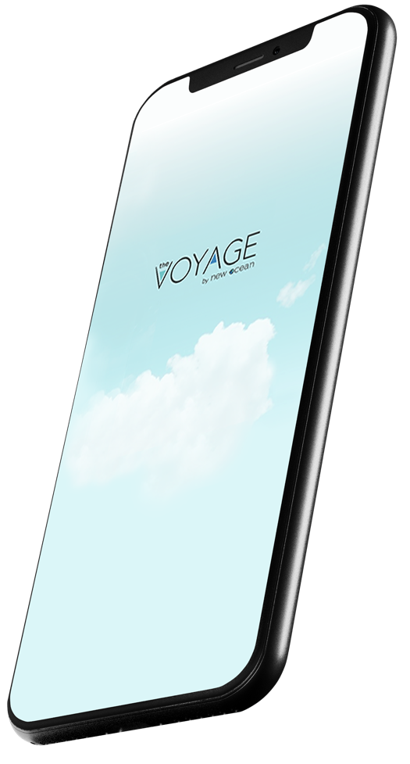
OUR SOLUTION
Choose How You Implement
Use your existing mobile presence or web platforms
SENSIBLY DESIGNED FOR EASY INTEGRATION AND FAST IMPLEMENTATION
With our all-in-one app, The Voyage, you can have your employees engaging in minutes
Our platform is designed to work for you, with you, to achieve your health goals, from wherever you’re starting to wherever you’re going.
Implement our APIs to maintain control of all aspects of your technology
Maintain Complete Control with The Bridge
The Bridge is what we call our flexible, open API (Application Programming Interface) platform, which combines enhanced mobile technology, behavioral economics, and third-party integration.
Roll out the entire suite of functionality or pick and choose based on the specific needs of your organization

Slide 14
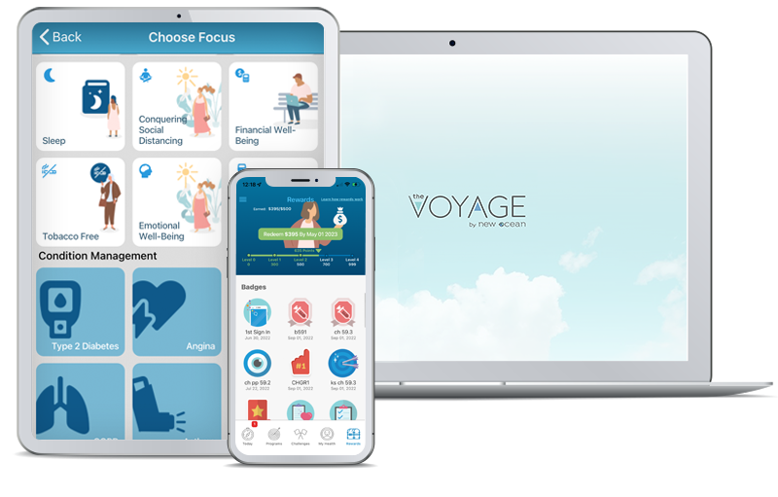
A FULL SUITE OF SUPPORT
HERE FOR YOU AT ALL STAGES OF ONE INTEGRATED HEALTH JOURNEY
Healthy lifestyle management program suite
Hundreds of programs designed by our clinical experts to address
Nutrition
Physical Activity
Stress Management
Sleep
Financial Well-being
Memory
Cognitive Fitness
Mental Health
Emotional Well-being
Tobacco Cessation
Responsible Drinking
COVID-19
Chronic Condition Management
Comprehensive chronic disease self-management programs are integrated into our health management suite because they’re essential for the health of your people and your business; more than 50% of US adults are living with at least one chronic condition

Slide 15

CHRONIC CONDITION MANAGEMENT
ATTACK THE COSTLIEST AND MOST CHALLENGING AREA OF HEALTH AND WELLNESS
First health and wellness solution with an integrated product designed specifically for chronic conditions
Addresses 80% of chronic disease costs
Programs are designed by our in-house team of clinical experts to address specific chronic conditions, including:
Type 2 Diabetes
Asthma
COPD
Hypertension
High Cholesterol
Post-Heart Attack Support
Angina
Depression
Anxiety

Slide 16

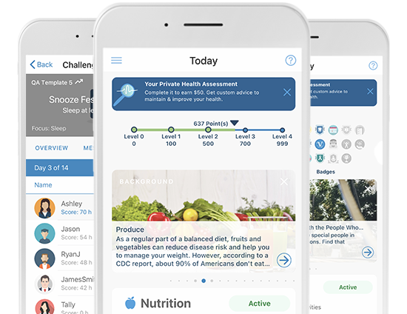
PERSONALIZED
ENCOURAGING HEALTHY, PERSONALIZED OUTCOMES THAT CREATE LASTING CHANGE
We inspire users to make healthy lifestyle changes through:
Health content library resource center – Thousands of pieces of proprietary, curated content includes articles, actionable insights, videos, recipes, and quizzes
Health tools and trackers – Seven- and 30-day charts for monitoring weight, blood sugar, blood pressure, and other health metrics
Apps & device connection – Seamless integration with third-party apps, devices, and wearables
Social Communities, blog, support team feature, and message boards
Rewards engine with fulfillment platform
Premium live support

Slide 17

SEAMLESS
AN ALL-IN-ONE APP
With hundreds of proprietary health and well-being tools, New Ocean’s user-facing app, The Voyage, drives lasting behavior change. It takes your employees on a seamless journey, marked by an intuitive user experience that minimizes time spent searching.
The app also integrates third-party health apps, fitness watches and trackers, and other Bluetooth-enabled health products.
Simple Health Assessments - Our reimagined private health assessments break down barriers to completion with fun, engaging, user-centric designs.

Slide 18

UPGRADE
IT’S TIME TO STOP PAYING FOR HEALTH AND WELLNESS THAT DOESN’T WORK
  As healthcare costs continue to soar and financial pressures increase, it may seem like it’s only a matter of time before what’s best for your company becomes somehow at odds with what’s best for your employees. We firmly believe these two goals are not mutually exclusive.
  Our program is built around the premise that healthy employees and healthy bottom lines go hand in hand. So, get on board, and change the tides on health and wellness at your organization with New Ocean Health Solutions.

Slide 19
THANK YOU

