Slide 1
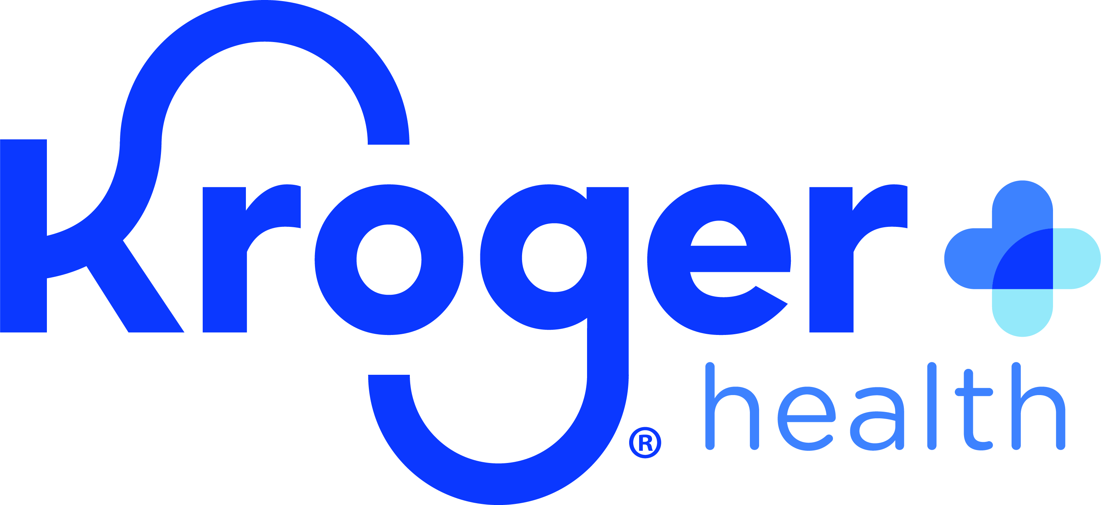
Kroger Health’s Medical Nutrition Therapy Service
At Kroger, we believe FOOD AS MEDICINE
means a dedicated, educated, and personalized approach to eating and enjoying food so we can live healthier lives and prevent illness before it starts
Factors Considered in MNT
1
Medical Nutrition Therapy is Clinically Effective
MNT is an evidence-based, clinically effective therapy that incorporates nutrition assessment and interventions, typically resulting in the prevention, delay, or management of diseases or conditions.
MNT CPT codes: 97803 (Initial appointment), 97802 (Follow-up appointment), and 97804 (Group MNT)
Medical conditions
Medications
Stage of behavior change
Dietary preferences
Social determinants of health
2
MNT is Delivered Face-to-Face and Through Telenutrition, a Personalized, Friendly 1:1 Video Counseling Call
Telenutrition is a 1:1 video chat appointment with an expert Kroger Health Registered Dietitian from the comfort of one’s home.
Our dietitians personalize support for chronic conditions via Medical Nutrition Therapy (MNT).
Our dietitians also help customers navigate a tight food budget, learn to select and prepare new or unique foods, learn to shop online and improve their at-home cooking skills, and more.
Medical conditions MNT helps with:
Diabetes
Heart disease
Pre-Diabetes
Cancer
Kidney disease
Malnutrition
And many more
MNT may decrease HbA1C by 1-2% for patients newly diagnosed with diabetes¹
MNT may reduce total and LDL cholesterol by 6-13%, and triglycerides by 11-20%, in patients with dyslipidemia²
1. Pastors et al., 2002 2. Sikand et al., 2018
© Kroger Health 2021

Slide 2
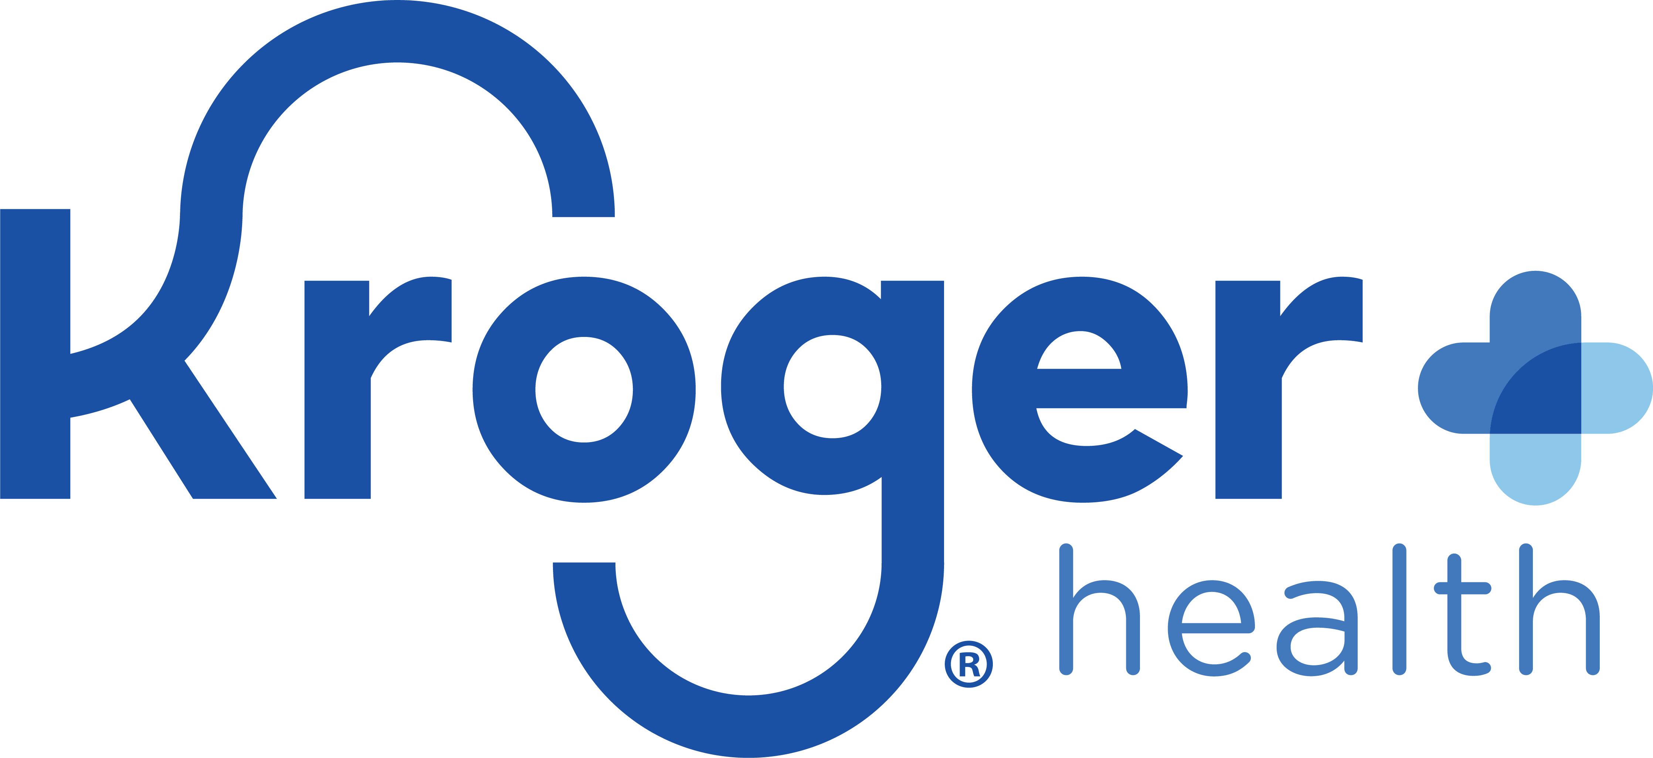
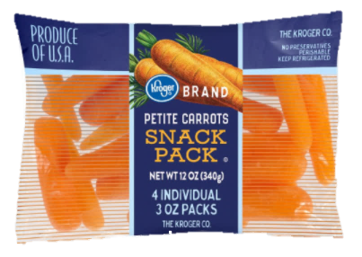
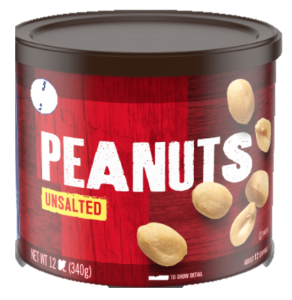
3
Why Kroger Health Retail Dietitians for MNT?
Kroger retail dietitians are uniquely situated to help patients make the healthful choice the easy choice through food product knowledge and a personalized, understanding, and pragmatic approach with patients.
A Personalized, Understanding Approach
Numerous social, environmental, and societal factors make meeting nutrition needs complex. Our dietitians can triage various factors to provide practical nutrition care that accounts for the complexities of everyday life, even multiple health conditions.
Our dietitians help patients alleviate guilt and shame around food so they can eat in a way that works long-term for their health, budget, lifestyle, and taste preferences.
Kroger dietitians can help patients find the joy in eating to create sustainable and impactful health changes for their future.
Access to Kroger Ecosystem of Tools and Services
As America’s largest traditional grocery retailer, Kroger has an ecosystem of tools and services that our dietitians can tap into to support patients.
Patients can seamlessly schedule appointments through our online scheduler, where they get to choose from a list of dietitians one that matches their needs.
Our dietitians can teach patients of all ages how to conveniently shop online for tasty, healthful items within their busy schedules. Patients can learn how to utilize grocery pick-up and delivery services.
These tools and services save patients time, making it easier for patients to make better-for-you choices.
Pragmatic, Concrete Guidance
Kroger Health Dietitians provide the tangible education and food product knowledge consumers need to bridge the gap between instruction and action when the medical community shares ambiguous advice such as “work on improving your diet.”
General health guidance:
“Eat less sodium to help with your hypertension.”
Kroger dietitian guidance:
You mentioned how hard it is to find quick afternoon snacks low in salt to have before your shift ends at 5.
I know you’re also on a budget. A quick, affordable, low-sodium snack option within your budget is a pack of baby carrots.
Pair the carrots with unsalted nuts and you’ll get a fiber-filled, protein-dense, low salt snack that will keep you full until you clock out, all while helping you address your high blood pressure.”
© Kroger Health 2021

Slide 3
Evidence for MNT Effectiveness on Various Conditions
Diabetes
Cancer
MNT may decrease HbA1C by 1-2% for patients newly diagnosed with diabetes.¹
MNT can improve weight maintenance and energy intake in patients with gastrointestinal cancers. Dietitian intervention may decrease length of stay after major surgery.⁵
Heart Disease
Kidney Disease
MNT may reduce total and LDL cholesterol by 6-13% and triglycerides by 11-20% in patients with dyslipidemia. Increased time spent with an RDN may result in greater improvements.² A small study found that MNT reduced medication use for a cost savings of $638 per patient per year among patients with dyslipidemia.³
In a retrospective cohort study, people with CKD who received MNT were 3x less likely to start dialysis and had improved nutritional biomarkers compared to participants who did not receive MNT over a 10-year period.⁶
Malnutrition
Pre-Diabetes
In a 12-week randomized controlled trial, older adult patients at nutritional risk receiving MNT gained more weight (+.5 kg vs. -.9 kg; P = .025), consumed more energy (P = 0.168), and protein (+19 g protein/day vs. 3 g protein/day (P = .003), and were less likely to be hospitalized compared to controls.⁷
In a 12-week randomized controlled trial, patients with pre-diabetes receiving MNT significantly lowered their HbA1c (from mean of 5.95% to 5.71%) and significantly decreased their Diabetes Risk Score (-2.22 points).⁴
Our Dietitian Patient Testimonials
“I was overwhelmed by my recent cancer diagnosis and am so thankful that your services were available to me during this difficult time.”
“I’m down like 18lbs… my resting heart rate is down from 103 to 86, my pants are looser, I have more energy, and my brain fog is gone. My yearly blood work is coming up , and I'm excited about it.“
“The Kroger Health team has been amazing… I weighed in at 292.6 [pounds] and then last week I weighed in at 183.4. It’s been an amazing journey.”
Learn more about Joe’s story
“I’ve worked with many dietitians before, but I usually stop going because I feel judged and like I can’t do anything right. I know that when I meet with you it’s a safe space without judgement and I’m motivated to learn with you.”
“I love that your approach is to add foods in, rather than take foods out. It’s liberating.”
1. Pastors et al. (2002) 2. Sikand et al., (2018) 3. Sikand et al., (2000) 4. Parker et al. (2015) 5. Kenny, Touger-Decker, and August (2020) 6. de Waal, Heaslip, and Callas (2016) 7. Beck et al. (2015)
© Kroger Health 2021

Slide 4
Citations
Beck, A., Andersen, U. T., Leedo, E., Jensen, L. L., Martins, K., Quvang, M., ... & Rønholt, F. (2015). Does adding a dietician to the liaison team after discharge of geriatric patients improve nutritional outcome: a randomised controlled trial. Clinical rehabilitation, 29(11), 1117-1128. https://journals.sagepub.com/doi/abs/10.1177/0269215514564700
de Waal, D., Heaslip, E., & Callas, P. (2016). Medical nutrition therapy for chronic kidney disease improves biomarkers and slows time to dialysis. Journal of Renal Nutrition, 26(1), 1-9. https://pubmed.ncbi.nlm.nih.gov/26391566/
Kenny, E., Touger‐Decker, R., & August, D. A. (2021). Structured Review of the Value Added by the Registered Dietitian to the Care of Gastrointestinal Cancer Patients. Nutrition in Clinical Practice, 36(3), 606-628. https://aspenjournals.onlinelibrary.wiley.com/doi/abs/10.1002/ncp.10568
Parker, A. R., Byham-Gray, L., Denmark, R., & Winkle, P. J. (2014). The effect of medical nutrition therapy by a registered dietitian nutritionist in patients with prediabetes participating in a randomized controlled clinical research trial. Journal of the Academy of Nutrition and Dietetics, 114(11), 1739-1748. https://www.sciencedirect.com/science/article/abs/pii/S2212267214011459
Pastors, J. G., Warshaw, H., Daly, A., Franz, M., & Kulkarni, K. (2002). The evidence for the effectiveness of medical nutrition therapy in diabetes management. Diabetes care, 25(3), 608-613. https://care.diabetesjournals.org/content/25/3/608?utm_source=TrendMD&utm_medium=cpc&utm_campaign=Diabetes_Care_TrendMD_0
Sikand, G., Cole, R. E., Handu, D., deWaal, D., Christaldi, J., Johnson, E. Q., ... & Ekvall, S. M. (2018). Clinical and cost benefits of medical nutrition therapy by registered dietitian nutritionists for management of dyslipidemia: a systematic review and meta-analysis. Journal of clinical lipidology, 12(5), 1113-1122. https://www.sciencedirect.com/science/article/abs/pii/S1933287418302745
Sikand, G., Kashyap, M. L., D WONG, N. A. T. H. A. N., & Hsu, J. C. (2000). Dietitian intervention improves lipid values and saves medication costs in men with combined hyperlipidemia and a history of niacin noncompliance. Journal of the American Dietetic Association, 100(2), 218-224. https://www.sciencedirect.com/science/article/abs/pii/S0002822300000663
© Kroger Health 2021

